Slide 1
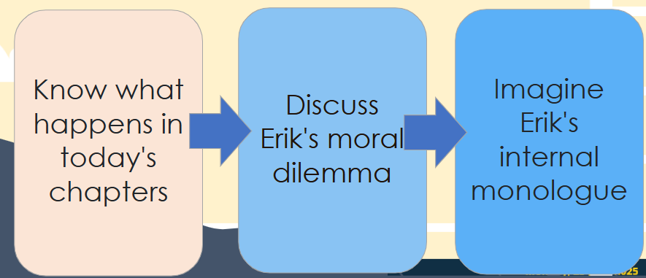
Do Now
Draw a six square bingo grid.
Choose six from any of the words on the right to fill in the box with.
I will then describe, without saying aloud, each of the things until somebody shouts bingo.
We want a full house!
Ravi
county lines
Erik
Peer pressure
dilapidated
verse Novel
extended metaphor
the twins
Gangs
Viking Line
exploitation
K1
bullying
alleycats
Ben & Travis
trap House
parentification
Lockdown
the Flo
DQ: Can I explain Erik's moral dilemma?

Slide 2
DQ: Can I explain Erik's moral dilemma?
Know what happens in today's chapters
Discuss Erik's moral dilemma
Imagine Erik's internal monologue

Slide 3


Make your predictions
This is the last poem from the next section of the novel. What could be happening here?
So, if you’re thinking
I’m about to make
another stupid, selfish, choice,
you’re wrong.
This wasn’t selfish.
& it wasn’t a choice,
not really.
DQ: Can I explain Erik's moral dilemma?

Slide 4
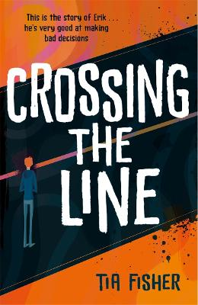
Let’s read:
Choices pages 180-196
As we read, consider:
In which poem do you think K1 reveals more about his true nature?
  p.184 K1 reaches for the or p.186 You can see
  Explain why you think this.
How is a sense of danger/threat created in this section?
P.191-2 By this time: How does Erik feel about his decision to say no? How do you know this?
P.196 So, if you’re thinking: Do you agree with what Erik says here? Why? Does this change your opinion of Erik?
DQ: Can I explain Erik's moral dilemma?

Slide 5
Let’s read:
Preparation pages198-214
As we read, consider:
What is Erik scared of in this section?
DQ: Can I explain Erik's moral dilemma?

Slide 6
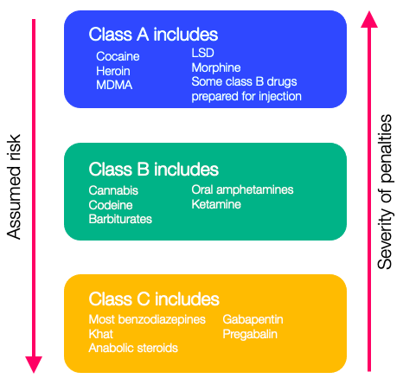
Discuss
Turn & Talk
1. Why does Erik agree to sell class A drugs at the seaside? Erik agrees to sell drugs at the seaside because…
2. Why did Erik need to get banned from the school trip?
3. Why is the seaside mission a dangerous one? What is at stake for Erik?
DQ: Can I explain Erik's moral dilemma?

Slide 7
Model response
Erik agrees to sell drugs because he is compassionate towards his mum's financial situation, and he told his dad he'd take care of his mum. He can’t see how he could say no to K1.
Erik needed to get banned from the school trip because he'd agreed to sell drugs at the seaside. The school won’t know he’s is missing but neither will Mum.
The seaside mission is dangerous because he'd be selling Class A drugs which comes with a punishment of 7 years in prison, and he will run a risk of attack by other gangs while he is carrying drugs or money.
DQ: Can I explain Erik's moral dilemma?

Slide 8
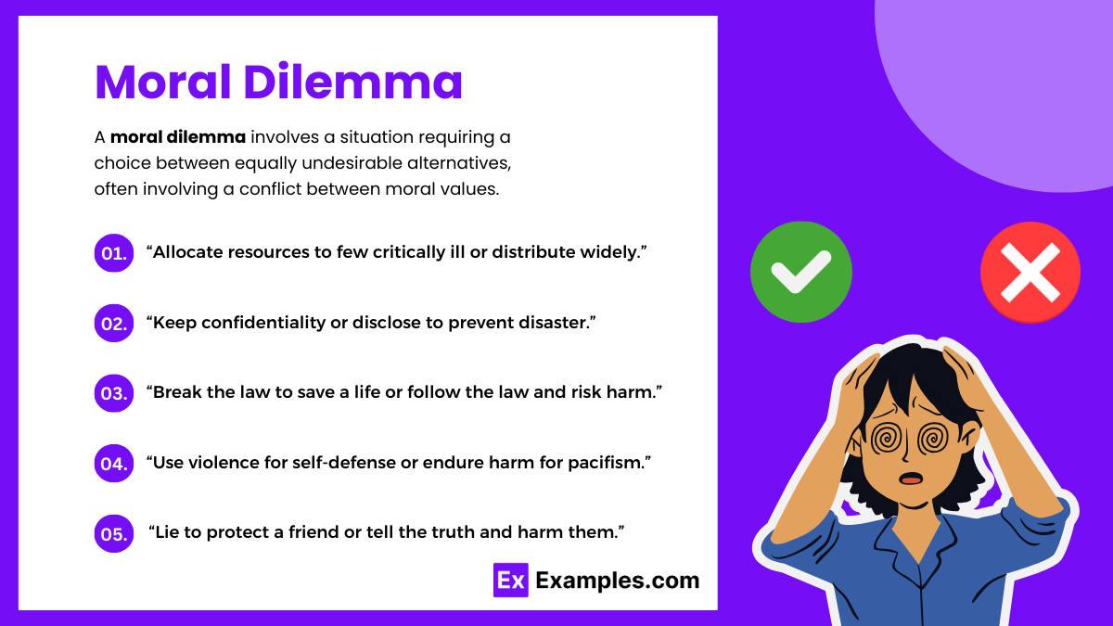
Erik's Moral Dilemma
DQ: Can I explain Erik's moral dilemma?

Slide 9
Erik's Moral Dilemma
Erik has just been suspended from school and thrown off the school trip because he has reluctantly accepted K1's request to sell Class A drugs at the seaside.
Reasons to agree to K1's mission | Reasons to reject K1's mission
DQ: Can I explain Erik's moral dilemma?

Slide 10
Erik’s Moral Dilemma
Imagine you are Erik at this point in the novel, write an internal monologue about your thoughts and feelings.
Start with: Ever since I said yes to K1, thoughts have been racing round my head like a...
I can’t stop thinking about...
Part of me feels like...
Deep down, I know that...
I wish I had...
What if I had just said no?
Everything feels messed up because...
Stretch it: can you use the extended metaphor of dominos?
Key vocabulary: conflicted, compassion, dilemma
Reasons to agree to the mission | Reasons to reject the mission
Compassion towards his mum and her financial situation | It is illegal
Scared of K1 if he said no | Letting his Dad down
DQ: Can I explain Erik's moral dilemma?

Slide 11
Model response pt 1
Ever since I said yes to K1, thoughts have been racing round my head like a row of dominoes tipping one after the other—once that first one fell, everything else came crashing down. I can’t stop thinking about what I’ve got myself into. One bad decision has knocked everything sideways, and now I can’t seem to stop the chain reaction.
I can’t stop thinking about Mum—how tired she looks every night after work, how she tries to hide the bills from me, how she pretends everything’s fine when I know we’re barely scraping by. I thought maybe, just maybe, agreeing to the mission would help. That I could finally give her something back. Some relief. But that compassion is now tangled in a dilemma I can’t escape.
Part of me feels like I’ve betrayed everything Dad stood for. He believed in doing the right thing, even when it was hard. And here I am—breaking the law, working with K1 of all people, and keeping it all a secret. What would he say if he saw me now?
Deep down, I know that fear played a bigger part than I want to admit. I was scared. Scared of saying no. Scared of what K1 might do to me, or worse, to Mum. That fear shoved the first domino, and I didn’t stop to think about how fast everything would fall after that.
DQ: Can I explain Erik's moral dilemma?

Slide 12
Model response pt 2
I wish I had asked for help. I wish I had talked to someone—anyone—before making that choice. But I didn’t. I let the pressure build and made the snap decision to go along with it. Now I’m trapped in something I don’t understand, with no way out that doesn’t come with a cost.
What if I had just said no? Maybe I’d be scared, sure. Maybe K1 would have come after me or tried to hurt me somehow. But maybe I’d still feel like me. Not this version of me who lies to his mum, who jumps every time the phone buzzes, who can’t sleep at night without thinking it’ll all come crashing down.
Everything feels messed up because I said yes for all the wrong reasons—and even the right reasons don’t feel right anymore. I’m conflicted. Torn wanting to help Mum and disgust for what I’m doing.
Each day I get deeper into this mission, another domino falls. I keep hoping I’ll find the one that will stop the rest from toppling—but I haven’t yet. And I don’t know how much longer I can hold the line. When the tower topples, it's gonna be carnage.
DQ: Can I explain Erik's moral dilemma?

Slide 13
Exit Ticket
Has Erik made the right choice in this chapter?
What could he have done instead?
What do we learn about Erik’s character based on today’s reading?
DQ: Can I explain Erik's moral dilemma?

Slide 14
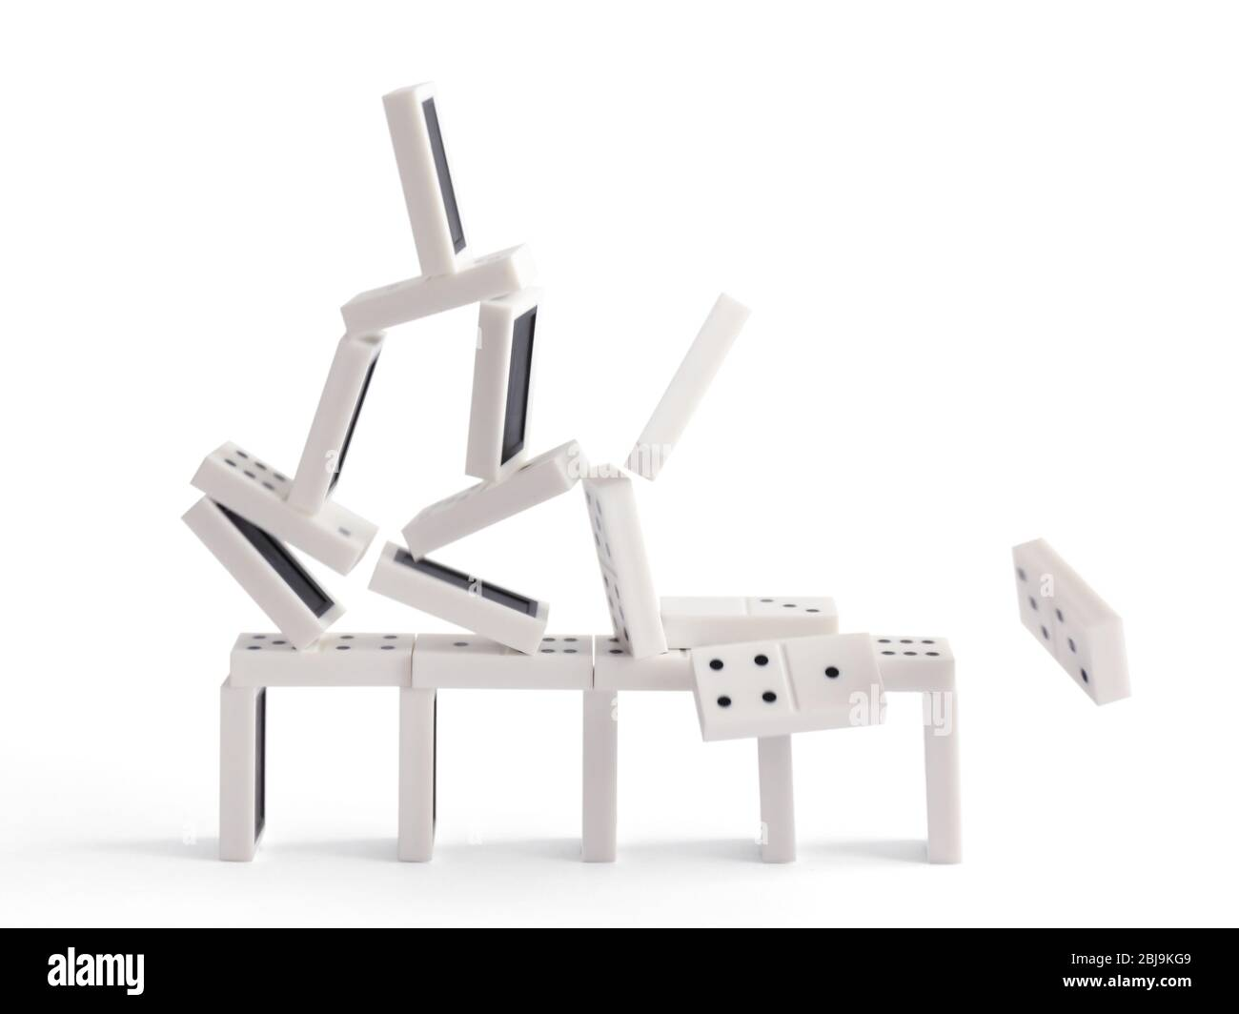
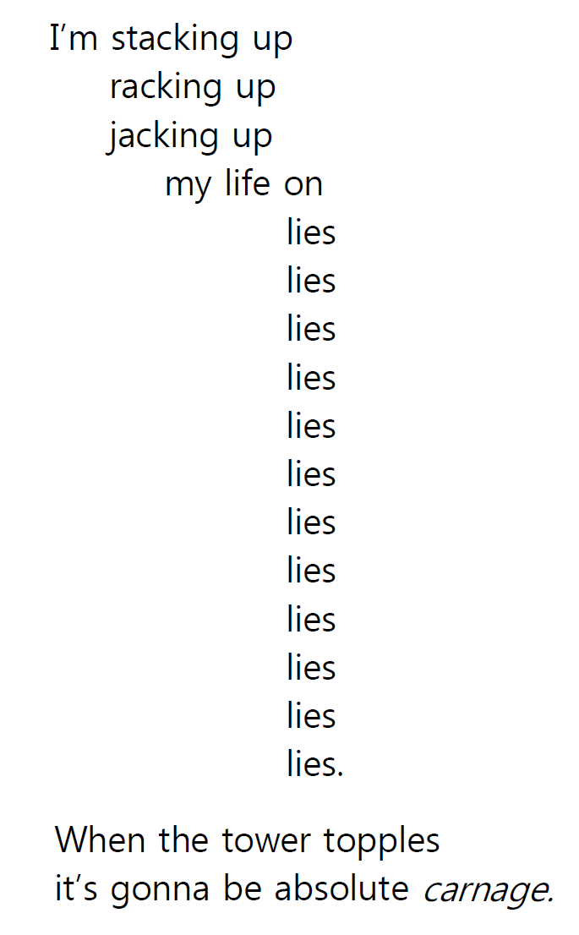

How does Fisher show the potential impact of County Lines on Erik?
‘When the tower topples/ it’s gonna be absolute carnage’
EXPLODING THE QUOTATION
Big idea: Where does your quote fit into the rest of the extract/big picture?
Methods: What specific devices can you identify in this quotation?
Words: Zoom in on specific words within the quotation. What is the significance in the use of this word? Why is the writer doing this?

Slide 15
Example phrases
Fisher continues to use the extended metaphor of dominos to highlight the negative implications of county lines exploitation.
Erik says, ‘when the tower topples / it’s gonna be absolute carnage’. The verb ‘topples’ implies… Fisher has already used the verb ‘topples’ on p.9 to describe . . .
Furthermore, the imagery ‘carnage’ connotes…
Fisher uses this metaphor to foreshadow…​

