Slide 1
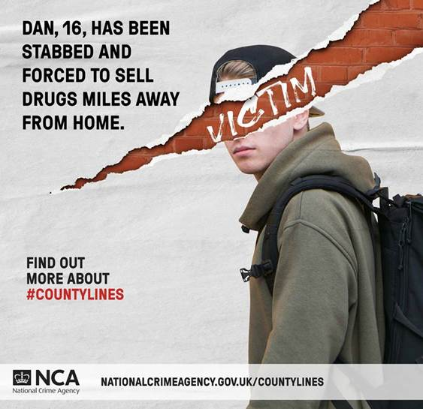

Recap: How do these posters link to Erik's situation?
Turn & Talk

Slide 2
DQ: Can I craft a helpful and informative blog post?
Gather information - check and note your sources
Make a plan of your blog post
Draft and redraft it. Finally, check for SPaG.

Slide 3
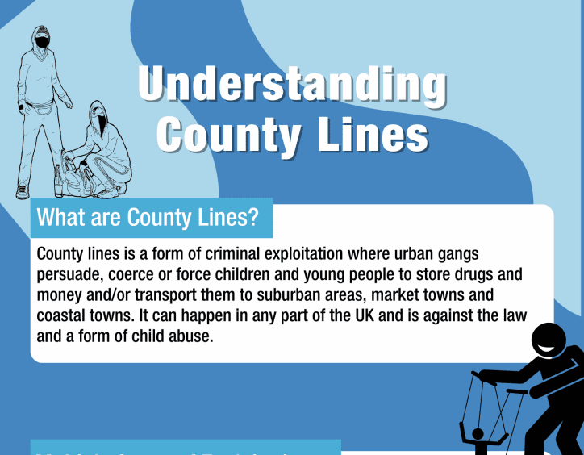
Use the Getting Help section on p351 to read information on county lines online. Why do you think these are good sources of information?

Slide 4
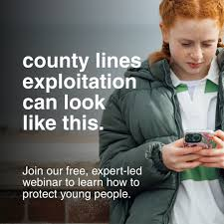
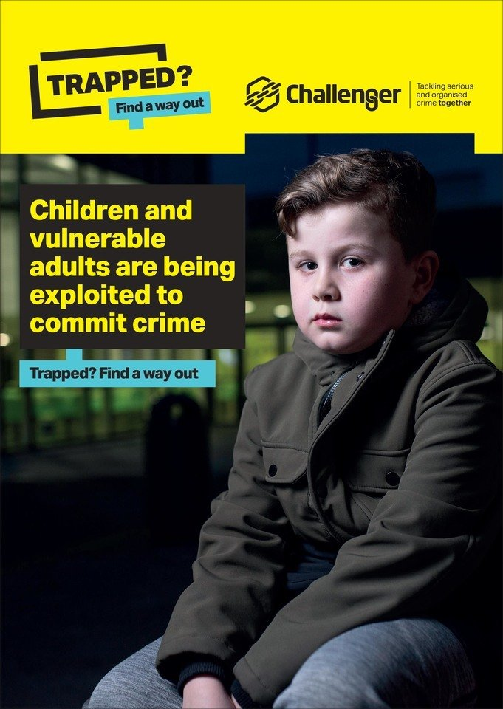
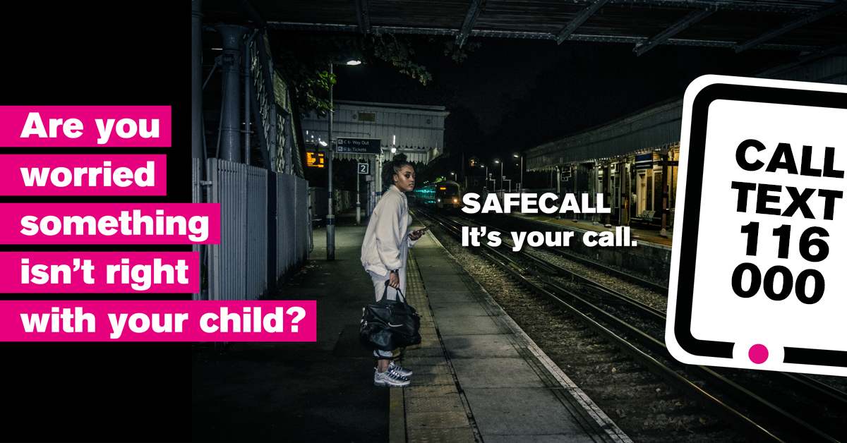
Do Now – Label the persuasive techniques in these posters and explain their effect.
Stretch it: Say which are ethos, logos and pathos

Slide 5
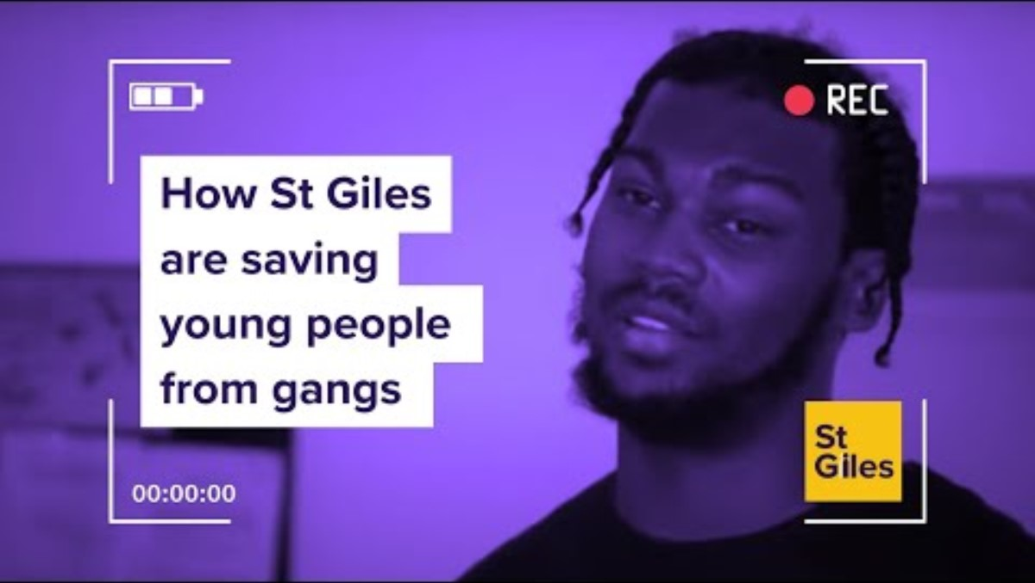
Watch it
Notes:
BBC How St Giles are saving young people from gangs
https://youtu.be/2V0QNNORgrI?si=SI48DS8ZylP4uNM-
(will play in slide show mode)

Slide 6
Write an article
Ravi prints information that he believes will help Erik's mum understand county lines child criminal exploitation. The subject matter is so alarming, it makes her face 'turn as pale as paper'.
Task: Write an informative article about county lines for the school newsletter.
‘Ravi’s printed out some information that he said would help my mum understand but what she reads on county lines turns her face pale as paper.’ p322

Slide 7
Your article should:
Use clear and formal language suitable for a school newsletter.
Explain what county lines is, including how it works.
Describe who is most at risk and how young people are targeted.
Include warning signs that someone may be involved.
Suggest how to get help and where to go for support.
End with a powerful final message to raise awareness and keep others safe.

Slide 8
Model response
Spotting the Danger: What You Need to Know About County Lines
By Year 9 Student Reporter
July 2025
County Lines is a serious issue affecting young people across the country — including in our own communities. It’s a form of criminal exploitation where gangs use children and vulnerable people to move drugs from cities into towns and rural areas. The name comes from the phone lines used to take drug orders, which often stretch across county borders.
How Does It Work?
Criminal gangs recruit young people — often teenagers — to transport drugs or money. They may offer gifts, money, or even protection to gain their trust. But once someone is involved, it’s very hard to get out. The gangs use threats, violence, and manipulation to keep control.
Who Is Most at Risk?
Anyone can be targeted, but children who are struggling at school, feeling isolated, or spending a lot of time unsupervised are especially vulnerable. Social media and gaming apps are sometimes used to contact young people secretly.

Slide 9
Model response pt 2
If someone you know:
Suddenly has new clothes, money or phones they can't explain
Goes missing or is away from school a lot
Changes their behaviour, becoming anxious or secretive
Has unexplained injuries
these could be signs they’re being exploited.
Ravi, a Year 9 student, says:
"I didn’t realise how easily someone my age could get caught up in something so dangerous. We all need to be aware and look out for each other."
How to Get Help
If you're worried about yourself or someone else, speak to a trusted adult — like a teacher, parent, or school counsellor. You can also contact organisations like Childline or Fearless.org, which allow you to report concerns anonymously.
Stay Aware. Stay Safe.
County Lines is real, and it’s dangerous — but by staying informed and speaking up, we can help protect ourselves and each other. Don’t keep quiet. Help break the line.

Slide 10
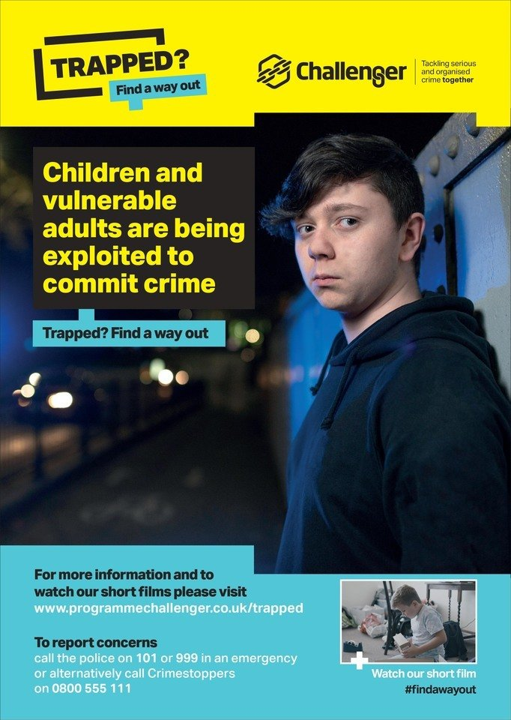
Draw a poster
This poster should:
Define what county lines exploitation is, how it operates, and the risks it poses to young people
Be eye-catching, easy to read, emotive.
Provide signposting – if people are concerned, what can they do?

Slide 11
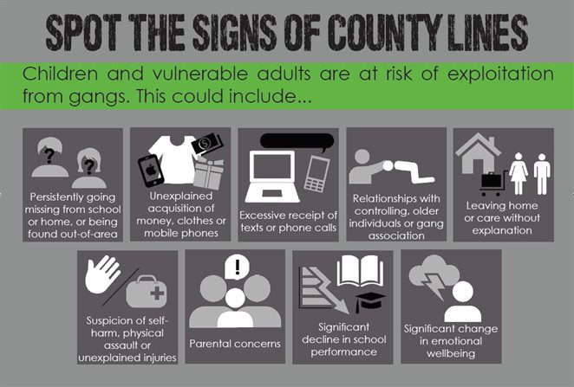
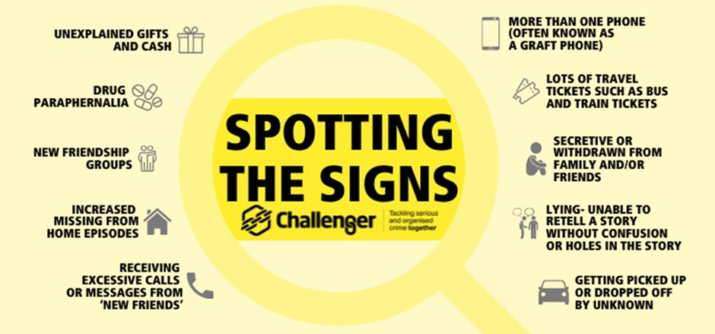
Design a leaflet with warning Signs for parents
Outline some of the common signs parents can look for to spot their child's potential involvement in county lines activities.

Slide 12
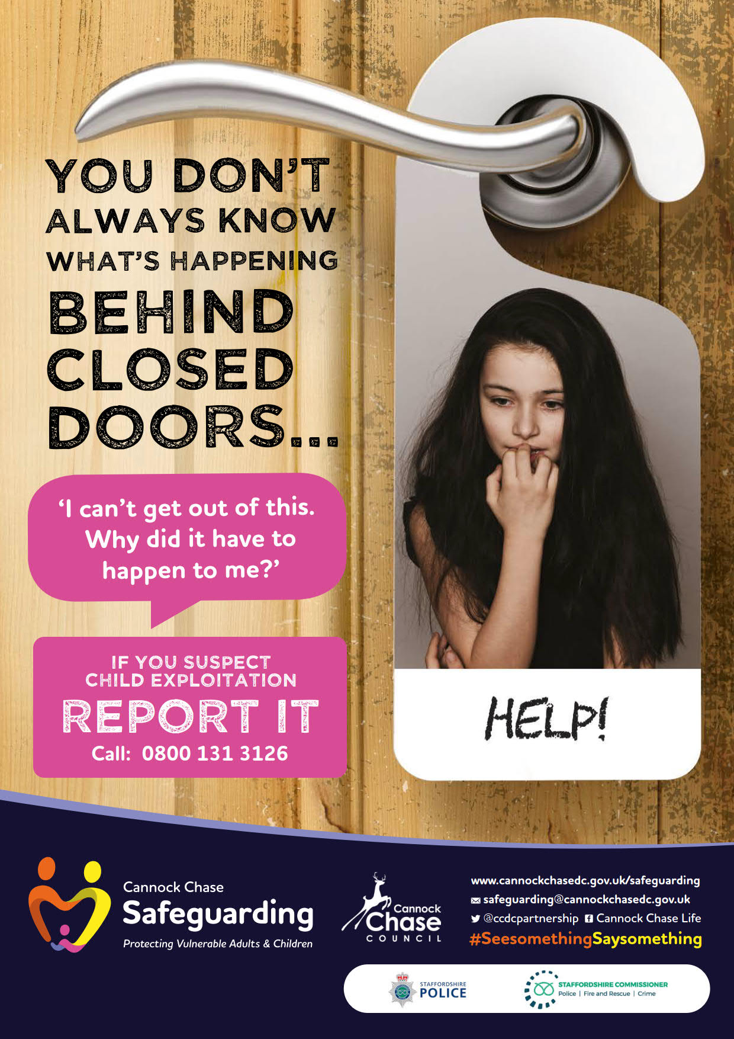
Task cont’d
Offer practical advice on how parents can protect their children from getting involved and what steps they can take if they are concerned.
Make sure to strike a balance between raising awareness and offering reassurance.
‘Ravi’s printed out some information that he said would help my mum understand but what she reads on county lines turns her face pale as paper.’ p322

Slide 13
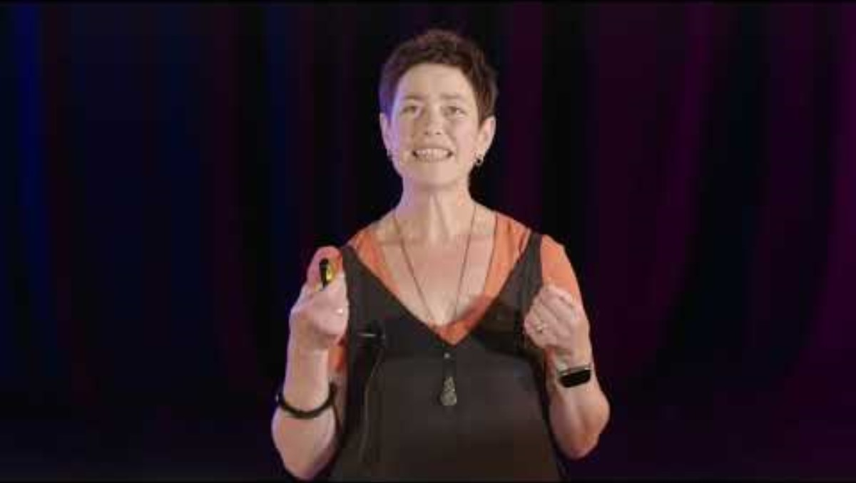
Notes:
Teachers – you could show pupils Tia Fisher’s TEDX talk at https://www.youtube.com/watch?v=EgJgJZujUcU which is aimed at the community. It’s 15 minutes, so perhaps just start at the relevant part where she talks about warning signs? Below is the slide she refers to,

Slide 14
Notes:
Teachers – you could show pupils Tia Fisher’s TEDX talk at https://www.youtube.com/watch?v=EgJgJZujUcU which is aimed at the community. It’s 15 minutes, so perhaps just start at the relevant part where she talks about warning signs? Below is the slide she refers to,

Slide 15
Changes
phones
friends
new stuff
drugs or weapons
injuries
missing
Notes:
Phones – Are they getting lots of unexplained phone calls and texts or using more than one phone?
Friends – Changed friendship groups?
New stuff – More money, or flashy trainers
Injuries – Maybe they’ve been beaten up – or harming themselves as a response to stress. With girls, can you see signs of sexual exploitation, like sexual language or STIs
Missing – Have they gone missing – coming back exhausted and dirty
Drugs or weapons – If you find weapons or scales or they’re picked up by the police with a lot of drugs on them – they’re probably involved with county lines. If you’re worried, search their rooms. A tip – count your knives and make sure you know if one is missing.

Slide 16
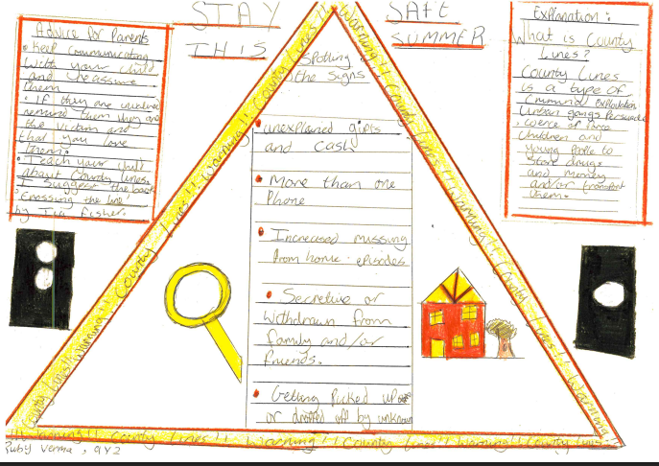

Slide 17
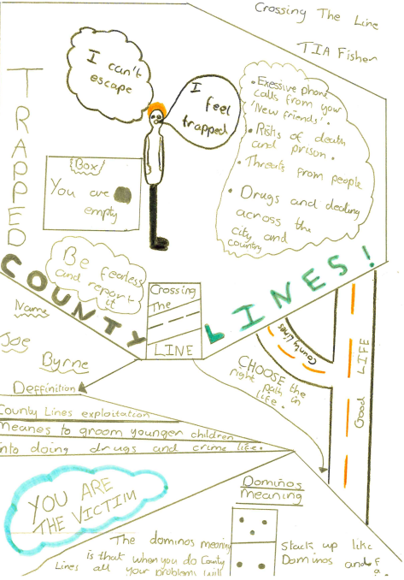
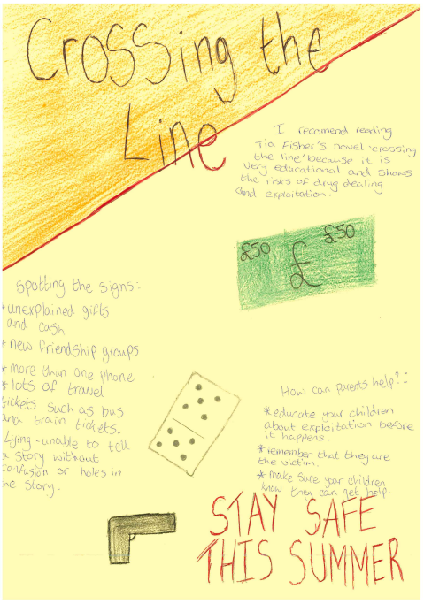

Slide 18
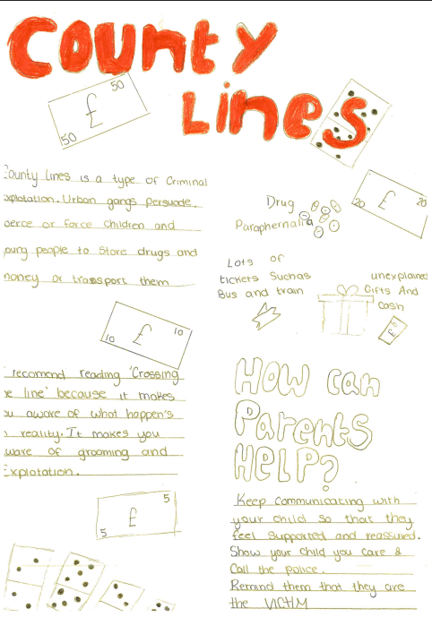
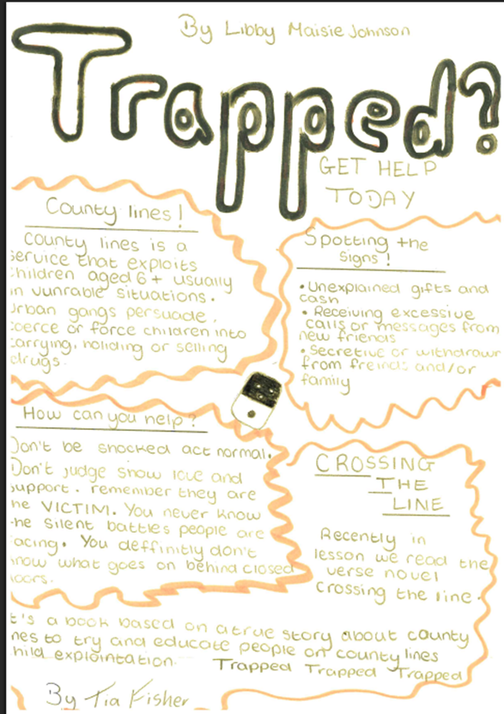

Slide 19
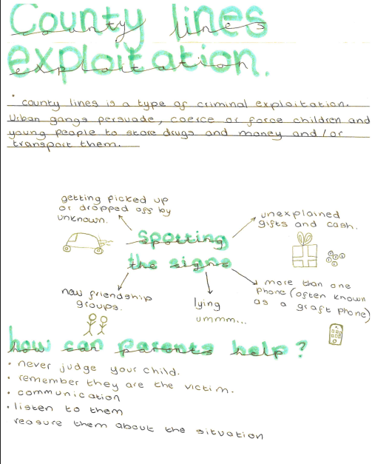
You could publish them in the school newsletter and / or make a display of others in the school to educate and protect our community?

