Slide 1
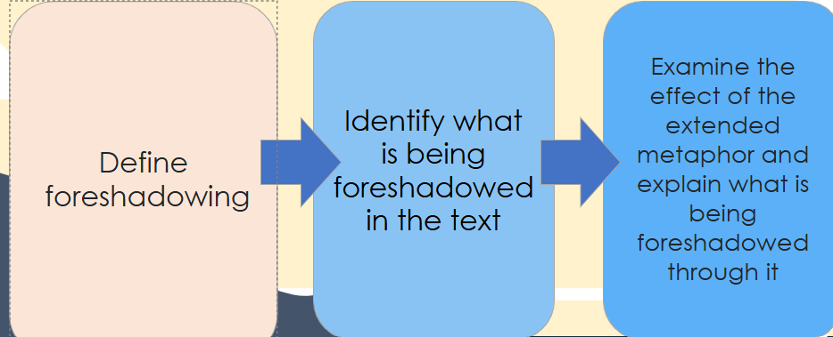
Foreshadowing
Page number | Quotation and techniques | What could be foreshadowed?
p.4 | ‘Got no idea of what’s about to / hit me’ | Literally it foreshadows... Metaphorically it foreshadows...
p.4 | ‘Dad’s face… / It rips my heart / when I think about it now’
p.5 |  | Erik in unhappy in the present day
p.16 | ‘there’s so much else / to be sorry for / now’
Extension: Based on what we have read so far, what predications can you make for the novel?
Notes:
Students complete the table

Slide 2
The speaker in the opening feels safe. | County lines exploitation doesn’t happen today.
The writer is confined by rules through writing in verse. | Crossing the Line is an ordinary novel.

Slide 3
Do Now
Stick your false statements into your book. Each statement is wrong and needs evidence to prove it wrong.
approximately 14,000 children were identified as at risk or involved in child criminal exploitation in 2022 to 2023
It happens today
Around each statement, write 3-4 reasons why the statement is incorrect.
The speaker in the opening feels safe. | County Lines Exploitation doesn’t happen today.
The writer is confined by rules through writing in verse. | Crossing the Line is an ordinary novel.
Finished?
Can you find one quotation per statement that proves it wrong?

Slide 4
DQ: What is foreshadowed in the opening?
Define
foreshadowing
Identify what is being foreshadowed in the text
Examine the effect of the extended metaphor and explain what is being foreshadowed through it

Slide 5
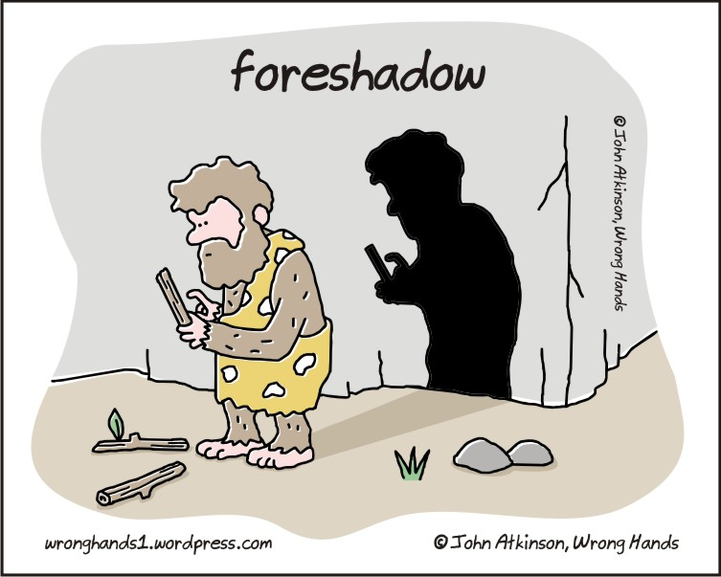
New vocabulary:
Say it out loud together!
Write your own definition of the word ‘foreshadowing’.
Definition: is a literary device where a writer gives an advance hint or warning about what will happen later in the story. | New word: Foreshadowing (noun) | In a sentence The thunder and lightning foreshadowed the danger to come.
Synonyms Predict Imply Anticipate Foretell foresee |  | Etymology. "Fore-" means "before" or "in advance," So "foreshadowing" literally means to cast a shadow before.

Slide 6
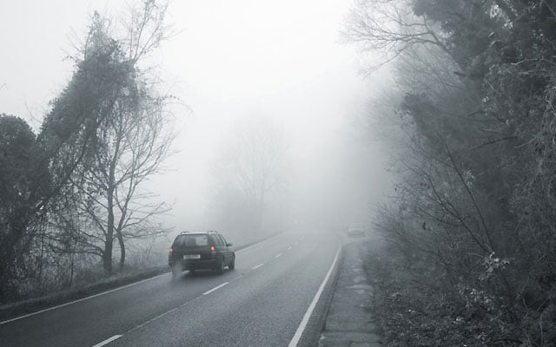

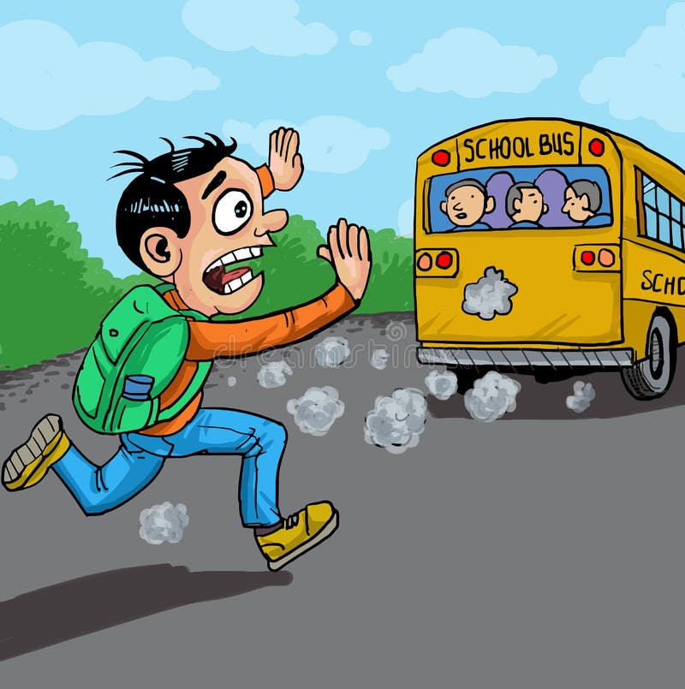
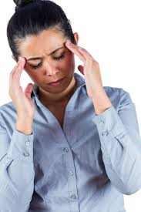
Checking for understanding
Together, can we work out what might be foreshadowed in these snippets?
The sun beat down. I watched as Claud’s eyes closed and he started to snore.
Work with a partner to figure out some possibilities!
Dad rubbed the windscreen and slowed right down. “I can’t see a thing! he complained.”
Write your ideas around each one.
Mum winced and rubbed her temples. She did that a lot these days.
“STOP!” But the school bus was already pulling away. Again.
Remember, each idea should be be an event that could happen later, which is being hinted at now.

Slide 7
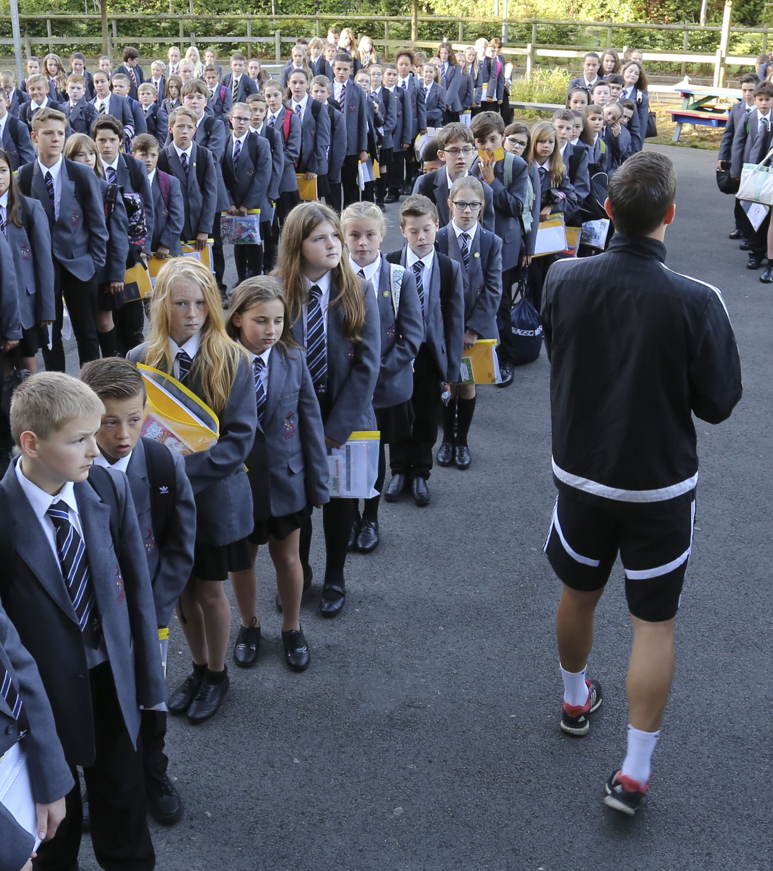
Think back to your first day at secondary school:
Turn & Talk
How did you feel starting a new school?
Was there anything you were excited about?
Was there anything you were worried about?
How did it feel going from the oldest to the youngest year group?

Slide 8
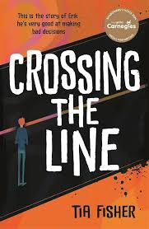
Let’s read:
Holland Road Secondary p 4-16
As we read, consider:
What are your initial thoughts about this section of the text?
What do we learn about Erik in this section?
Why do you think the novel is told as a flashback but in the present tense tense? On p16, who do you think is Erik is addressing?
In your opinion, why do people bully others?

Slide 9
New vocabulary:
Say it out loud together!
Write your own definition of an‘extended metaphor’.
Definition: A metaphor that is developed over several lines, paragraphs, or even throughout an entire book | New word: Extended metaphor (noun) | In a sentence The author uses an extended metaphor of dominoes to make us think about how one decision impacts another.
Synonyms an allegory an extended analogy a sustained metaphor a conceit |  | Why use an extended metaphor?
It adds depth and complexity to the writing. Makes imagery more vivid and engaging, increases emotional impact, makes it more thought-provoking.

Slide 10
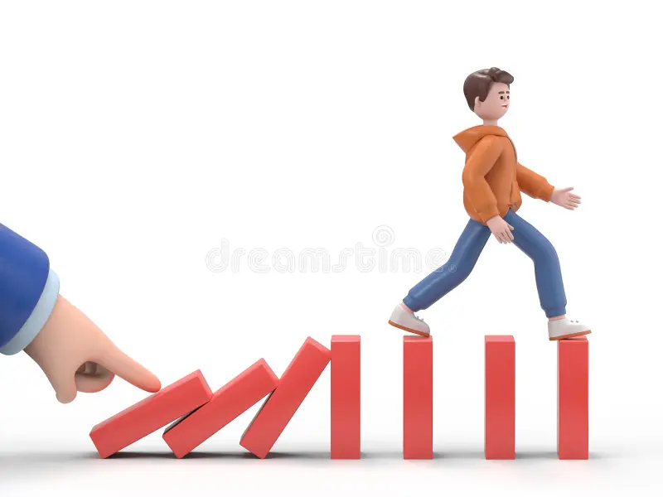
What is the first thing to go wrong for Erik?
Turn & Talk
Erik describes making bad decisions using an extended metaphor, comparing them to a line of falling dominoes
What is the first event (domino) that happens that makes Erik more susceptible to making bad decisions?
What is being foreshadowed through this extended metaphor?
How has the author used the metaphor visually though the book?

Slide 11
Foreshadowing
Page number | Quotation and techniques | What is being foreshadowed?
p.4 | ‘Got no idea what is about to / hit me’ | Literally it foreshadows..? Metaphorically it foreshadows..?
p.4 | ‘Dad’s face… / It rips my heart / when I think about it now’
p.5 |  | Erik is unhappy in the present day
p.16 | ‘there’s so much else / to be sorry for / now’
Extension: Based on what we have read so far, what predictions can you make for the novel?
Notes:
Students complete the table

Slide 12
Model response
Page number | Quote | What is being foreshadowed?
p.4 | ‘Got no idea what is about to hit me’ | Something traumatic or life-changing is going to happen to Erik.
p.4 | ‘Dad’s face… It rips my heart when I think about it now’ | The father may suffer or die; something painful will happen to him.
p.5 | 'I hate a lot of things these days' | Erik is unhappy in the present day
p.16 | ‘there’s so much else to be sorry for now’ | Erik will make a major mistake and feel guilty about it.
Extension: Based on what we have read so far, what predications can you make for the novel?
Notes:
Students complete the table

Slide 13

Exit Ticket
Based on the poem ‘I’m a target’ on p.16, what do you think will happen next? Why?

Slide 14

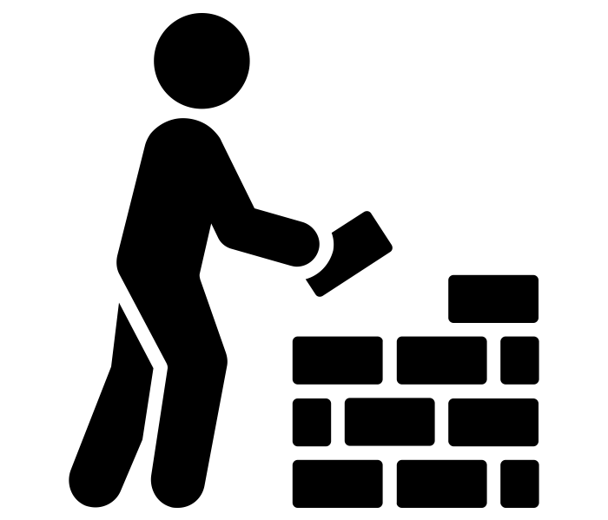
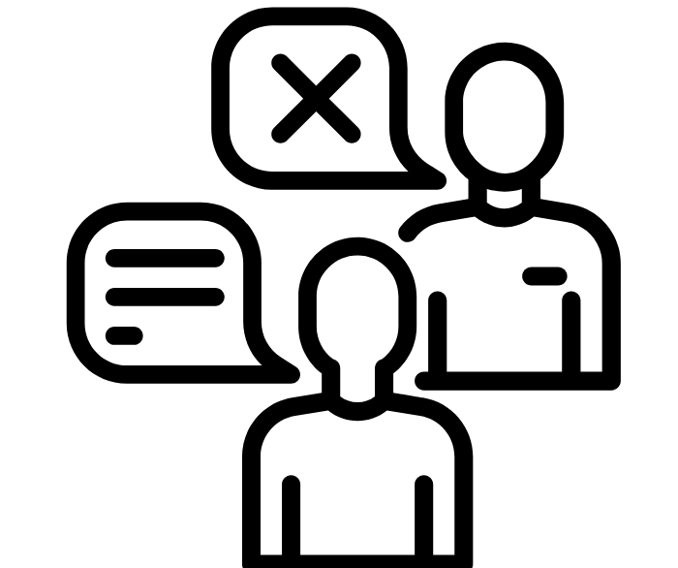
ABC – Habits of discussion
Ask Phrases: | What is your evidence for that point/Can you provide another example to support your point? Why did you think that _________? I’m not sure I understood your point – could you explain it again?
Build Phrases: | There is another example of what _______ is talking about …. I would like to build to what _______ said … Another way we might interpret that is …
Challenge Phrases: | I respectfully disagree with ________ because … I think it is more complex than what we have been saying because… I understand why you would say that but…

