Slide 1
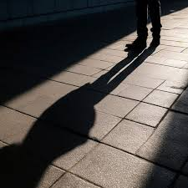
Do Now - example
This is a random image. It does not explicitly link to Crossing the Line – but here is how you could make it link:
Erik felt his dad’s presence like a shadow beside him all the time.
K1’s threats were a shadow cast over Erik’s whole life.

Slide 2
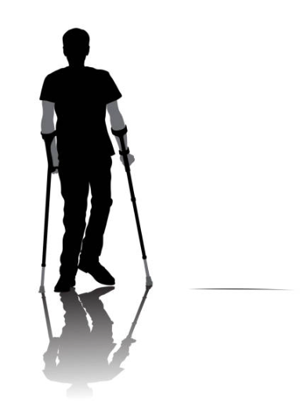

Do Now – your turn
Chose ONE of these random images.
Make five implied links between this image and the story.

Slide 3
DQ: How do Erik's actions lead to dangerous consequences?
Read the climax of the novel
Hot-seat main character
Predict the ending

Slide 4
We will be reading for most of today's lesson.
In the sections we are reading today, the author has used the F word for authenticity. However, instead of reading it out loud, we will use the sound 'eff'.
DQ: How do Erik's actions lead to dangerous consequences?

Slide 5

Seaside p230-231
As we read, consider:
Whose home are they in? Is Fritz a welcome guest? Where else have we seen evidence of ‘cuckooing’?
How do you think Mikey feels about Fritz and the job he has to do?
Do you think Maria has any choice? Why do you think this?
Can you think of any other types of county lines coercion?
Notes:
Last question - Teachers could talk about sexual coercion of girls?

Slide 6
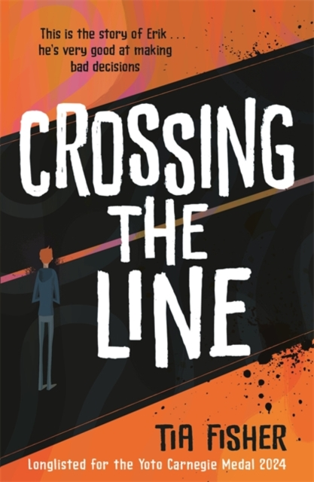
Let’s read
Seaside 216-244
As we read, consider:
‘Seaside’ ends with the rival gang threatening to kill Erik.
‘We already gave K1 his final warning’
Do you think K1 was mindful of this when he sent Erik to the coast?
What can/should Erik do in this situation?

Slide 7
  This quotation is after Erik receives a threatening phone call from the North Street gang.
  What image device is this?
  What does the image of a ‘cold blade’ suggest?
  What does the adjective ‘cold’ emphasise?
  4. What is the effect of the verb ‘slices’?
‘A cold blade of fear slices through my ribs.’

Slide 8
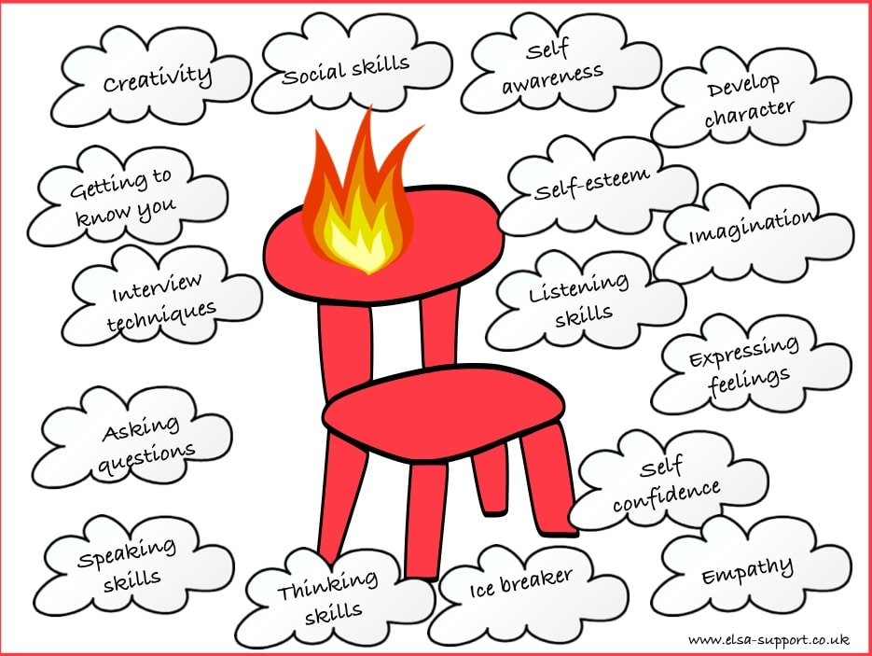
Hot Seat Erik
Explore Erik’s internal conflict and emotional state through spoken language and improvisation.
DQ: How do Erik's actions lead to dangerous consequences?

