Slide 1

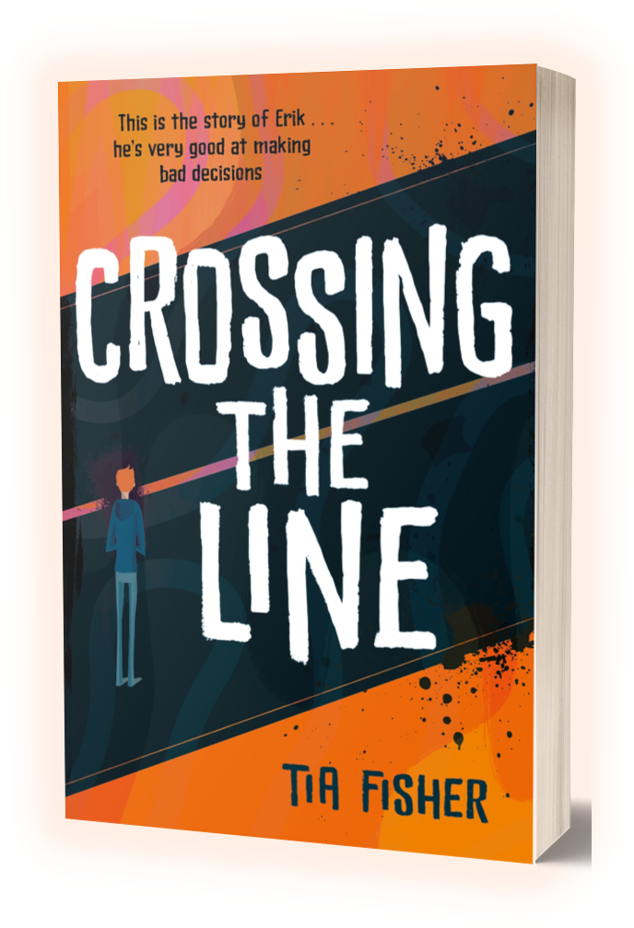

TEACHING RESOURCES - KS3
CROSSING THE LINE: After Reading, Drama
TIA FISHER

Slide 2
DRAMA ACTIVITIES: HOT-SEATING
Hot-seating is a good technique to encourage empathy and create a deeper engagement with the characters. The groupings below are suggestions only. See this link for setting up hot-seating. Students can work in small groups of three or more and can be hot-seated in pairs.
In the hotseat: Questions from:
K1 Mums on the estate, Erik’s mum, Maria (Mikey’s mum)
Ravi Teachers at school, Erik
Erik The police, his mum, Ravi, K1
Erik’s mum Social workers
Mikey’s Mum Mikey, Erik, Fritz,
Extension follow-up writing activity:
Imagining you are one of the hot-seated characters, write a page-long statement defending yourself. Why is it ‘not your fault’?

Slide 3
DRAMA ACTIVITIES: ROLE ON THE WALL
Role on the wall is a great empathy-provoking tool to help students understand how we are shaped by what has happened to us. You’ll need paper and different coloured pens; markers and large sheets of paper/wallpaper for the big figures if you make them.
  Pick a character from Crossing The Line.
  In pairs, draw an outline of a person on a sheet of paper (template below)
  On the outside of the outline, write or draw pictures of the external forces (events, circumstances, interactions with other people, etc) that affect the character throughout their story or life. What happened to them? What did they do? Students can use quotes as evidence.
  One the inside, write or draw pictures of the character’s personality traits, feelings or emotions throughout the story/their life.
  Draw lines between things on the outside and feelings on the inside and /or link them thematically or into positive/negative etc
  Create more drawing for different characters. Compare and contrast them. Do they connect at all?
  If possible, ask students to draw around each other to make a full-sized outlines on large sheets of paper, for the wall. Students add their work to make an ensemble analysis.

Slide 4
DRAMA ACTIVITIES: FREEZEFRAME
Freezeframe is another good technique to encourage empathy and create a deeper engagement with the characters. Can be used here to encourage thoughts about the wider responsibilities of communities towards bullying, gangs and victims. Here is a useful resource on working with freezeframes.
Students work in small groups of three or four.
Choose a ‘crowd scene’ from the book, where there are background ‘witnesses’ as well as the major players, for example:
  Erik being bullied by Travis and Ben on his first day
  K1’s first conversation with Erik in the rec
  In the shopping centre when Erik finds his dog poisoned.
  When the driver drops Erik off at Fritz’s trap house.
When the students have created their tableau, the teacher should tap them on the shoulder and asks them to explain their role in the scene and what they are thinking/feeling/deciding.
In a drama session, students could work out how to move from one freezeframe to the next.
Alternative: students could work in groups on a white board or flipchart board to draw stick-figure tableaux and thought bubbles.

Slide 5
DRAMA ACTIVITIES: DECISION ALLEY
Decision (or Conscience) Alley is a great tool for getting students to think about the issues involved in a situation, to develop empathy, consider multiple viewpoints, use persuasive language and reflect on character motivations. Here is a useful resource on working with the decision alley technique.
One student is chosen to be the decision-maker and the rest of the students form two groups representing the opposing sides of an argument. The teams work together to create persuasive arguments, which they call out as the decision-maker walks between the opposing sides. After the walk, the ‘character’ must make their choice.
Suggested decision-making moments in Crossing the Line :
  Erik – should he accept K1’s first offer to sell drugs?
  Erik – should he run the drugs to the trap house on the coast?
  Erik – should he carry out Ravi’s plan to ditch the gun?
  Ravi – should he tell someone about Erik’s involvement with county lines?
  Erik’s mum – should she move away to protect her family?
Extension follow-up activity:
Make a mind map of the alternative decisions and the probable consequences of each.

