Slide 1
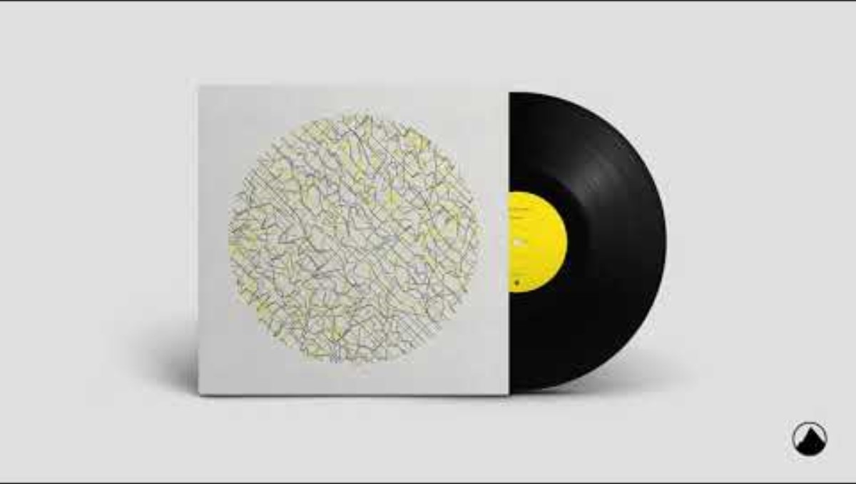
Music used in the stage adaptation. Could play during Do Now and ask students how it fits the themes.

Slide 2
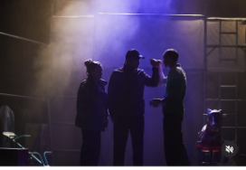
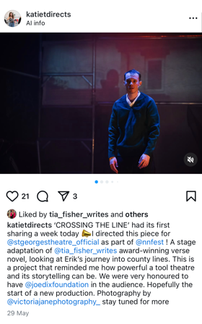
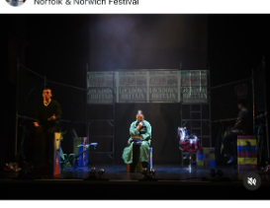
Do Now
Look at these images from the new ‘Crossing the Line’ play.
Task: Write a paragraph advertising the play to go on a poster with these photos.
Use rhetorical devices.
Sentence Starter: Erik no longer feels safe...

Slide 3
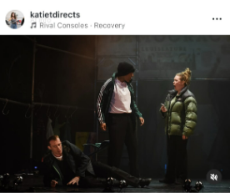
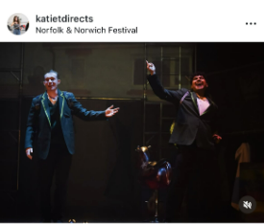
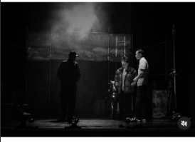
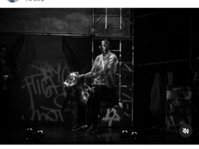
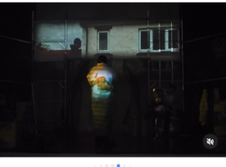
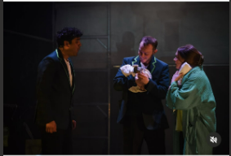
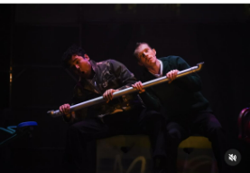
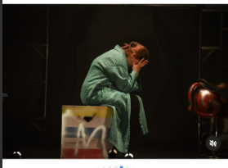

Slide 4
Model response
Erik doesn’t feel safe anymore. A few bad decisions changed everything.
Coming soon to a theatre near you, Crossing the Line is a powerful and urgent play that shines a light on the impact and dangers of County Lines exploitation.
Essential viewing for every teenager, it shows how quickly our lives—like dominos—can fall over when we don’t have the knowledge to make the right choices.
Don’t miss your chance to see it. It could change everything.

Slide 5
DQ: How does the extended metaphor of dominos create sympathy for Erik?
Read two chapters
Discuss how many dominos Erik has stacked up
Explain why Erik felt pressured by K1

Slide 6

Today, we’re going to read about a turning point in Erik’s life — a bad decision that sets him on a very different path.
In ‘Training’, we see the potential Erik had — a glimpse of how things could have gone if he’d stayed focused at school.
In ‘K1’, we find out where that potential leads when he takes a different route.

Slide 7
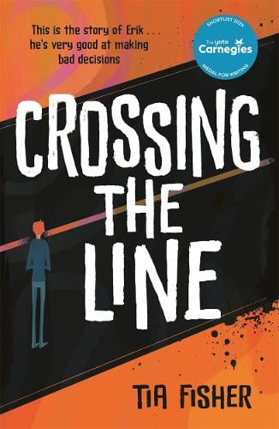
Let’s read:
Training pages 92-112
As we read, consider:
Why do you think Erik didn’t want to be seen/noticed by Mr Robinson?
Do you think the layout on p.99 is effective? Why?
Why do you think Mr Robinson starts to push Erik? Might this be good for Erik?
What is your opinion about Travis and Ben’s actions in this section?
Are Erik’s feelings about his mum at the end of the section justified, in your view?

Slide 8
Let’s read:
K1 pages 114-124
As we read, consider:
How are your first impressions of K1 shaped by others’ reactions to him?
What is Erik being asked to do?
What are the rewards he is promised?
Where in the text can you see he’s not sure about saying yes?
What are the factors which make him agree? Which do you think is the biggest factor?

Slide 9
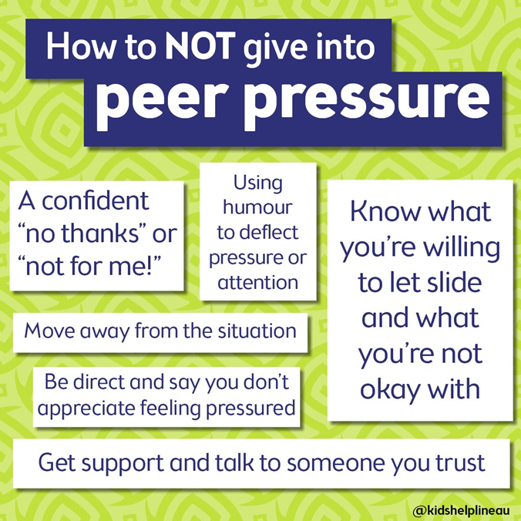
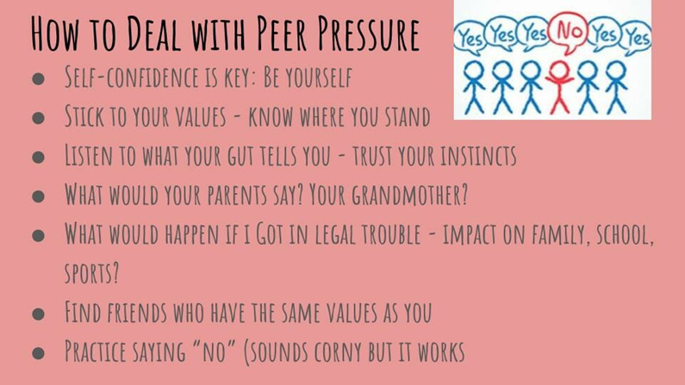
How can we say no?
Erik had reservations about saying yes to K1 - but it would have been incredibly difficult to say no.
K1 isn’t just another peer—he’s a powerful member of a drug gang.
How could Erik have possibly said no?
Let’s practise now!

Slide 10
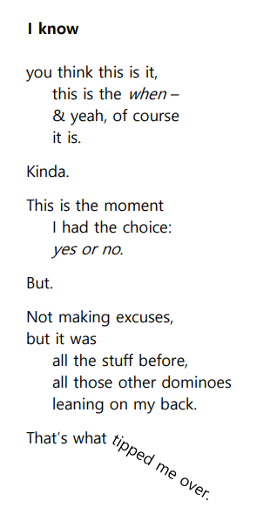
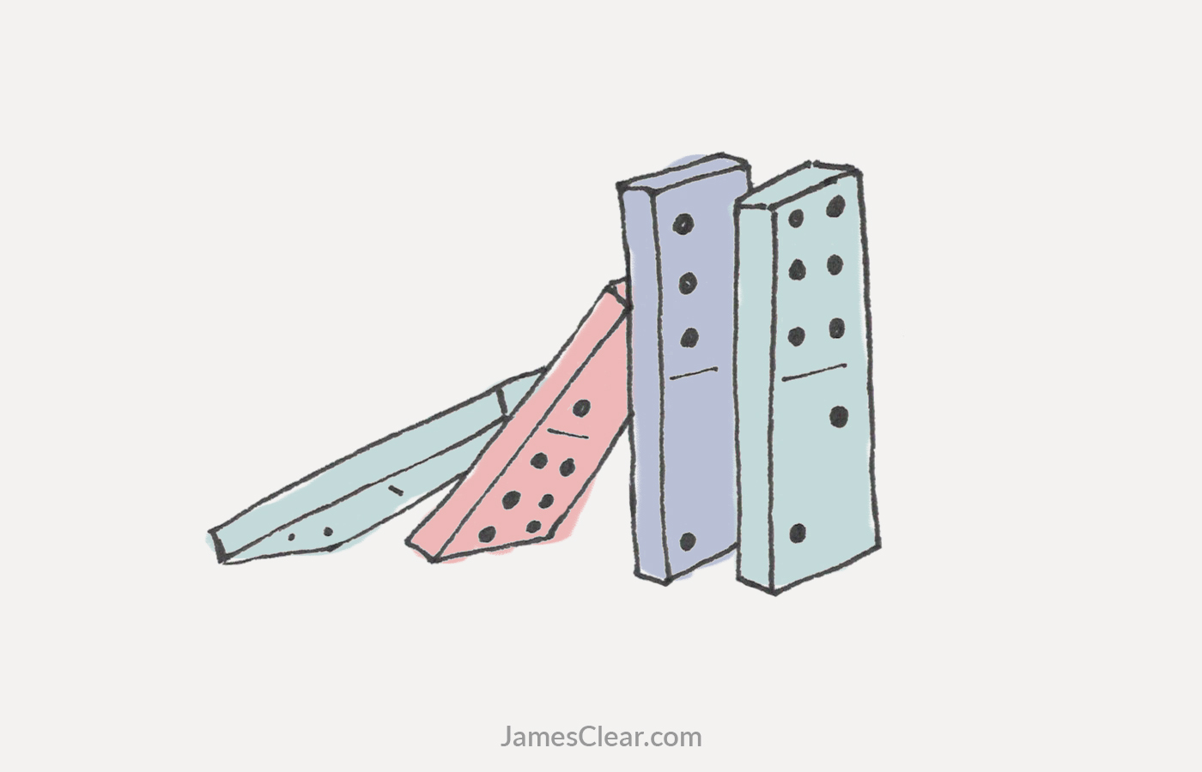
Decisions and Consequences pages118-119 ‘I know’
Turn & Talk
Are dominos an effective extended metaphor? How?
Does it take much force for one domino to topple and push the whole line over?
How does this link to Erik's story?
Notes:
Please ensure that discussion is teacher lead and expectations are reinforced

Slide 11

Who is vulnerable to being exploited by County Lines?
According to the charity, St Giles, these are the 5 vulnerabilities that might make someone more vulnerable and suspectable to County Lines Exploitation.
Trauma
– Bad experiences in childhood (like losing someone or seeing violence) can make a young person more likely to trust the wrong people.
Abuse
– If someone has been hurt or treated badly, they might be more likely to believe people who pretend to care but want to use them.
Instant Gratification
– Wanting things quickly (like money, clothes, or respect) can make young people take risks without thinking about the consequences.
Glamourisation
– Criminal life is sometimes made to look exciting, cool, or rich.
Misinformation
– If someone doesn’t know the truth about what County Lines really is, they can be tricked into getting involved.
How many vulnerabilities does Erik have?

Slide 12
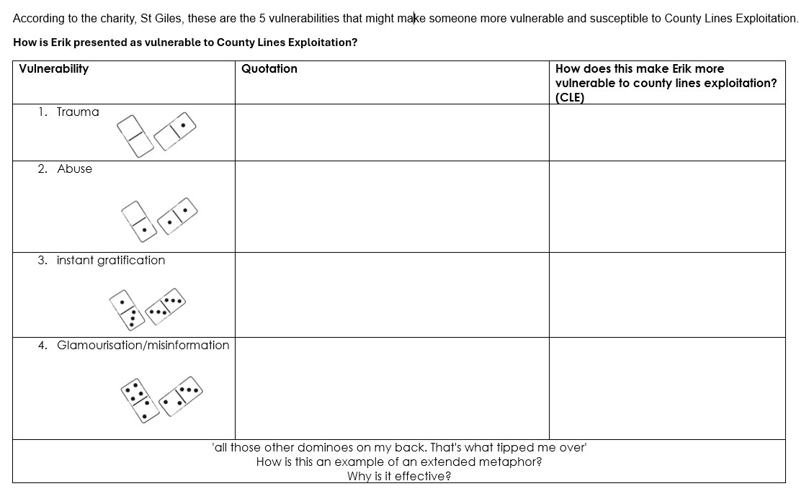
Independent Practice

Slide 13
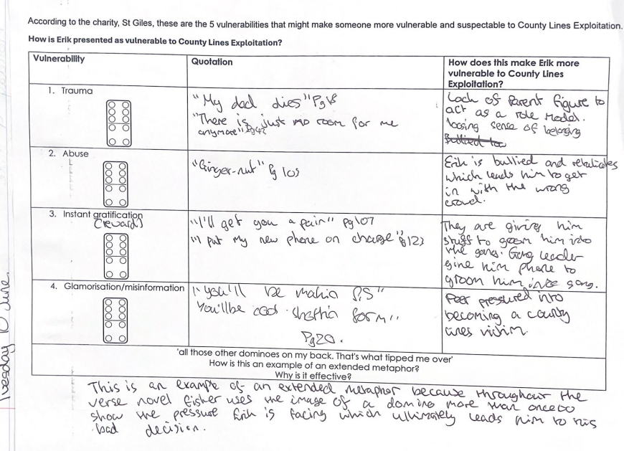

Model response
Excellent understanding of extended metaphor!
Notes:
Trauma: 'loads of kids lose their grandparents, but no one else at school was careless enough to lose their actual dad p19;
Abuse: Ginger-nut' p103
Instant gratification: 'more money than I've had for months' p90
I let them send the boy to hunt me down Adidas in size eight' p107;
'I put my new phone on charge' p123
Glamorisation/misinformation: 'you'll be makin' ps. You'll be cool shottin for me p120
'all those other dominoes on my back. That's what tipped me over'

Slide 14
Exit Ticket
What other direction could Erik's have life taken?
What circumstances would have needed to be different? (Think about what subject he was excelling in at school.)

