Slide 1
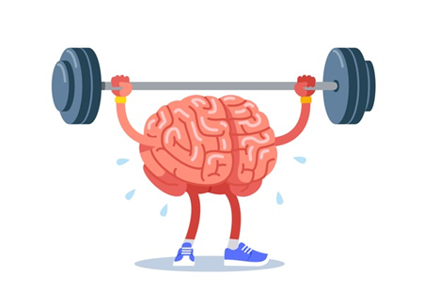
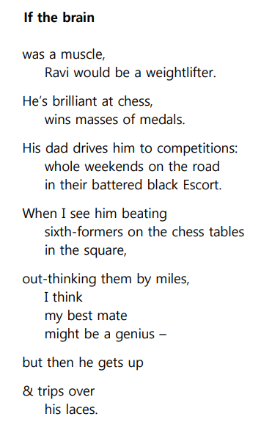


Slide 2
‘Do it now’ task – Spin the Wheel
On the next slide, click the ‘spin’ button to spin the wheel. Click it again to stop it.
Each section of the circle contains a character, theme or idea from
Crossing the Line
Write down one thing about the character, theme or idea that the pointer lands on – it can be anything!
Be prepared to share your ideas.

Slide 3


Jonny
Mum
Erik
Ravi
hypervigilant
the twins
Starting school
SPIN
young carer
foreshawoing
parentification
grief
county lines
poverty
susceptible
dominoes
bullying
tekhnologic
Notes:
https://tekhnologic.wordpress.com/2017/02/21/the-spinning-wheel/ Ony works in slide show presentation mode

Slide 4
DQ: How is Ravi presented as a good influence on Erik?
Activate prior learning
Know how Erik's dominos continue to topple
Explain why Ravi is a better influence than Travis and Ben.

Slide 5

Let’s read:
Travis and Ben pages 66-74
Do not read the swear words out loud.
As we read, consider:
What does Erik do that impresses Travis and Ben?
What does Erik accept from Travis and Ben that might make him become under their grip and control?
Notes:
Taking drugs from someone gives them power over you. It can lead to pressure, danger, and losing control of your own choices. It’s never just “a one-time thing.
How might Erik giving into this peer pressure lead to further problems?

Slide 6

Let’s read:
Ravi pages 76-90
As we read, consider:
How does Ravi's character act as a foil to Travis and Ben's?
How might Ravi be a better influence on Erik than Travis and Ben?
Why does Ravi want to get fit?

Slide 7
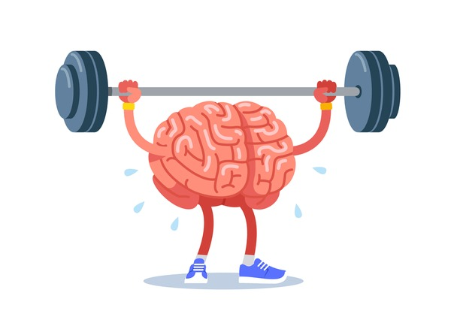

Annotate this poem by answering these questions:
Turn & Talk
How does Fisher use language to show Ravi's strengths?
How does Fisher use language to show Ravi's weaknesses?
In the last sentence, is Erik being affectionate or mean? How do you know?

Slide 8

Independent Practice: Character profile of Ravi
Outside of the outline of Ravi, write quotations about his appearance
Not very sporty: quote:
EXAMPLE Wants to get fit: "I need to get in shape" pg 84:
Intelligent – quote:
Inside the outline of Ravi, write quotations his personality
Like chess = quote:
Romantically interested in Betty – quote:
Stretch it:
Write a what, how, why paragraph about how Ravi is presented as a good influence on Erik compared with Travis and Ben
Notes:
Imagine you know more about Ravi: what are his favourite films? What does he look like?
What is he most proud of? What are his favourite subjects at school?

Slide 9
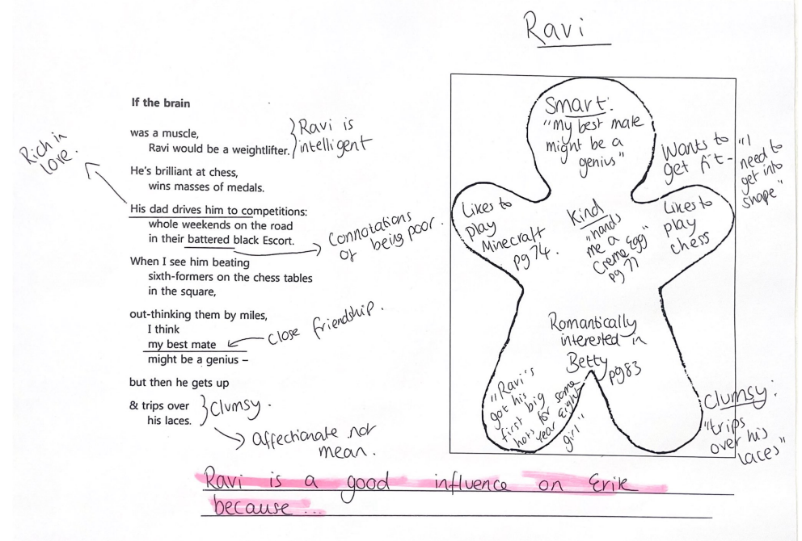

Slide 10
Exit Ticket
Ravi is a good influence on Erik because...

