Slide 1
Do Now
Create a mini timeline with six points on it.
Write down six key events that have happened so far in the story in chronological order.

Slide 2
DQ: How does Fisher use figurative language for effect?
Read pages
126-150
Explain the effect of the metaphor
Create your own metaphor and then transform it into a simile

Slide 3
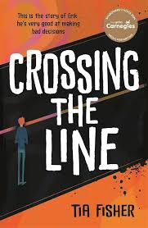
Let’s read:
Lies pages 126-132
As we read, consider:
Why does Erik not want to visit his dad’s grave? What does this show about how Erik’s view of his own actions?

Slide 4
Let’s read:
Cats pages134-150
As we read, consider:
How is Erik presented as powerful?
How are the drug addicts presented?

Slide 5
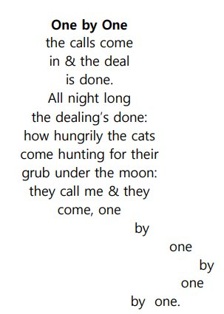
Metaphor
Turn & Talk
Fisher uses metaphor to create vivid images in the readers' heads.
A metaphor is something that is not literally true.
What metaphor does Fisher use to describe the drug addicts?

Slide 6
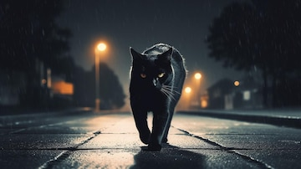
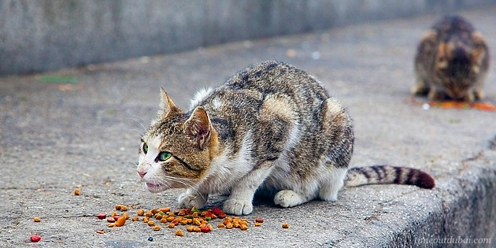
How does Fisher use language for effect?
‘. . .my alleycats as they come
skulking, slinking, stinking
up to me . . .’
Why does Fisher use the possessive pronoun 'my'?
Who is being compared to alley cats?
What does an image of an alley cat imply?
What is the effect of the list 'skulking, slinking, stinking’?
What poetic device is Fisher using in these three words?
Notes:
Metaphor connotes uncared for, disease ridden, animalistic imagery (dehumanises them – like Caliban!)

Slide 7
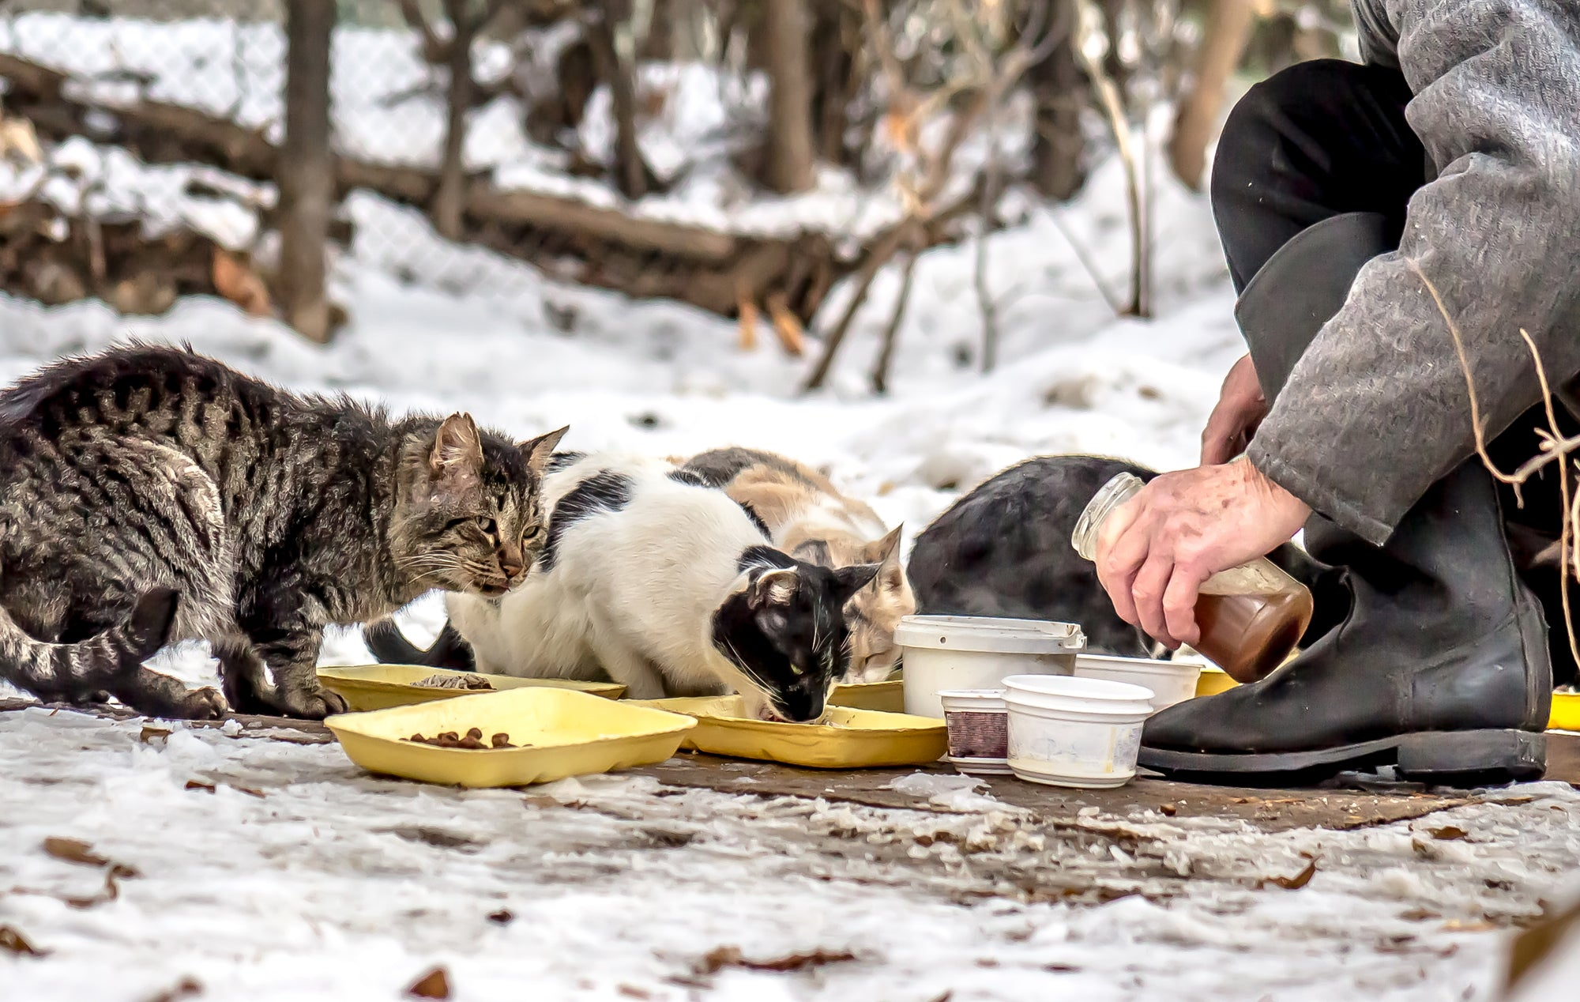
Alley Cat
A stray or feral cat that lives outdoors, often in urban areas (like alleys); May once have been owned or born in the wild; Survives by scavenging or hunting; often avoids people.
What does this metaphor help us to understand about the people dependent on Erik's supplies?
Stretch it: what other metaphors has Fisher used throughout the novel so far? Why are metaphors helpful?
Notes:
Metaphor connotes uncared for, disease ridden, animalistic imagery (dehumanises them – like Caliban!) Also, drug gangs call the drugs they supply ‘food’ – hence feeding the cats

Slide 8
How does Fisher use language for effect?
Fisher introduces a metaphor to represent the people buying drugs from Erik . ‘My alleycats as the come skulking, slinking, stinking up to me’. The possessive pronoun ‘my’ reveals… Furthermore, the metaphor ‘alleycats’ is used to describe the drug addicts and has connotations of …Finally, the list of three verbs imply…Fisher may have done this in order to…

Slide 9
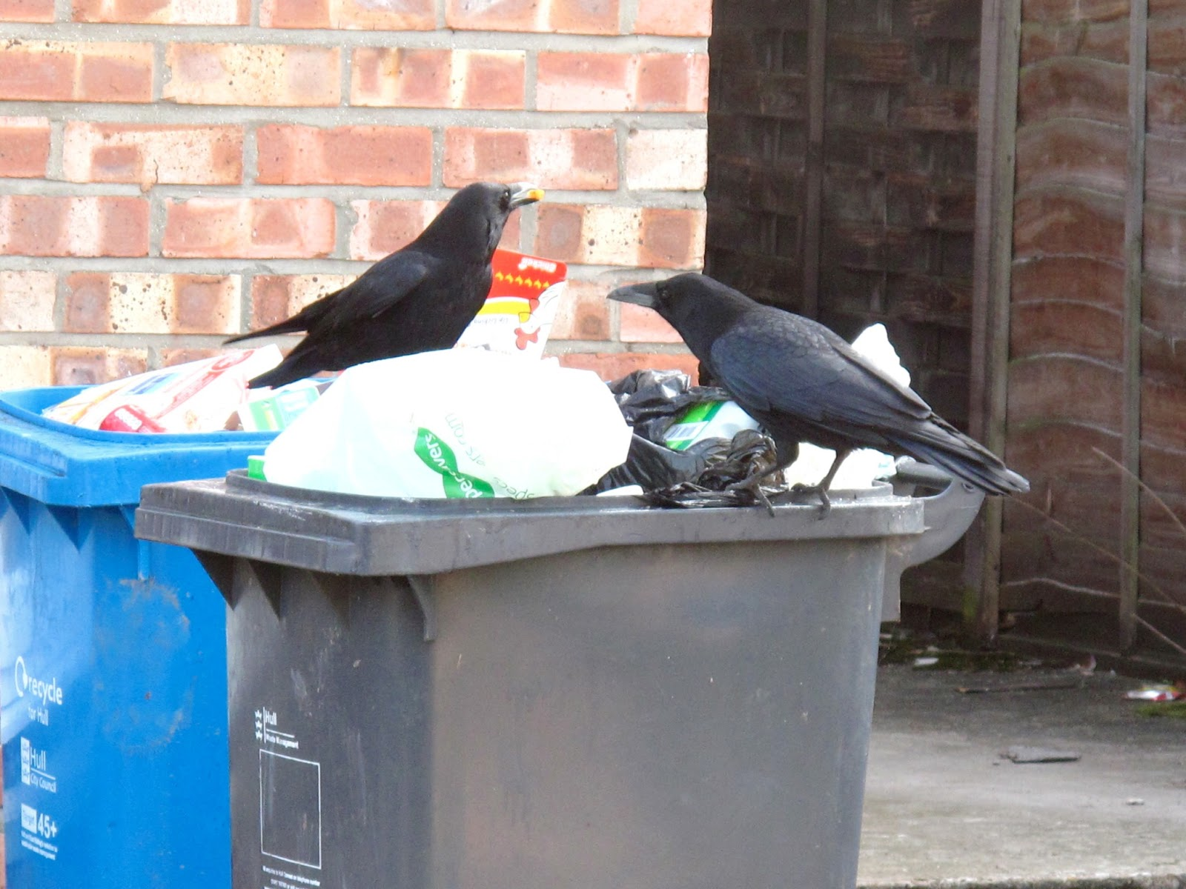
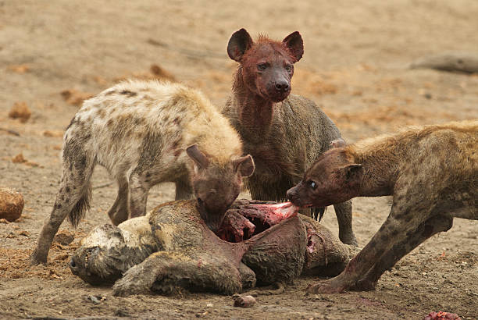
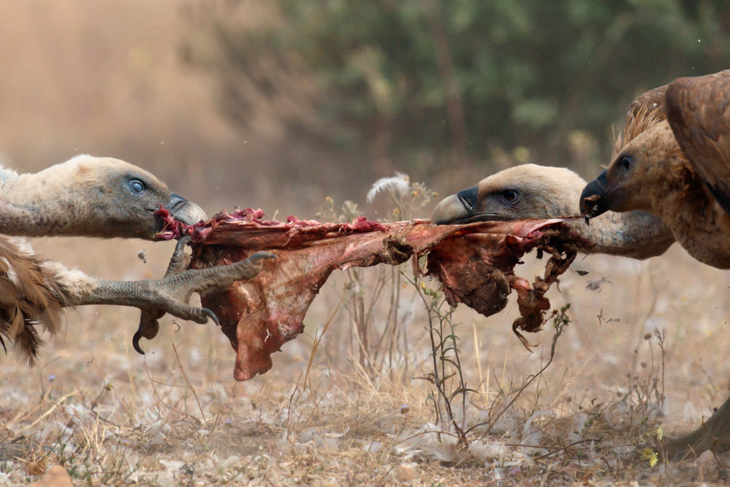
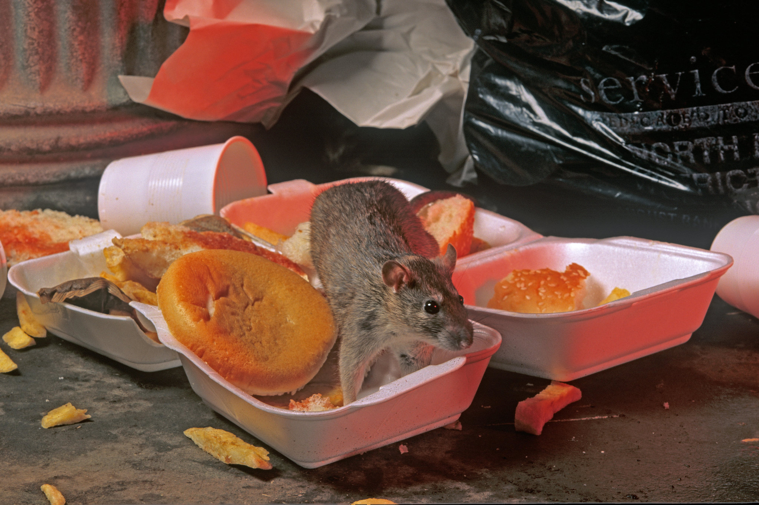
Exit Ticket
Fisher uses the metaphor of an alleycat to describe the drug addicts.
Can you think of a different metaphor for them?
Write a sentence to use it:
‘My [insert new metaphor] as they come
[insert 3 verbs linked to your new metaphor]
up to me
Stretch it – can you now turn it into a simile?

Slide 10
How does Fisher use language for effect?
‘I go fishing​
in the city’s stagnant pools,
wading in the murkiest
waters'
How does Fisher present Erik as powerful here?
What does the metaphor of going fishing represent?
What is the effect of ‘stagnant’ and ‘murkiest’?

