Slide 1

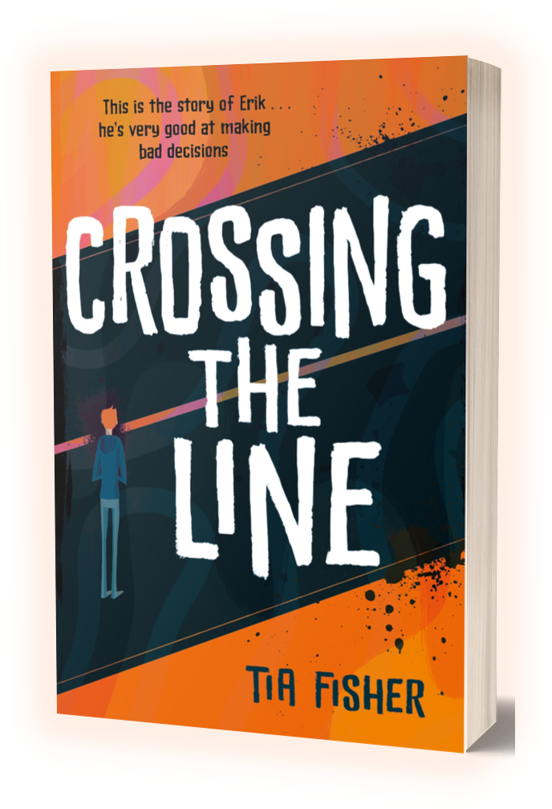

TEACHING RESOURCES - KS3
CROSSING THE LINE: Themed Activities
TIA FISHER

Slide 2
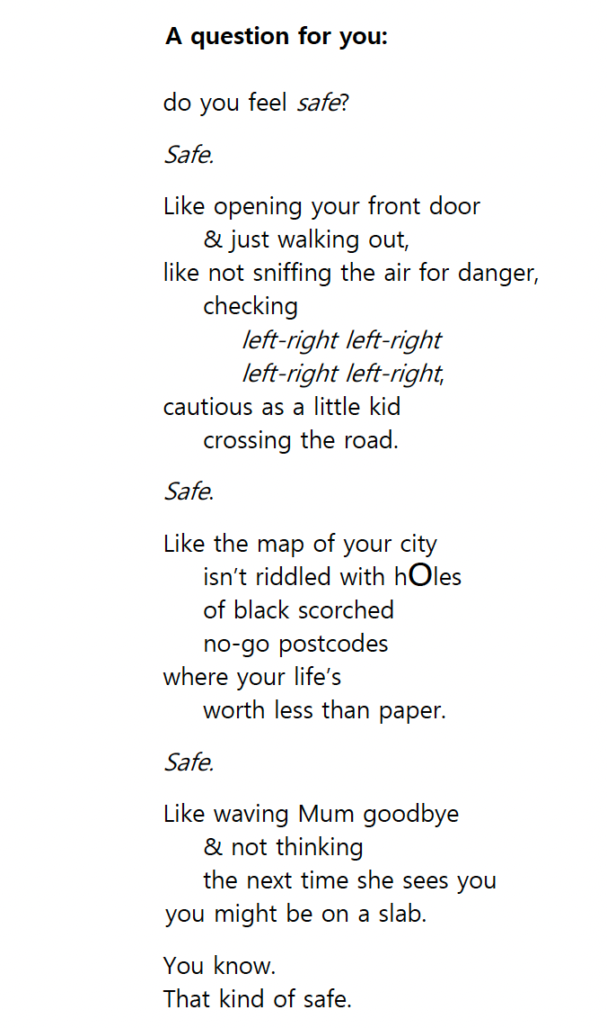
ACTIVITY: SAFETY (p1)
This is the opening of Crossing the Line .
  How does it make you feel?
  Who do you think the speaker is scared of?
  Do you have any idea of who the speaker is talking to?
  Is this poetry? Why/Why not?
  How does it feel to read it aloud?

Slide 3
ACTIVITY: SAFETY (p1)
How does the way the text is laid out on the page affect the way you take in the information?
  Here are the same words, written in prose:
    Which version do you think is most effective at conveying the speaker’s emotion, and why?
  Is feeling safe important to you? Use your imagination to think of a place where you feel really safe. Picture yourself there and write a paragraph about where are and how you are feeling.
  Some personalities can be described as ‘risk-taking’. Make a list of the kinds of jobs which would you require you to be a ‘risk-taker’. Is being a ‘risk-taker’ always a good or bad thing?
‘A question for you: do you feel safe? Safe. Like opening your front door & just walking out, like not sniffing the air for danger, checking left-right left-right, left-right left-right, cautious as a little kid crossing the road. Safe. Like the map of your city isn’t riddled with holes of black scorched no-go postcodes where your life’s worth less than paper. Safe. Like waving Mum goodbye & not thinking the next time she sees you, you might be on a slab. You know. That kind of safe.’

Slide 4
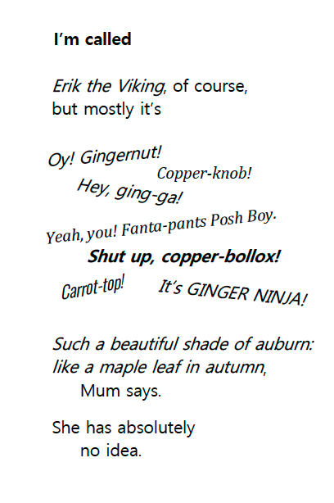
ACTIVITY: BULLYING (p14)
When Erik starts at secondary school, he's immediately picked on. He realises at this school it’s ‘not OK’ to have red hair.
What is the effect of the dynamic text layout and the different typefaces?
  Why do you think people with this particular hair colour are picked on? Do you think it’s fair? What other physical characteristics do people make fun of? How do you think it feels to be mocked for something you can’t change?
  If it happened to you (or a friend) what could you do about it? Have you every stuck up for a friend? What might stop you from trying to help?
  Erik says his mum has ‘absolutely no idea’. Why do you think she’s so unaware? Do you tell the people at home everything that goes on at school?

Slide 5
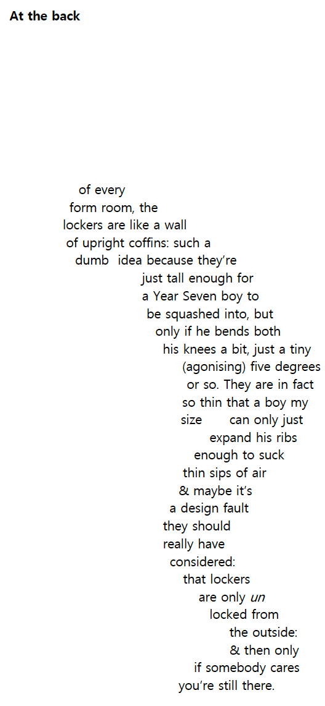
ACTIVITY: BULLYING (p15)
  Look at the poem’s shape without reading the words. What do you think it could be about? Now read it. Were you right?
  Being shut inside a locker must have been a horrible experience for Erik. Is all bullying physical? What impact do you think being bullied has on its victims?
  What are your school’s antibullying policies? Do you think they are effective?
  What advice would you give to anyone being bullied? How could you be an ’upstander’ rather than a bystander?
  Do you think this poem had greater impact because of its shape? How did reading it make you feel?
  Do you think this poem has a greater or lesser impact than a photograph? Why?

Slide 6
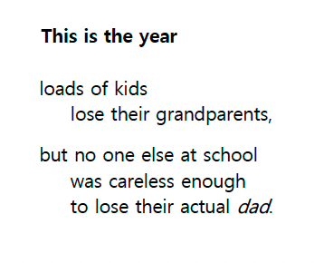
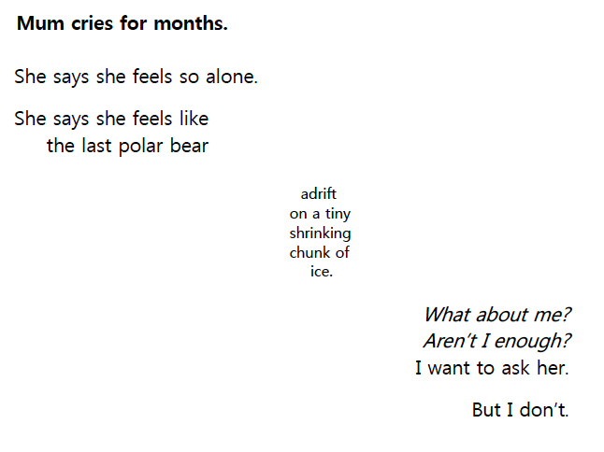
ACTIVITY: BEREAVEMENT (p19 & p21)
Erik’s father died during the pandemic when he was twelve.
  What can you tell about Erik from the way talks about his father’s death?
  Erik can’t get counselling. What impact do you think not being able to talk about his father’s death might have on him?
  Extension: What could Erik have said to his mother? Working with a partner, improvise a constructive conversation between Erik and his mother, telling each other how they feel.

Slide 7
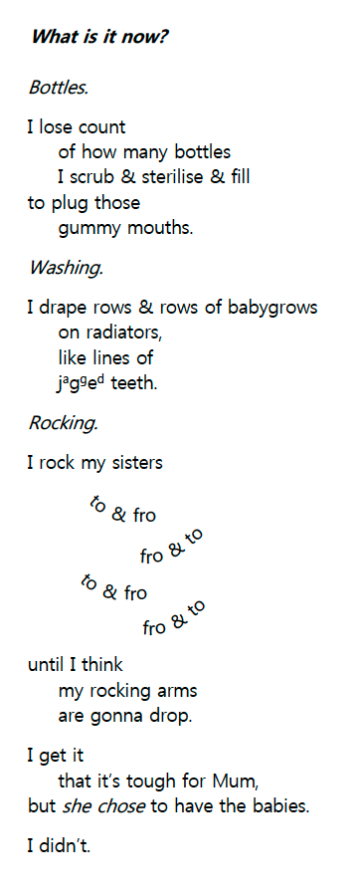
ACTIVITY: EXHAUSTION (p47)
Erik’s mum gets a new boyfriend, but he leaves her when he finds out she’s pregnant with twins. Erik’s only in Year Nine, but he has to take on a lot of new chores.
  What jobs around the house do you do? Do you have to help look after siblings? Do you think it’s fair to be asked to help around the house when you have schoolwork to do?
  Do you think you should be paid for jobs you do in the house? Why/why not?
  Extension: Look up the word parentification. What does it mean? How could it be applied to this situation?

Slide 8
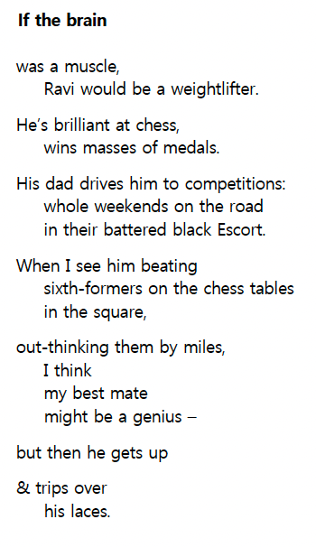
ACTIVITY: FRIENDSHIP (p83)
Ravi has been Erik’s best friend since primary school. Erik says this about Ravi: ‘He’s a bit different too, but in a different way.’
From Erik’s description of Ravi in this poem:
  Can you think of some adjectives to describe him?
  Do you get an idea of what he might look like? Can you draw a sketch of him?
  Imagine more about Ravi. For example: What are his favourite films? What music does his like? What does his bedroom look like? What is he most proud of? What is his favourite word? etc.

Slide 9
ACTIVITY: FRIENDSHIP (p83)
  Did you start secondary school with any friends from primary? Are they still your friends now?
  Are any of your friends very different in personality from you? Do you always understand your friends’ points of view?
  What is important to you in your friendships? Here are some ideas: use them to build your own list.
      Loyalty – they stand up for you
      They make you laugh
      They share the same interests
      They live near you
      You’re all in the same group of friends
      They’re talented / clever
  Now rank them in order of importance. Compare your list with your friends’ – are they similar?

Slide 10
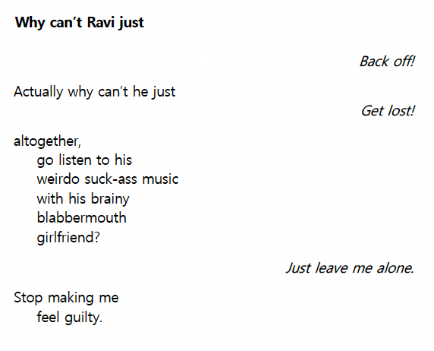
ACTIVITY: FRIENDSHIP (p167)
Later in the story, Ravi and Erik argue about Erik’s involvement in the drug gang.
  How is this description of Ravi different from the one you looked at previously? What do you think makes Erik talk like this about his friend?
  Have you ever had a serious argument with a good friend? Did you make up afterwards? Do you think you should ever apologise to a friend after an argument, if you don’t think you were in the wrong?
  The author has aligned some words to the right and italicised them. Why do you think she has done this? What effect does it have?

Slide 11
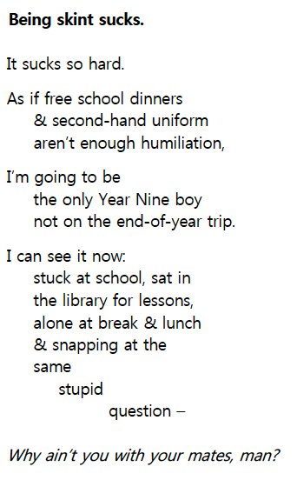
ACTIVITY: BEING BROKE (p57)
Erik’s dad died and Erik’s mum was subsequently made pregnant and abandoned. She’s struggling to raise Erik and his twin baby sisters alone. Money is really tight.
  In this poem, what is Erik’s overriding issue?
    a. He wants to go to on the school trip really badly.
    b. He feels humiliated.
    c. He wants new uniform.
  How could you help others from feeling embarrassed if they need second-hand school uniform and free school meals?
  Erik is made vulnerable to the gangs because he wants things he can’t afford. From what you’ve learned so far about his situation, in what other ways do you think he is vulnerable? Discuss ways that gangs might use children’s vulnerabilities to groom and exploit them.

Slide 12
ACTIVITY: BEING BROKE (p57)
Extension
What impact do you think not having enough money has on schoolchildren? How has Marcus Rashford tried to help? What more does your school do? For example, does your school collect food for foodbanks? Offer a breakfast club? Like Erik’s school, does it have a ‘hardship fund’? Does it collect textbooks that students don’t need any more to give away or sell cheaply? Does it have second-hand uniform sales?
Form groups to discuss practical ways your school could help disadvantaged students at your school. Present these ideas back to the class.

Slide 13
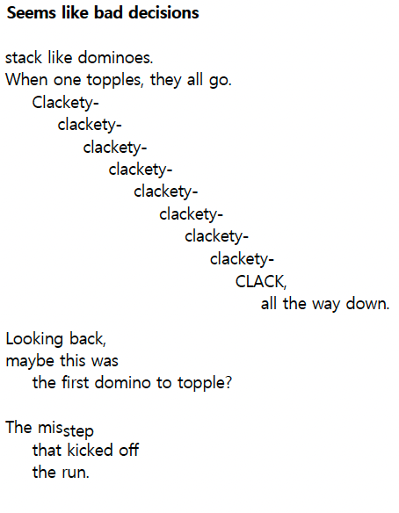
ACTIVITY: DECISIONS AND CONSEQUENCES (p9)
Erik compares the way his life has fallen apart to a domino run toppling.
  Do you think this is an effective metaphor? Why/why not? Would the poem work as well if the layout was conventionally left-aligned?
  Have you ever made one wrong decision that seemed to set off a whole load of others? How could you have stopped your ‘dominoes’ from tumbling?
  Think about a difficult decision you’ve got to make. Maybe choosing your GCSEs, telling a secret, whether you should ask out that crush…. ? Write down the pros and cons in two columns. What are the possible consequences of choosing one way or the other? Do you think this is a good way to make a decision?

Slide 14
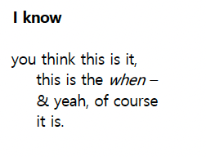
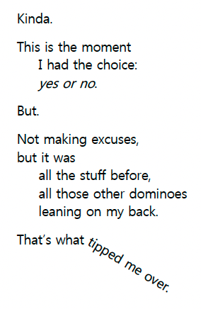
ACTIVITY: DECISIONS AND CONSEQUENCES (p118-119)
Erik is in the rec, talking to the gang leader, K1. He’s on the point of agreeing to sell drugs for the gang when he ‘steps out of the action’ to directly address the listener.
  Do you think Erik is just making excuses? Can you ever justify bad decisions because of the situation you’re in when you make them? Should we always be held responsible for our actions?
  We all make mistakes. Think about a choice you’ve made that hindsight revealed was the wrong one. If you knew then what you know now, could you have made a different decision? If you had, how do you think your life would be different now? Seconds chances are important. Have you been able to correct this wrong decision in any way?
  Do you think risk-takers ever consider the consequences of their actions? If you worked on the ‘Safety’ section, think back to your discussions about different types of risk-takers.

Slide 15
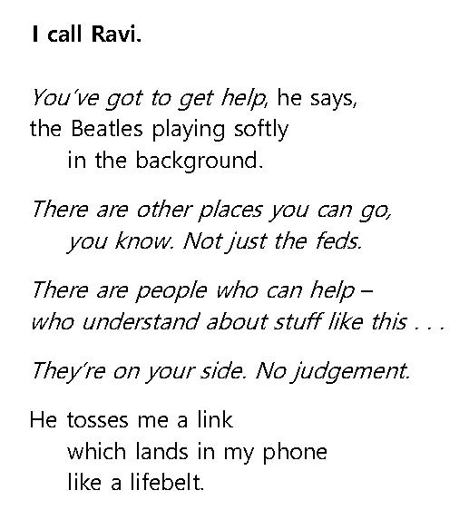
ACTIVITY: GETTING HELP (p345)
  Extension: Follow the link to the author’s website to find out more about the writing of Crossing the Line and sources of help and support: https://www.tiafisher.com/writing-crossing-the-line.
  What might stop Erik reaching out for help?

Slide 16
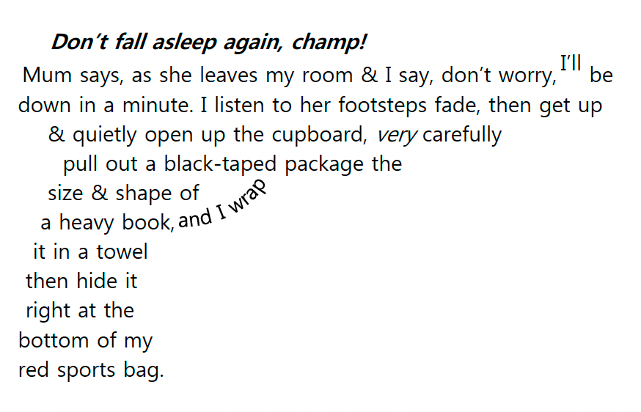
ACTIVITY: WEAPONS (p295)
At this point in the story, Erik has been asked to carry a mysterious package for the drugs gang. He and Ravi have discovered it is a gun. Erik doesn’t want to carry the package, especially now he knows it’s a gun, but he’s being forced to.
  Why do you think the author doesn’t directly tell us the package is a gun?
  Have any young people you know been involved with weapons like knives or guns? What do you think of young people carrying knives? Would you ever carry a knife in any circumstances? What could be the consequence of carrying a weapon?
  What kind of hold do you think the gang could have over Erik?
  When Erik’s best friend Ravi finds out about Erik’s involvement with the gang, Erik persuades him not tell anyone because he’s scared of what happens to ‘snitches’. Do you think Ravi should tell anyone? Discuss why or why not.

Slide 17
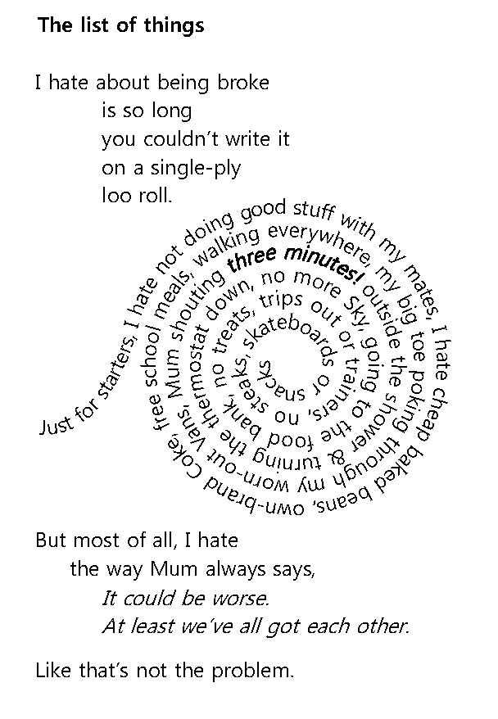
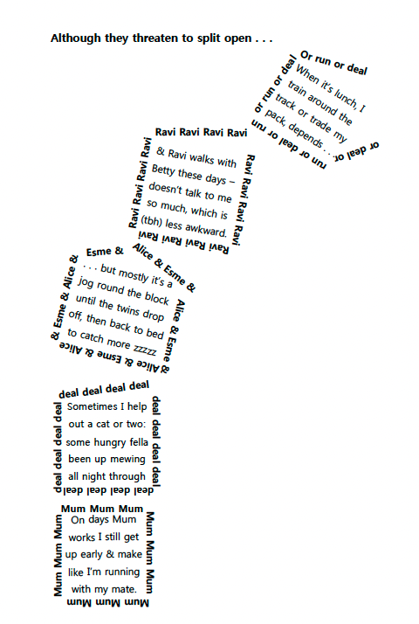
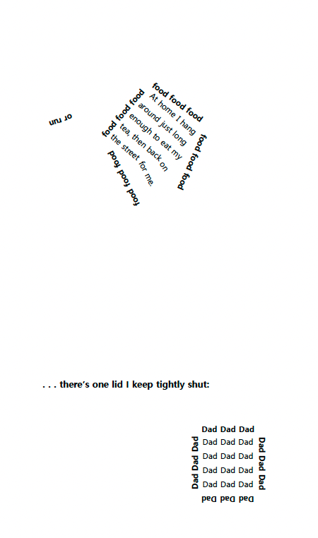
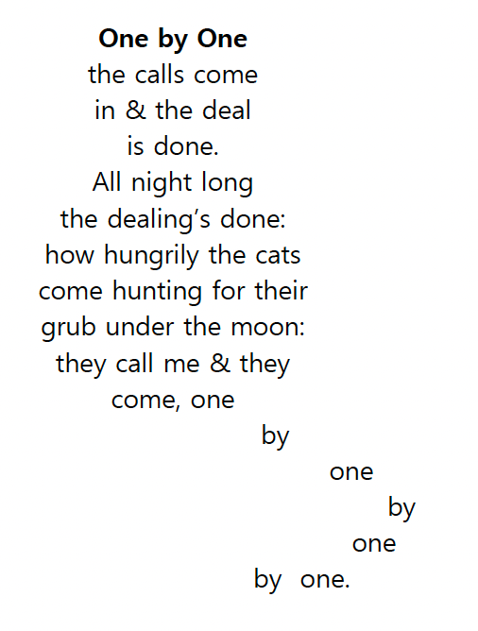
ACTIVITY: CONCRETE POETRY (p55, p136, p154)
Before you read these poems, squint at them to look at the shape. What do you think they will be about? Now read them.

Slide 18
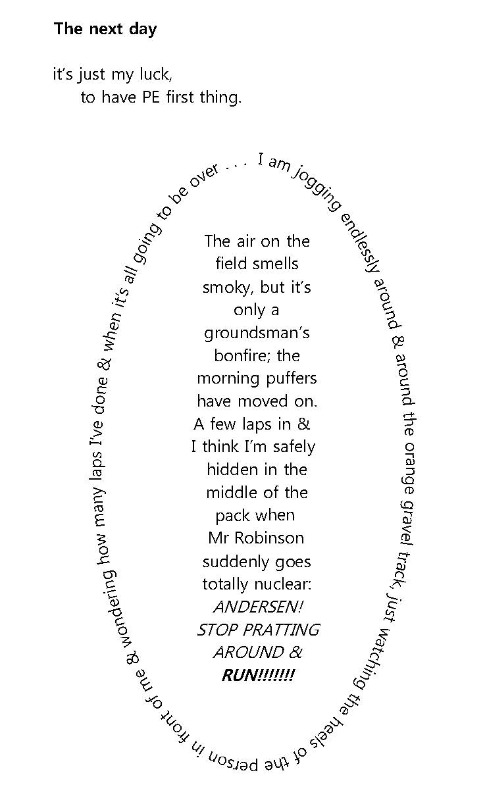
ACTIVITY: CONCRETE POETRY (p55, p136, p154)
  This kind of shaped poem is often called a ‘concrete’ poem. Why do you think this is? How does the shape of the poem add to your reading of it?
  Choose a piece of your own writing and rewrite it as a single concrete poem. You can choose a scene from a story you’ve already written, or the paragraph you wrote about your ‘safe place’ from the ‘Safety’ section in these resources. Think about the essence of what you want to convey. There are lots of ways you can do this – have a look at these examples here: https://becomeawritertoday.com/concrete-poem-examples

Slide 19
EXTENSION ACTIVITIES: CONCRETE POETRY
  Look at the different forms of poetry on this webpage and have a go at the exercises. https://poetry4kids.com/lessons/how-to-write-a-concrete-poem
  Calligrams are when just an individual word take on the shape of its meaning. Can you find an example of a calligram in the excerpts from Crossing the Line in these resources? Draw or type a calligram from any of these words: fear, enormous, crumbling, angled.

