Slide 1
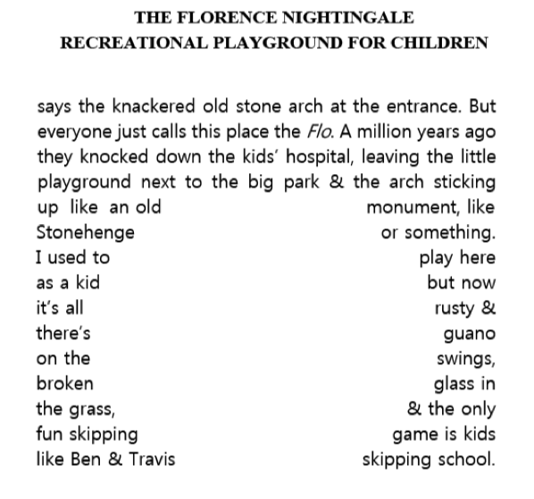
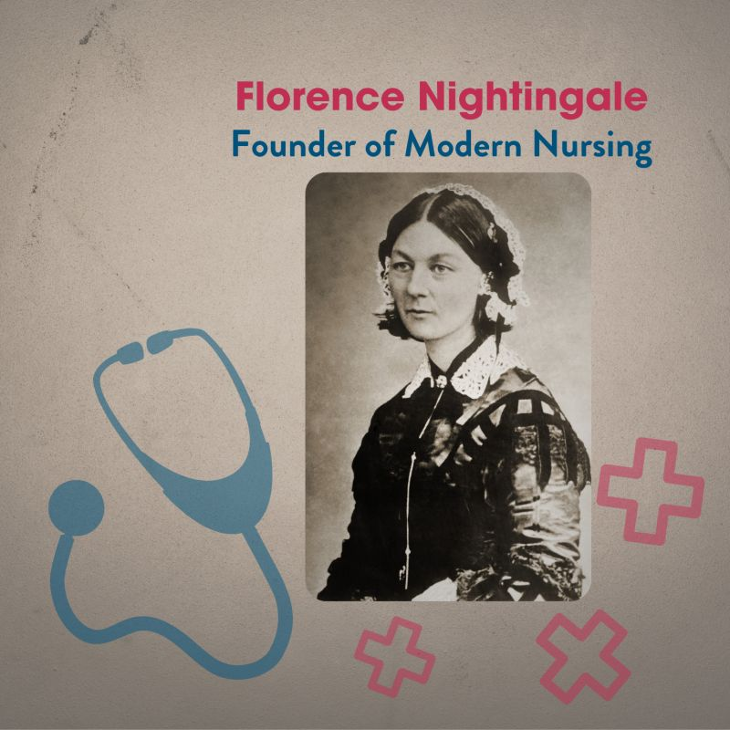
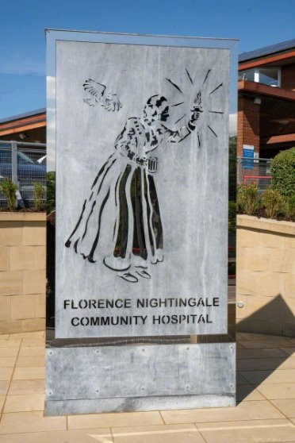
Do Now
What is the Flo?
What impression do you get of the Flo from the description?
Stretch it: What do we associate with Florence Nightingale? So how is the name of the park ironic?

Slide 2
Model response
The Flo is a rundown playground, once part of a children’s hospital.
It now feels abandoned and unsafe, with rust, bird droppings, and broken glass. Once a place of joy, it’s now a symbol of neglect and lost innocence.
The contrast between its caring name and current state is ironic because Florence Nightingale was a caring nurse who bought hope and healing, but the park is the opposite: hostile and decaying.

Slide 3
DQ: Can I describe a dilapidated and decrepit playground?
Know what happens in 'Boxes' and 'School'
Identify the imagery used in 'Boxes'
Analyse the imagery in detail

Slide 4
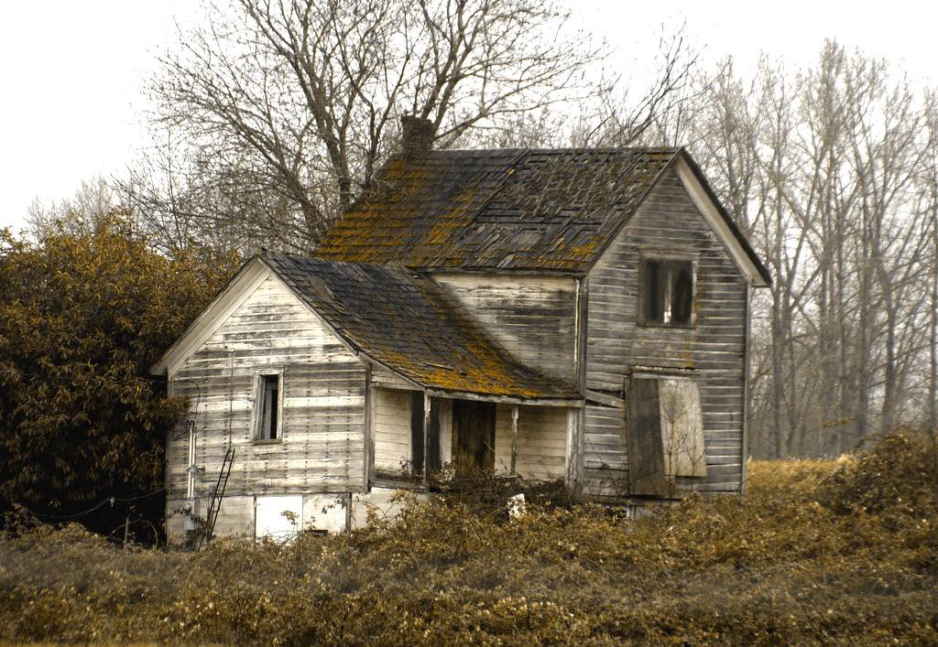
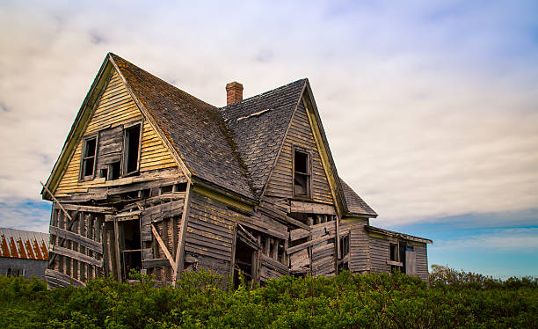
Based on the images, what do you think these words mean?
Dilapidated
Decrepit

Slide 5
Why are these good adjectives to describe the Flo?
Dilapidated
Decrepit
In a very bad condition because of age or lack of care.
Old and weak, especially from age or long use.

Slide 6
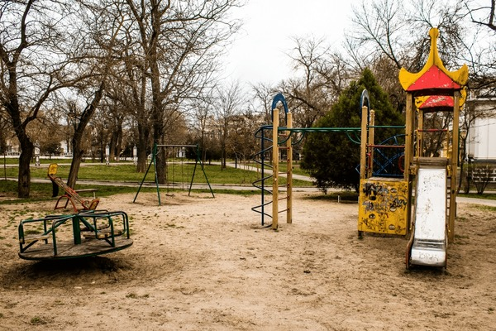
Creative Writing
Task: Write a description of ‘The Flo’ as suggested by this picture.
The picture is a starting point – remember to think about what might be out of the shot, or anything you want to add into the image.

Slide 7
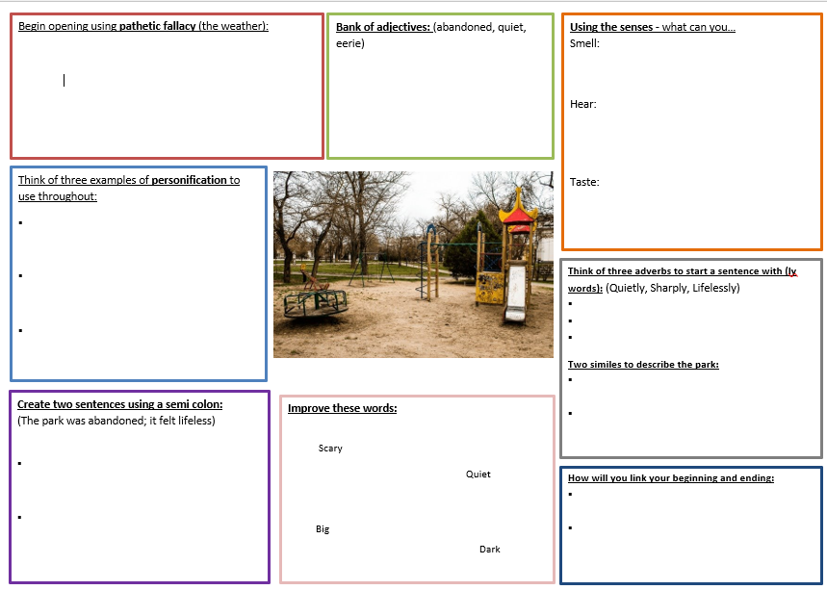
Plan!

Slide 8
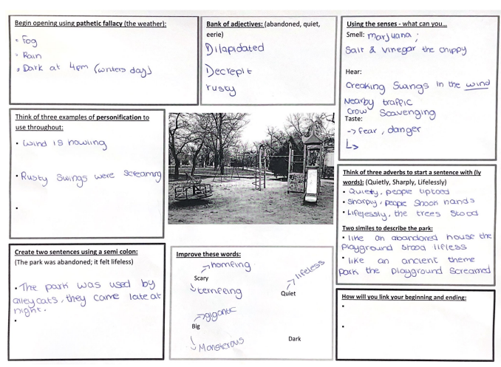
feedback

Slide 9
Free Writing: Zoom in on the setting
Once you have completed your planning sheet, I will give you twenty minutes to do free-writing, describing the setting of the Flo.
Sentence starter: The only sound was the protesting squeal of a recently-abandoned swing . . .
Stretch it: You could describe one aspect of the park as a concrete poem e.g. describe the swings in a paragraph that looks like swings.
Notes:
Free writing is a method of writing where the author focuses on continuous, unedited text output, without regard for grammar, spelling, or structure. It's a technique often used for brainstorming or overcoming writer's block, allowing for unfiltered thoughts and ideas to flow freely.

Slide 10
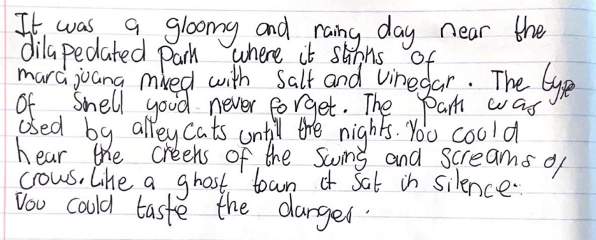
Model response

Slide 11
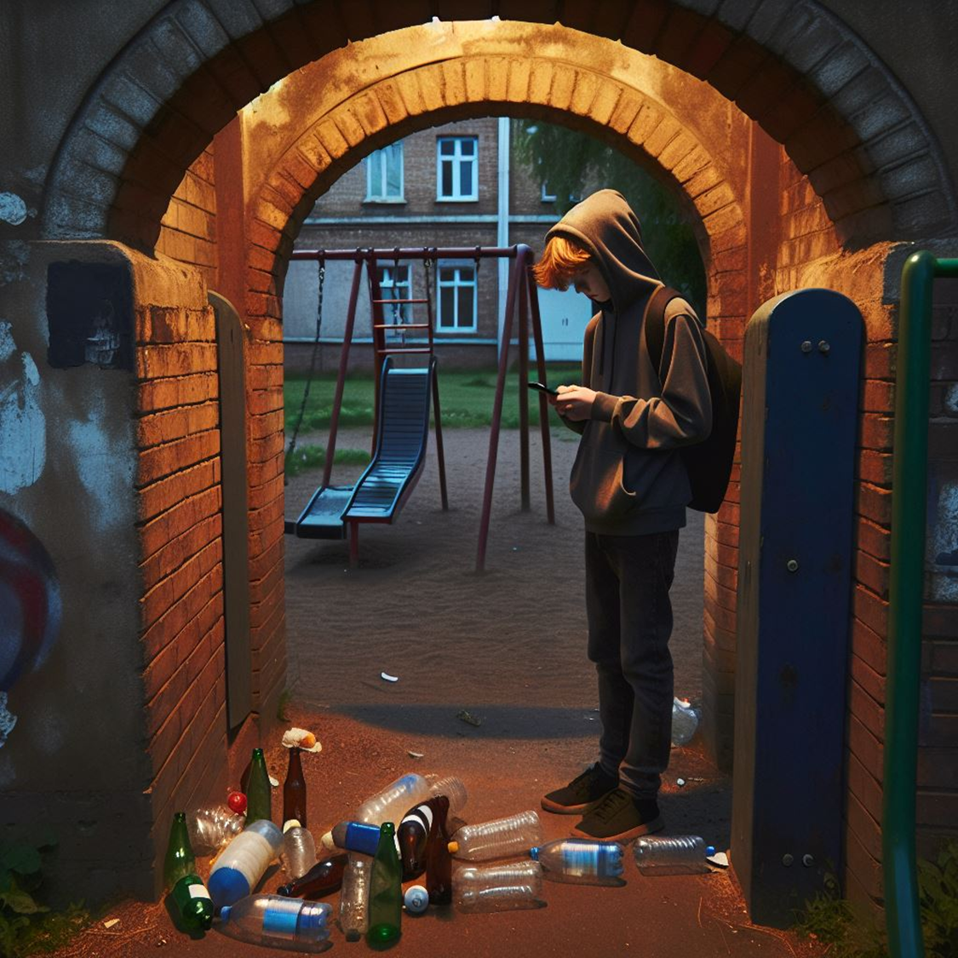
Zoom out – describe Erik waiting in the park
What is Erik doing in the park?
How does he feel?
What does he see and hear?
What is he thinking about?

Slide 12
Model response
Erik tapped the buttons on his phone as he cast his line for the next bite. Each click was punctuated with the rhythm of impatience; his face lit blue by the screen was tense.
Against the fading light, the swing seats swayed in wind as if they were shaking their heads in disapproval.
Like Ravi.
Erik stowed his phone angrily. What did he know anyway? Ravi had no right to judge.
His eyes darted to the alleyway, checking for a change in the shadows stretching out towards him. Was that a cat come calling for his food? Erik peered hard at the desolate Flo, at the streets beyond that stretched out into the night.

Slide 13
Stretch
Can you re-write the scene you write as verse?
Tips: Use as few words as possible
Use layout to add to the meaning
Let the reader do the work.

