Slide 1

Do Now
What lies has Erik told so far?
How is Erik’s life becoming more dangerous?
Why does Erik refuse to visit his dad’s grave?
What things does Erik find challenging at home?
What is the ‘Viking Line’?
Why do you think Erik calls it this?

Slide 2
DQ: How does Fisher use figurative language to reveal the impact of Erik's new job?
Know what happens in 'Boxes' and 'School'
Identify the imagery used in 'Viking Line' poem
Analyse what impact Erik's new job is having on his life

Slide 3
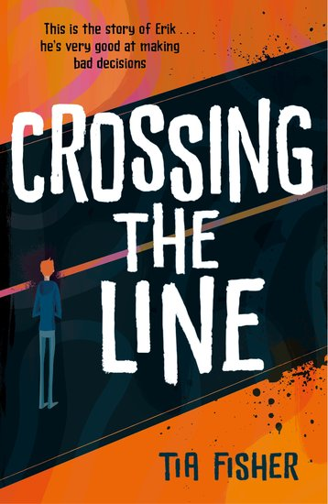
Let’s read:
Let’s all read Boxes
pages 152-162
As we read, consider:
What are your initial thoughts about this section of the text?
What do you think about Erik’s mum in this section?
What do you think about how Erik speaks to his mum?

Slide 4
Let’s read:
Let’s read School pg 164-178
As we read, consider:
What are your initial thoughts about this section of the text?
What do you think about Ravi?
What is your opinion of Mrs Raynor?

Slide 5
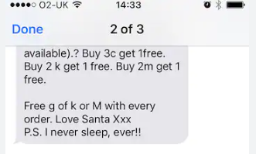
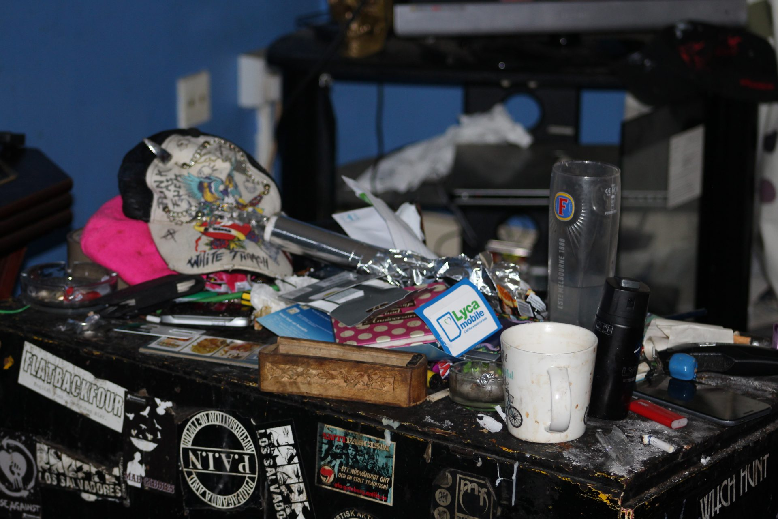

Word about
the Viking Line
spreads like a virus.
I’m busy
day & night
cutting | weighing | folding | sealing | running
Tired, yeah –
but
learning to
deal with it.

Slide 6
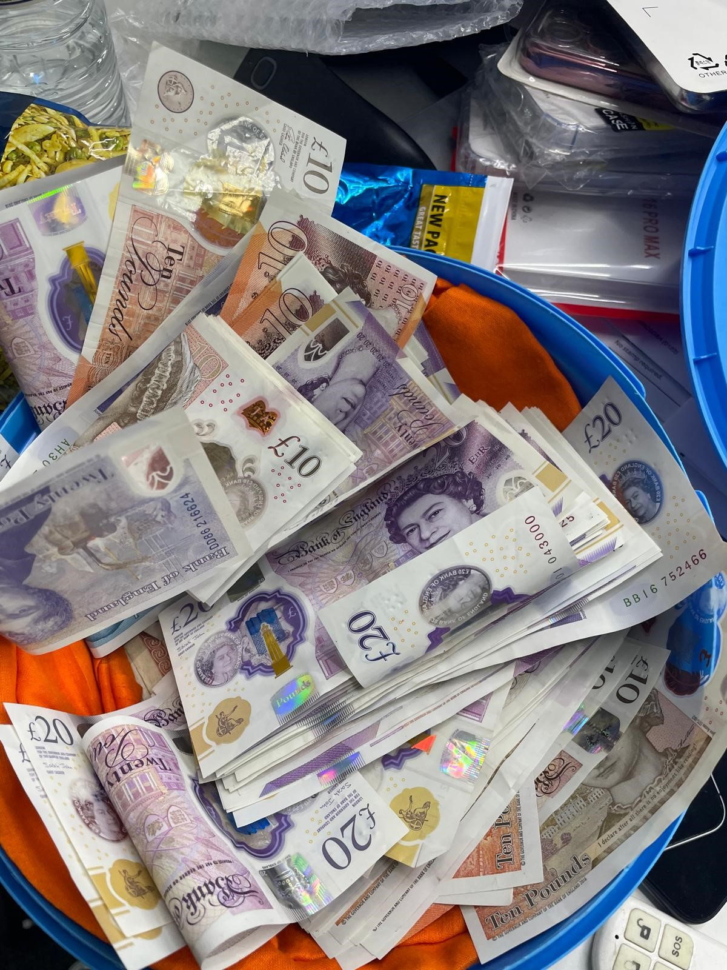

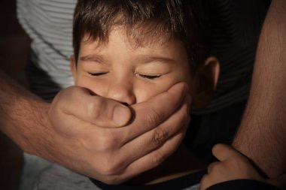
Putting money in my pocket
is like sucking in air.
I’m just gulping it.
By the end of June
it feels like
finally I can breathe –
like poverty’s taken
it’s sweaty hand
off my mouth.
In shops I exhale
cautiously

Slide 7
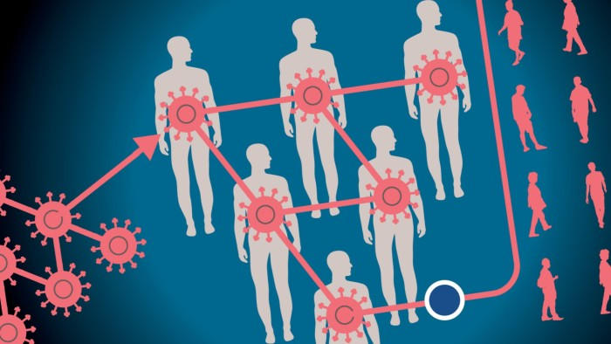
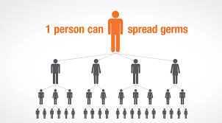
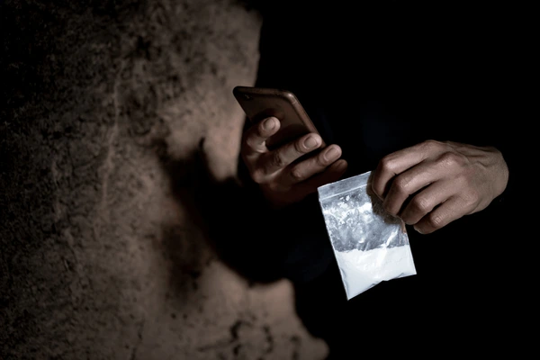
‘Word about the Viking Line spreads like a virus.’
What device does Fisher use here?
What is compared to a virus?
What are the connotations of a virus?
Where else is a virus mentioned?

Slide 8
Fisher uses imagery associated with death and destruction when talking about Erik’s drug’s hotline.
‘Word about the Viking Line / spreads like a virus.’ The simile suggests…the word ‘virus’ has negative associations such as ….
Which makes readers feel concerned for Erik because…
Fisher may have used this simile to teach readers…

Slide 9
Model response
Fisher uses imagery associated with death and destruction when talking about Erik’s drug hotline. ‘Word about the Viking Line spreads like a virus.’ The simile suggests that the information about the hotline is spreading quickly and uncontrollably, much like a disease. The word ‘virus’ has negative associations such as illness, infection, and harm, which makes readers feel concerned for Erik because it implies that his actions are dangerous and could have harmful consequences for others. Fisher may have used this simile to teach readers about the damaging and far-reaching effects of drug culture, showing how quickly it can infect and corrupt a community.

Slide 10
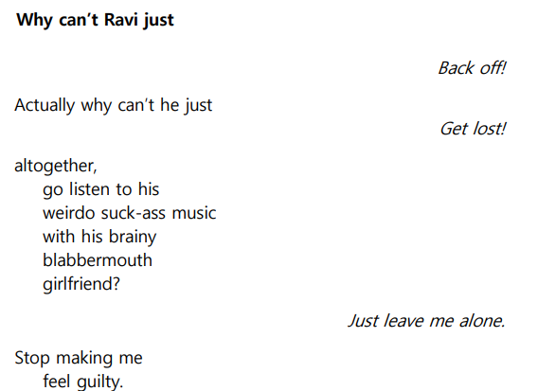
Exit Ticket
Why is Erik distancing himself from Ravi?
What concerns does Ravi have about Erik's behaviour?
Do you think this is the end for their friendship?
Stretch – describe how Fisher has mixed dialogue and narrative to tell this part of the story.

