Slide 1
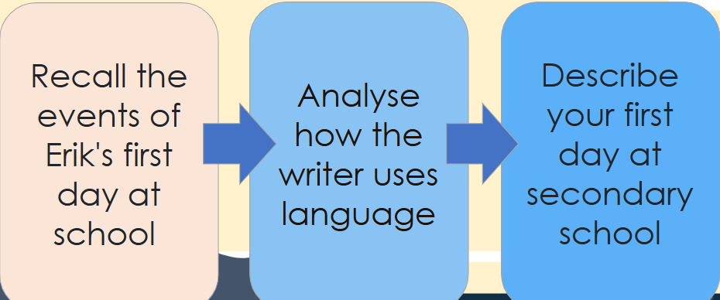
Do Now – Stop and Jot
Last lesson, we read about Erik's first day at Holland Road Secondary School. Write down what you can remember about it.
Erik's first day

Slide 2
DQ: Can I use ‘show not tell’ in a description?
Recall the events of Erik's first day at school
Analyse how the writer uses language
Describe your first day at secondary school

Slide 3
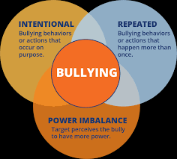
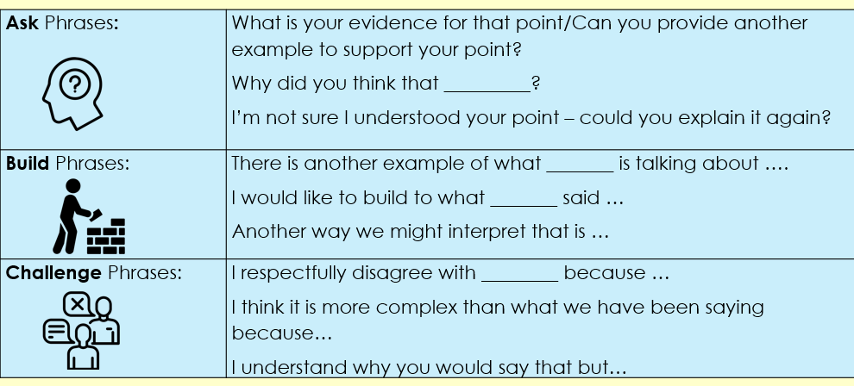
Was Erik bullied on his day of secondary school?
Turn & Talk

Slide 4
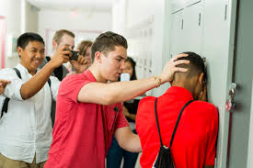
Today's Task
Write a one-page script about a year 7 being bullied by a year 9 child. In your script, have someone/a group intervene to stop the bullying.
Your script should include:
Dialogue that shows the power imbalance
A build-up of tension between characters
A turning point where someone or a group intervenes
An educational message or outcome that supports anti-bullying themes
Imagine this scene is being performed in an anti-bullying assembly.

Slide 5
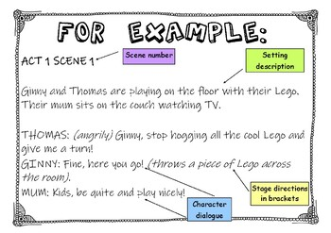
Features of a Playscript

Slide 6

Script Writing: Example
Title: Stand Up
Characters:
Josh (Year 7 – quiet, kind, new to the school)
Mason (Year 9 – the bully)
Ella (Year 8 – confident, notices what’s going on)
Sam & Amina (Year 7 friends of Josh)
Teacher (brief end appearance)
The school corridor, lunchtime. Josh is by his locker, getting books out. Mason walks past with a smirk and turns back.
Mason: (tauntingly) Well, well… if it isn’t the Year 7 who still carries a lunchbox. What’ve you got in there? Crayons?

Slide 7
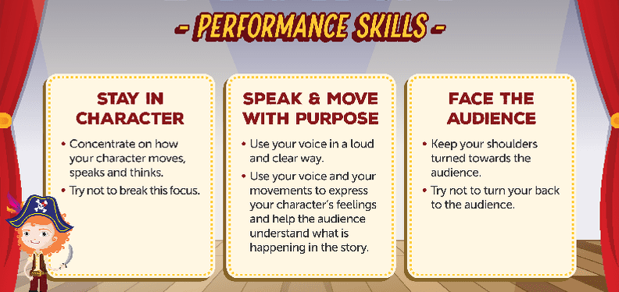

Opportunity to perform!

Slide 8
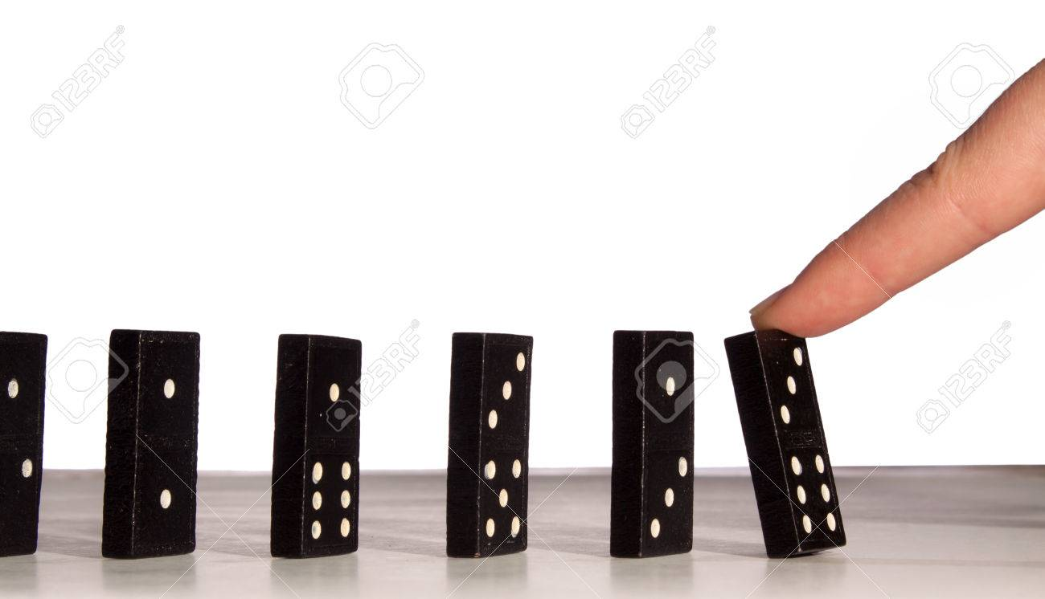
Exit Ticket
Do you think Erik's dominos would have begun to topple if he'd experienced a positive first day of secondary school?
What other events/dominos might happen to lead him to say 'there's so much else to be sorry for now'?
What is an extended metaphor?

