Slide 1
Do Now
Stick your statements into your book. 2 statements are right and 4 are wrong.
Erik is bullied for how he speaks | Erik is bullied because he has red hair | Foreshadowing is when the writer hints at events in the past
Erik uses the extended metaphor of falling dominoes for making bad decisions | Fisher wrote the novel in prose | Fisher wrote the novel to teach about social media
Around each statement:
Write 3-4 reasons why the statement is true/false .
Finished?
Can you find one quotation to support the statement?

Slide 2
DQ: How do Erik's experiences make him more likely to be taken advantage of?
Define ‘susceptible’
Analyse the impact of events on Erik
Explain how Erik is becoming more ‘susceptible’

Slide 3
Erik is presented as vulnerable on his first day of secondary school because of the bullying he experiences.
The bullying, and his punishment by the Headteacher, are some of the first events that lead Erik to his 'bad decision'.
In the section we are going to read today, Erik continues to face challenges and is becoming more susceptible to being taken advantage of.

Slide 4
Vocabulary:
Stick in your frayer model of your new word, susceptible
Definition: Susceptible means easily affected or influenced by something. | New word: Susceptible (noun) | Used in a sentence: Erik is becoming more susceptible to being exploited through county lines.
Synonyms vulnerable at risk |  | Sub- = under Capere = to take or catch So originally, susceptible meant “able to be taken or influenced by something.”
Around the outside of your frayer model:
Can you think of two more synonyms?
Write three more sentences using the word
Notes:
Predisposed towards, impressionable, suggestible,, temptable, capable, convincible, persuadable, pliable, open to, receptive to …

Slide 5
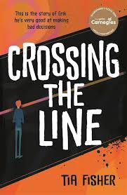
Let’s read:
Lockdown,
pages 18-22
As we read, consider:
How is life becoming harder for Erik?
What impact is this having? What are the 'dominoes’ toppling in this chapter?

Slide 6
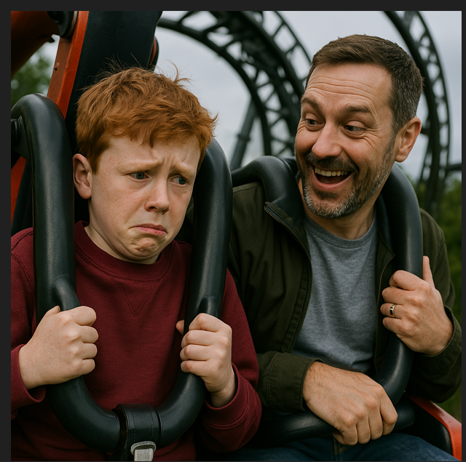
Let’s read:
Jonny, pages 24-38
As we read, consider
How is life becoming worse for Erik now?
What impact is this having? What are the 'dominoes’ toppling in this chapter?
How would you feel if you were Erik?

Slide 7

The extended metaphor
Turn & Talk
Erik continues to face challenges, which makes him even more susceptible to being exploited by County Lines gangs.
What has gone wrong for Erik in the section we've read today?
Bullied at school
Lockdown
Dad died
Mum and Erik not able to grieve together.
Mum's new partner
Mum pregnant with twins
Partner leaves
Mum upset
Skint
How do these events/dominoes make Erik susceptible to grooming?

Slide 8
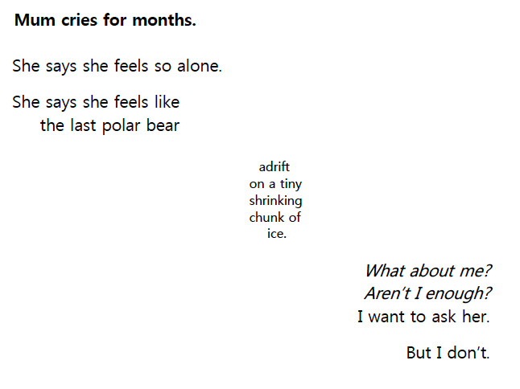
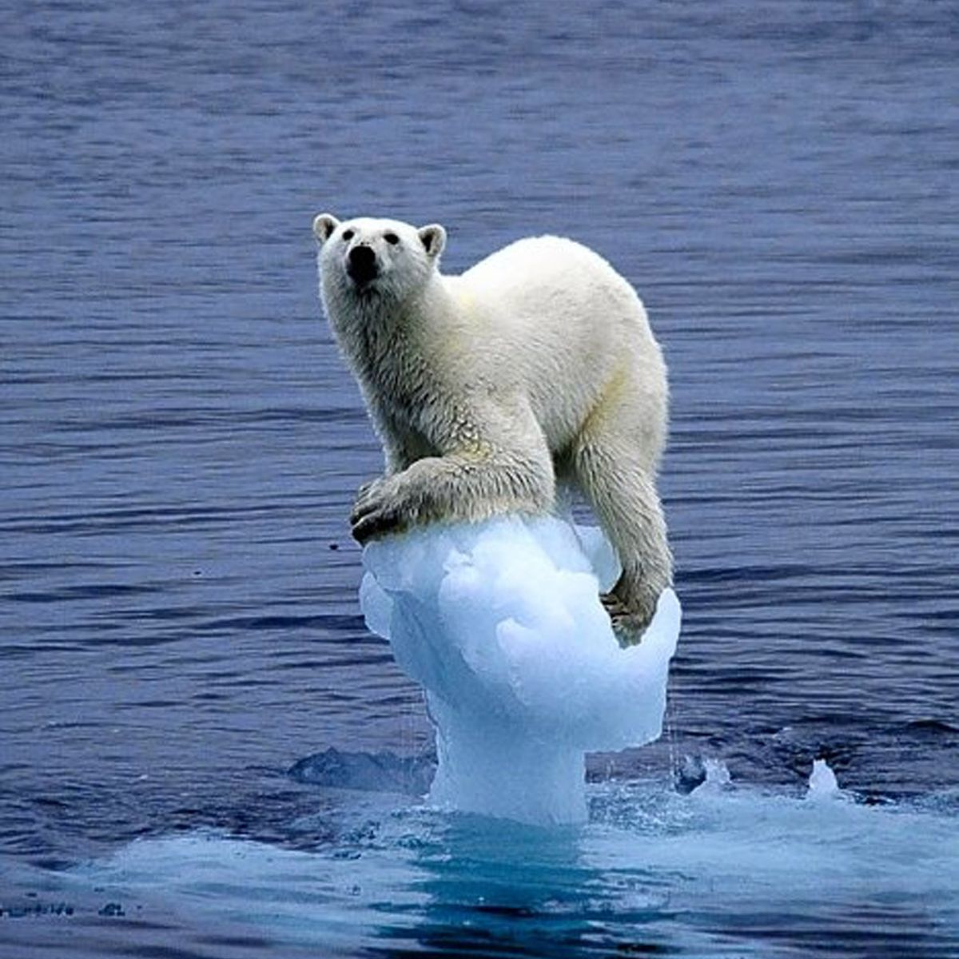
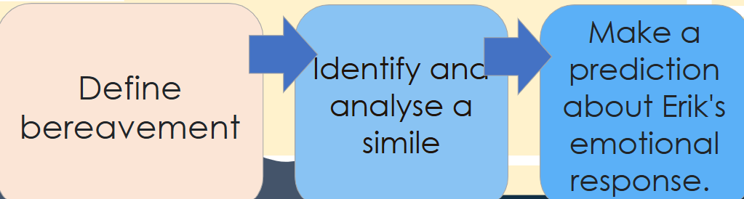
Stick this poem into your book.
How do Erik's experiences make him more likely to be taken advantage of by gangs?
Do you think he's getting enough attention at home?
What impact might that have on Erik?
How might this make him more susceptible to grooming?

Slide 9
How do Erik's experiences make him more likely to be taken advantage of by gangs?
'now we’re totally skint’.
What does the word ‘skint’ mean?
How might this make him vulnerable to exploitation?

Slide 10
Intervention
What do you think could be done for Erik at this moment to support him and to stop his downward spiral? Which different people could help him?

