Slide 1
Do Now
If this is the answer, what is the question?
Be as creative as you can.
Question ___________
Answer: Ravi
Question ___________
Answer: Parentification
Question ___________
Answer: K1
Question ___________
Answer: Travis & Ben
Question ___________
Answer: dilapidated
Question ___________
Answer: Exploitation

Slide 2
DQ: How does the article present the impact of County Lines?
Research a real-life County Line Exploitation victim
Summarise how the article shows the dangers of CLE
Compare and contrast the victim's life before and after CLE.

Slide 3

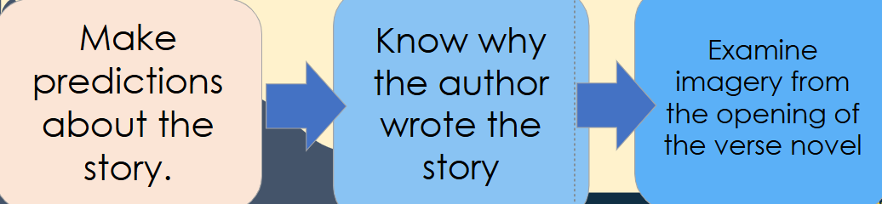
Key Word
Can you put ‘county lines’ and ‘exploitation' in a sentence about Erik, the protagonist in our verse novel?
Definition County lines is a form of child criminal exploitation which involves gangs forcing young people to carry drugs to different areas and sell them, putting the children at great risk. | New term County Lines Child Criminal Exploitation | Used in a sentence Erik had a good future ahead of him before he was exploited by a county lines gang.
Etymology "County lines" refers to gangs using phone lines for drug trafficking between areas. "Exploitation" comes from the Latin explotare, meaning "to take advantage of." |  | Related words drug routes trafficking networks abuse oppression coercion

Slide 4
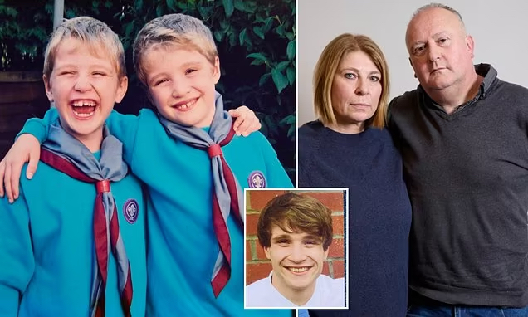
Real life story
Today we’re going to read a real-life article about a boy named Sam, who grew up in a loving family, but was tragically exploited by county lines drug gangs. The article is based on interviews with Sam’s devastated parents.
This article is powerful, emotional, and quite upsetting in parts – but it’s also incredibly important.
Like in 'Crossing the Line', It shows us how easily teenagers can be targeted, the signs that parents sometimes miss, and the terrible consequences of being drawn into gang life.
Notes:
Teachers – see Lesson 14 Word doc for the article.

Slide 5

Read
As we read, I want you to think about:
How does the writer make us feel sympathy for Sam and his family?
What message is the article trying to send to parents and young people?
How might real-life stories like this have motivated Fisher to write 'Crossing the Line'?
GLOSSARY
Grooming – Building trust in order to control or harm someone.
Vulnerable – At risk of harm or being used.
Trafficking – Moving people illegally for harm.
Coercion – Forcing someone to do something.
Safe House – A secret place to hide drugs or people.

Slide 6

Mini Whiteboards!
Silent Practice
A word to describe Sam's early life.
A word to describe how Sam's life changed.

Slide 7
How does the writer use language to show the contrast between Sam’s early life and his later experiences?
Complete this table with quotations from the article.
Early Life Quotes | Later Experiences Quotes
“Sam was a happy little boy. Cheeky, very funny, handsome, with many school friends and always laughing” | “At 18, Sam suffered a heroin and Valium overdose”
How does the contrast emphasise the tragedy?

Slide 8
What does this article show us about the impact of County Lines Exploitation on victims?
Turn & talk
This article highlights the devastating impact of County Lines exploitation by...
The fact that Sam went from a "happy little boy" to someone who was "pleading for help" shows...
Stretch it
Include a quotation.
Link it to Erik's story.
Sophisticated vocabulary: Devastating, tragedy, victim

Slide 9
How does the writer use language to show the contrast between Sam’s early life and his later experiences?
“It was a happy, joyful, safe, middle-class childhood”
The article highlights the devastating, _________ and _______ impact of County Lines. At the start of the article, we learn Sam had ‘a happy, joyful, safe, middle-class childhood’. The pattern of three highlights ______________________________________________________. The word ‘joyful’ implies ___________________________________________________________. However, later in the article Sam’s life becomes _____________ because _______________________. ‘At 18, Sam suffered a heroin and Valium overdose’. The age ‘18’ emphaises _________________ and draws readers attention to _________________________. This quote is a shocking contrast to earlier in the article which makes us think __________. The article was written to warn readers that __________________________________________
At 18, Sam suffered a heroin and Valium overdose,

Slide 10
Exit Ticket
Based on your research on the topic today, is the character of Erik in 'Crossing the Line' realistic?
Has Fisher made him too exaggerated, or do you think he is an authentic portrayal of a County Lines victim?
Explain what you base your opinions on.

