Slide 1
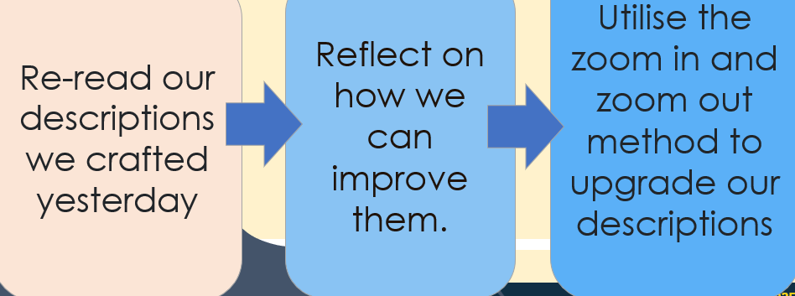
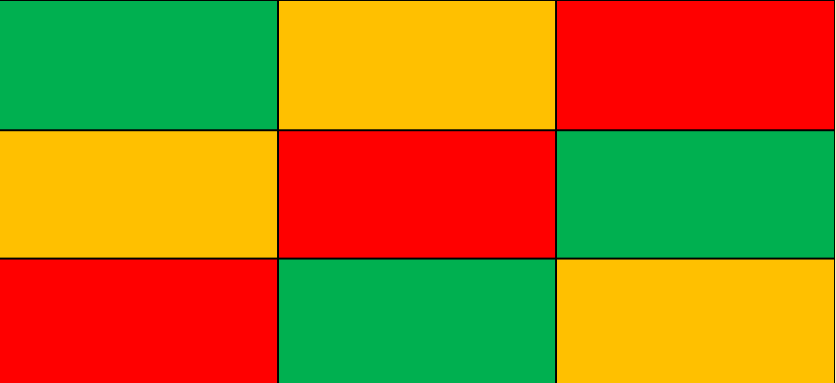
Knowledge Retrieval Challenge
What can you remember about …
Try to earn as many points as you can by remembering information from past lessons.
Key = from this week (1 point), from last term (2 points), from two terms ago (3 points)
Question?
Question?
Question?
Question?
Question?
Question?
Question?
Question?
Question?
Key = from this week (1 point), from last week (2 points), from two weeks ago (3 points)
Key = from this week (1 point), from last week (2 points), from two weeks ago (3 points)
Notes:
Teachers - Write your own revision questions and adjust the time period to your needs

Slide 2
Feedback – How many points have you got?
What can you remember about …
Try to earn as many points as you can by remembering information from past lessons.
Key = from this week (1 point), from last term (2 points), from two terms ago (3 points)
Question?
Answer
Key = from this week (1 point), from last week (2 points), from two weeks ago (3 points)
Key = from this week (1 point), from last week (2 points), from two weeks ago (3 points)
Key = from this week (1 point), from last week (2 points), from two weeks ago (3 points)

Slide 3
DQ: Can you remember the detailed plot of Crossing the Line?
Create a timeline
Write chapter titles and summarise plot events
Think about the ending of the book

Slide 4
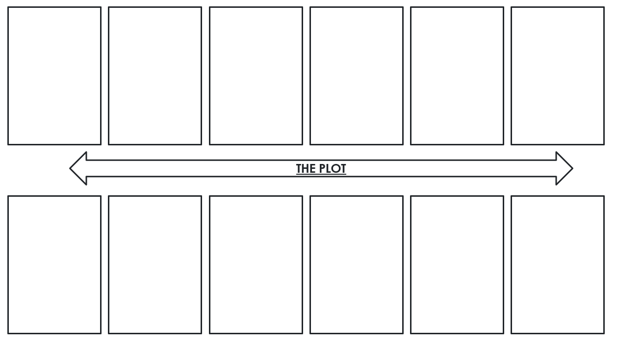
Independent Practice
How much of the plot can we recall?
Create a timeline of the key events of the plot in chronological order. Use your exercise book to help.
Ensure every box is filled and that you refer to chapter titles.
Finished?
Think about the ending of the book. Is there a logical progression towards that ending? Can you think of an alternative ending?

Slide 5
THE PLOT

Slide 6
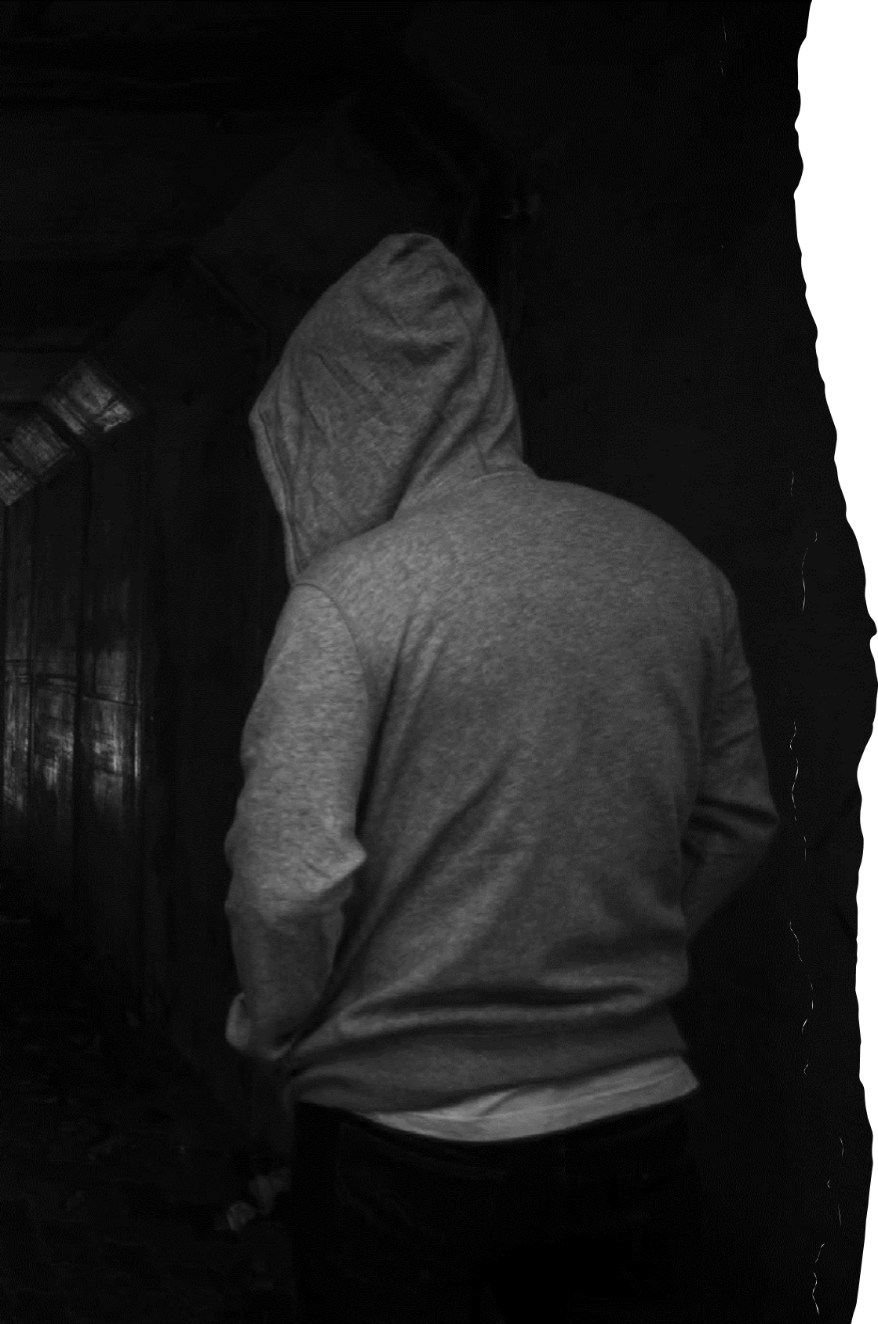
Exit Ticket
Was this a satisfying ending?
In your opinion:
Is this verse novel successful in raising awareness about
county lines exploitation?
Write a short paragraph detailing why.
Why do you think Fisher may have ended it this way?
Is there anything you wanted to know more about?
What questions do you have that are still unanswered?
Do you think she should write a sequel? Why do you think this?

