Slide 1

Do Now
Story re-cap
1) What is the name of the man that Erik’s mum dates?
2) What does exploitation mean?
3) What advice would you give to Erik right now?
4) What does susceptible mean?

Slide 2
Model response
One piece of advice we could give to Erik is to work hard in school to eventually get out of poverty.
Let me tell you my own story about how working hard at school transformed my life for the better....

Slide 3
DQ: How does the writer show Erik's ‘parentification’?
Know the difference between doing chores and parentification
Identify how Erik has become parentified
Explain how Erik is becoming more susceptible to CLE

Slide 4
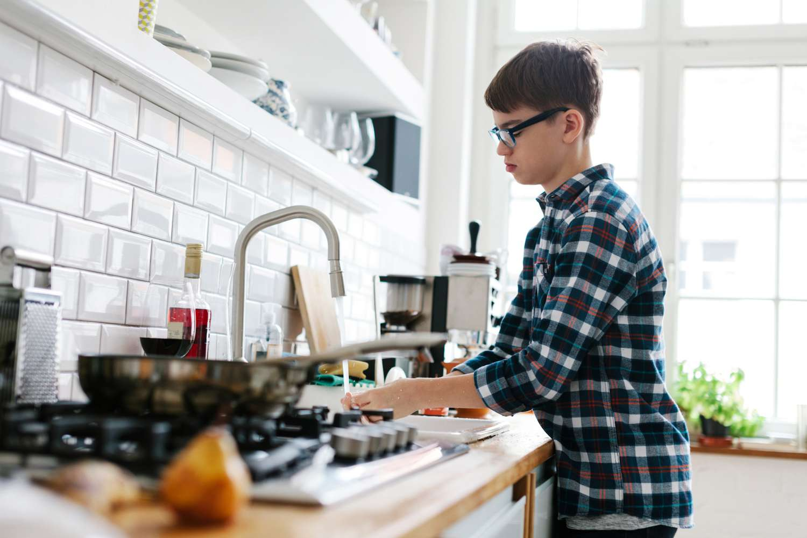
New vocabulary
Write out the new word 'parentification'
Say it out loud together!
Definition: when a child takes on the role and responsibilities of a parent, | New word: Parentification | Used in a sentence: Parentification meant Emma didn’t have a proper childhood –she had to care for her younger siblings and look after her mum too.
Synonyms: Carer |  | Etymology -ification (from Latin -ficare, meaning "to make or become")
Tia Fisher (the writer) used this word in an interview to describe Erik once the twins arrived.
Why might she have used this word?
Look at the etymology too

Slide 5
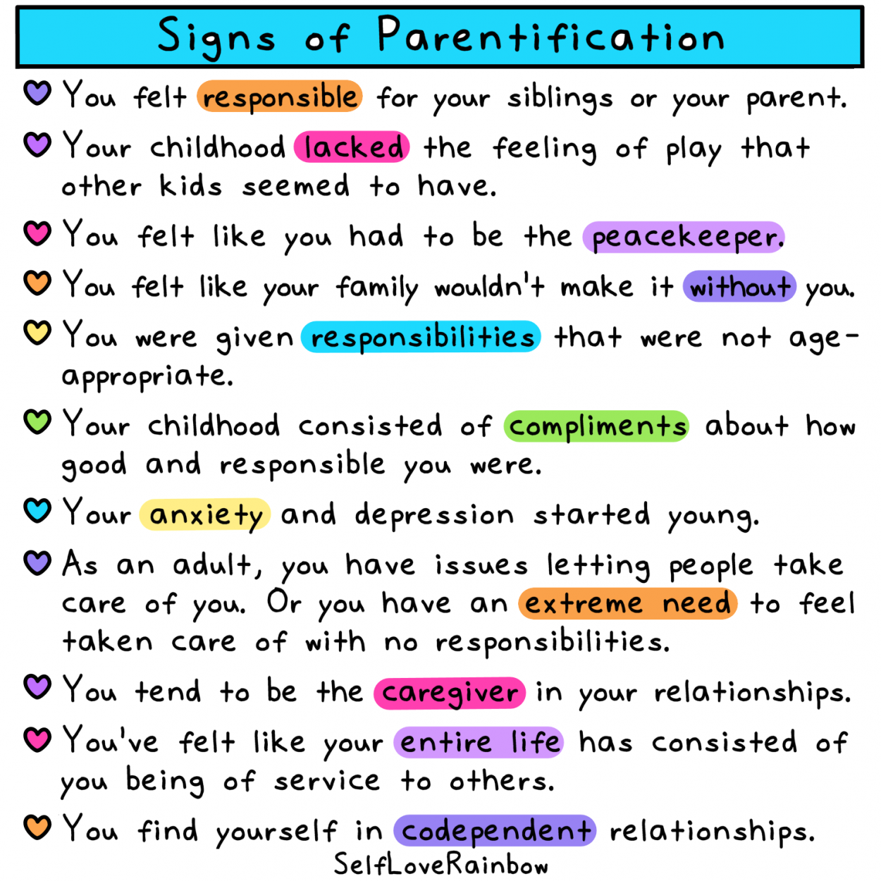
What is the difference between doing chores around the house and parentification?
What chores do you do?
Turn & Talk
Typical teenager chores and responsibilities:
Taking out the rubbish and recycling
Gardening
Doing laundry and ironing
Changing your own bed sheets
Cooking a few meals
Shopping for groceries
Kitchen cleaning
Pet walking and feeding
Keeping your bedroom tidy
Being responsible for younger siblings
Babysitting
Watering plants
Returning packages to the post office
Taking all mugs and plates from your room every day
Managing your own money

Slide 6
Let’s read:
The Twins pages 40-48
As we read, consider:
What has happened between Jonny's mum and Jonny?
How does Erik feel about his twin sisters?
How does Erik feel about his mum?
What powerful adjectives would you use to describe Erik in this section?
How can the keyword ‘parentification’ be applied to this section?

Slide 7
Let’s read:
Broke and Broken pages 50-64
As we read, consider:
What are your initial thoughts about this section of the text?
How is Erik coping with all the changes?
What is your opinion of Ravi and his family?

Slide 8
Silent Practice
What advice did the Welfare Officer give Erik on page 51? Do you think this was appropriate advice? Explain your answer.
Why might Erik have been scared to tell the Welfare Officer what was really happening at home?
When Erik, feeling tired and fed up, replies “yeah, whatever” to the Welfare Officer, he is ‘removed’ to the Blue Room. How does this moment link to the extended metaphor of dominoes? Can you use the word susceptible in your response?
If Erik had shared what was happening at home, what types of support do you think could have been put in place for him and his family?

Slide 9
Model response
Perhaps if Erik was in our school and they spoke to their form tutor/head of year for advice, they might suggest:
Eating a free breakfast at school
Having somewhere to rest in the school day
Providing a place to study after school
Offer for help with food: https://www.yourlocalpantry.co.uk/pantry-listings/birmingham-yardley-wood-pantry/
By sharing, Erik's life would become easier. By keeping it a secret, more dominoes are stacking up.

