Slide 1
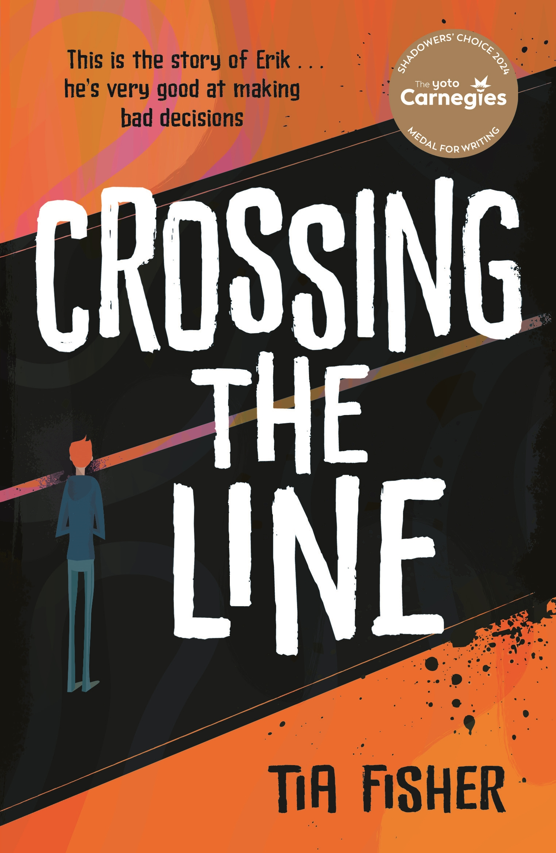
Thanks to Lucy Lewis, Head of English at Christ Church Secondary Academy School,
who allowed me to develop further the excellent resources she devised for her own classes,
and gave her permission to share them
with you here.
​
Please feel free to adapt for your own needs.
​
Tia Fisher September 2025.

Slide 2
Do Now
Look at the front cover of the book we’re about to read.
1.What does ‘crossing the line’ mean literally and metaphorically?
2.What ‘bad decisions’ do you think Erik is going to make?

Slide 3
DQ: How is Erik affected by his involvement in county lines?
Know why the author wrote the story
Examine imagery from the opening of the verse novel
Make predictions about the story.

Slide 4
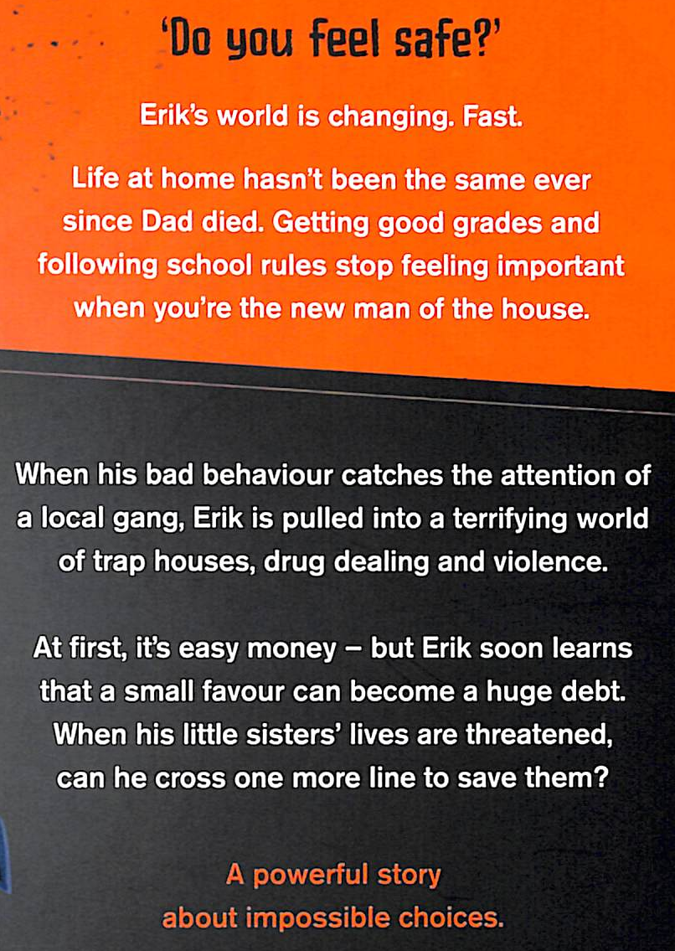

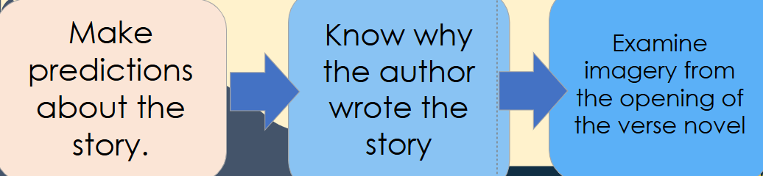
The Blurb
What predictions or ideas can you make based on the blurb
Consider: characters, plot, time/era, genre, target audience
Why do you think this has been written as a verse novel?

Slide 5
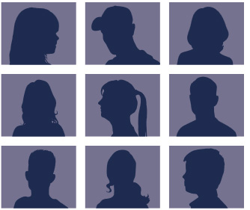
New vocabulary:
Stick your Frayer Model into your exercise book for your new vocabulary ‘county lines exploitation’.
Definition ‘County lines’ is a form of Child Criminal Exploitation (CCE) where gangs force young people to carry drugs to different parts of the country and sell them, putting themselves at great risk. | New words county lines exploitation | Used in a sentence Jimmy had a good future ahead of him before he got exploited by a county lines gang.
Etymology "County lines" refers to gangs using phone lines for drug trafficking between areas. "Exploitation" comes from the Latin explotare, meaning "to take advantage of." |  | Synonyms Drug routes Trafficking networks Abuse Oppression

Slide 6
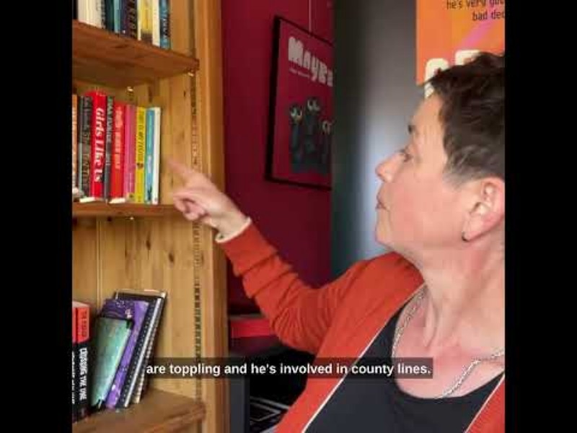
Your task:
Watch the video of Tia Fisher.
As we watch:
Continue to write around your Frayer Model with anything else we learn about county lines

Slide 7
Let’s read:
These words are taken from the back of Crossing the Line p355. We will read them together.
In 2019, my friend’s fourteen-year-old son – who’d been bullied and was disruptive at school – became aggressive. He was staying out all night, smoking weed. At first, his parents put it down to ‘teenage’, but by the end of that year he was so ill with anxiety, he’d stopped eating; he was so scared, he couldn’t even walk across town.
What was he so scared of? Eventually he confessed. Gangs. He’d been running drugs and weapons for a gang, and now he wasn’t safe anywhere. They were even threatening his family: it felt like there was no escape.
That was the first I’d ever heard of ‘county lines’ child exploitation. County what? I hunted around for information, but most of what I found was buried in police reports and documentaries. Although authorities already suspected there were tens of thousands of children in England being exploited by gangs to run and sell drugs, these children’s experiences weren’t reflected in books, or films, or on TV.
That’s why I wanted to write about it: to spread the word about this destruction of so many young lives. Lockdown made it much worse: today county lines is an epidemic among Britain’s vulnerable young people. If it’s happening to you or to a friend, I want you to know you aren’t alone, you aren’t to blame, and you can reach out for help.
My friend’s son is now, thankfully, safe, and he’s piecing his future together. He wants to help others if he can, and we talked for hours while he answered my many questions. I’ve used my imagination, of course: Erik’s story, as I have written it, is fiction, but many of the details of my character’s recruitment (grooming) and his life selling drugs in a regional city are real and came from our conversations. Because I was writing outside my own experience, it was my responsibility to do a lot of research: I read reports, the little fiction I could find, and listened to youth workers, to other young people and to families of county lines victims.
I’m very grateful that The Children’s Society gave their time to talk to me and read Crossing the Line for authenticity. They know that children caught up in county lines are victims, not criminals, and they work to get them vital support and protection.
If you recognise yourself, or anyone you know, in Erik’s story, then please don’t feel you have to cope with by yourself. I can’t promise a magic wand – I wish I could – but I hope very much that you will find someone, perhaps in the previous pages, who will listen to you and help.
As we read:
Why do you think we have chosen to read this book in school?

Slide 8
Turn & Talk
Independent Practice
What were some of the signs that the boy’s situation was becoming more serious?
What was the initial reason the boy’s parents thought his behavior was changing?
What did the boy eventually confess was causing his fear?
What is 'county lines’ criminal child exploitation, and how is it related to the boy's story?
What does the author say about the information available on county lines when she first heard about it?
How did lockdown impact the issue of county lines, according to the author?
What does the author hope to achieve by writing about county lines exploitation?
What steps did the author take to ensure the story was authentic and based on real experiences?
What message does the author want to send to readers who might be experiencing something similar to Erik’s story?

Slide 9
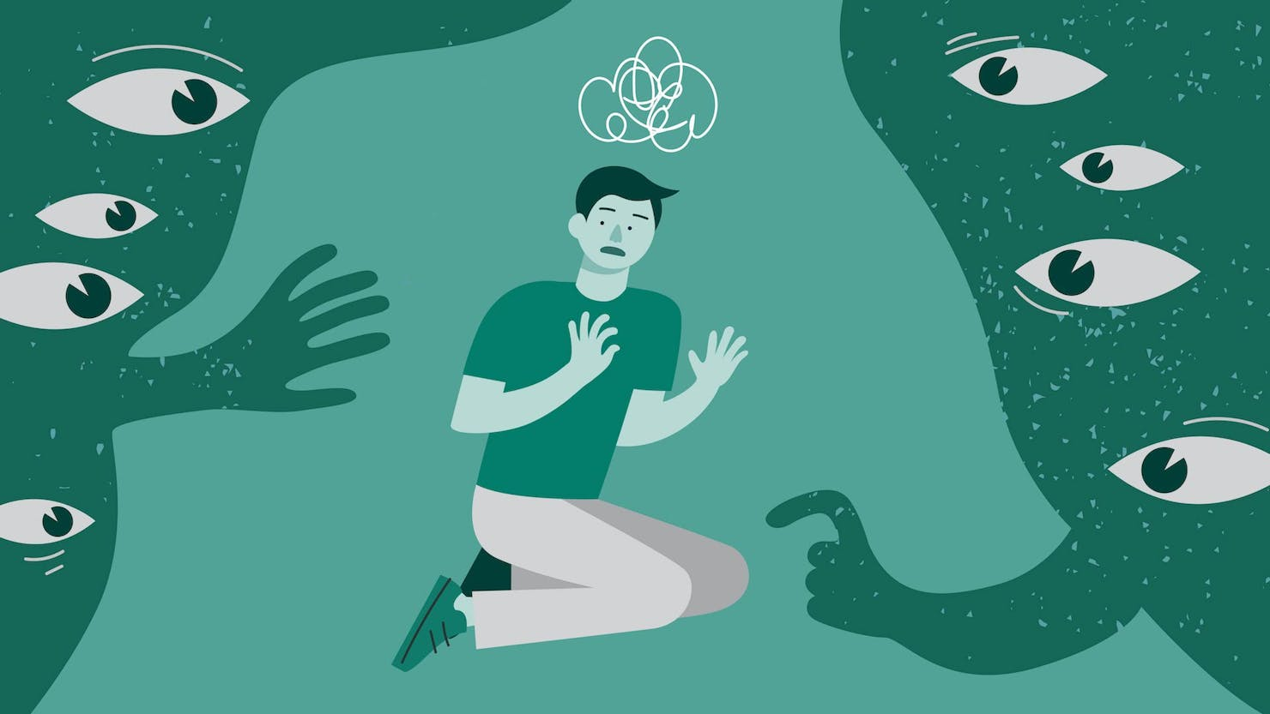
New vocabulary
Say it out loud together!
Definition: Hyperviligance is a state of increased alertness and sensitivity to potential threats in the environment. Causes of hypervigilance: Trauma, PTSD, anxiety disorders, childhood adversity. | New word: Hypervigilant Hypervigilant | Used in a sentence: Erik is hypervigilant – he jumps at the sound of a car backfiring and looks around him before he leaves the house in case he’s being watched.
Synonyms for vigilant (adj): Watchful Alert Attentive On the lookout On guard |  | Etymology: ‘hyper’ a prefix meaning over, above or beyond ‘vigilant’ from the Latin word ‘vigil’, meaning awake, watchful

Slide 10
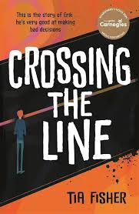
Let’s read:
Pages1-2
As we read, consider:
Who says, ‘A question for you?’ Who are they talking to?
Why do you think Erik doesn't feel safe?
How is Erik's life affected by the bad decisions he has made?
Where is Erik showing signs of hypervigilance?

Slide 11
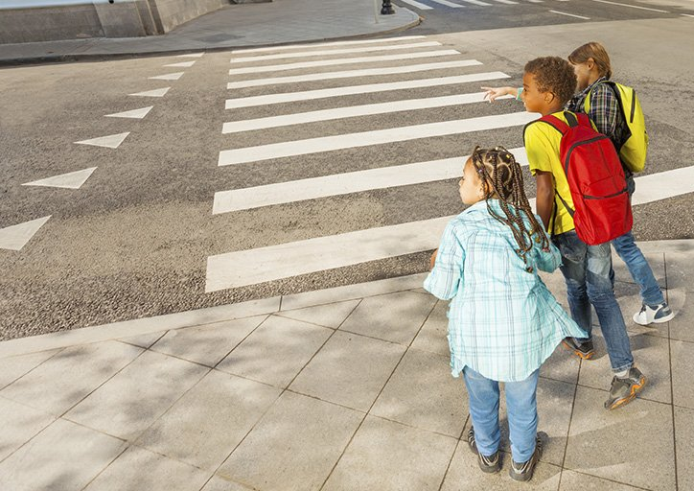
How has Erik's life been affected by his bad decisions?
cautious as a little kid crossing the road
What does this simile suggest about the impact of
county lines exploitation on Erik's life?
How is his hypervigilance manifesting itself?
Do you think he is right to watch out for danger all the time?

Slide 12
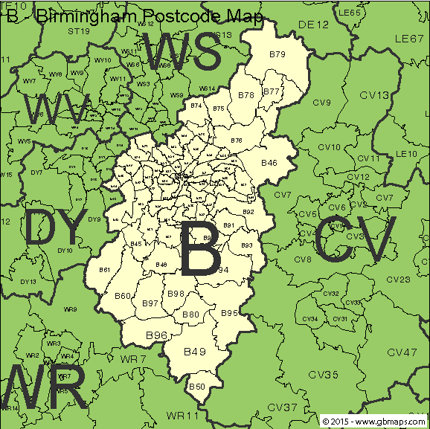
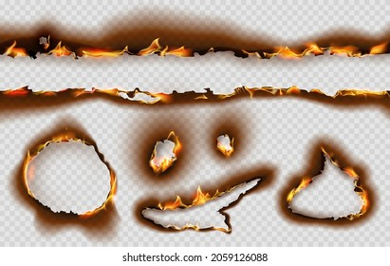
How has Erik's life been affected by his bad decisions?
the map of [the] city is riddled with holes of black scorched no-go postcodes … [my] life’s worth less than paper
Why do you think Erik can't go to some places in the city?
Do the gangs care about him? How do you know?
Where are the justifications for Erik’s hypervigilance here?
What does the imagery 'scorched' suggest? Think about what creates scorching and how fire can cause irreparable damage. Can you talk about this imagery in depth?

Slide 13
How has Erik's life been affected by his bad decisions?
the map of [the] city is riddled with holes of black scorched no-go postcodes … [my] life’s worth less than paper
In the opening of the verse-novel, readers learn the extent that Erik’s life has been negatively impacted by his bad decisions and that there are parts of his city he can’t go into. ‘My life’s worth less than paper’ – why do you think Fisher has used the image of ‘paper’?
Notes:
Paper = worthless, the map, and county lines term for ‘money’ – ‘Gimme the paper, man!’

Slide 14
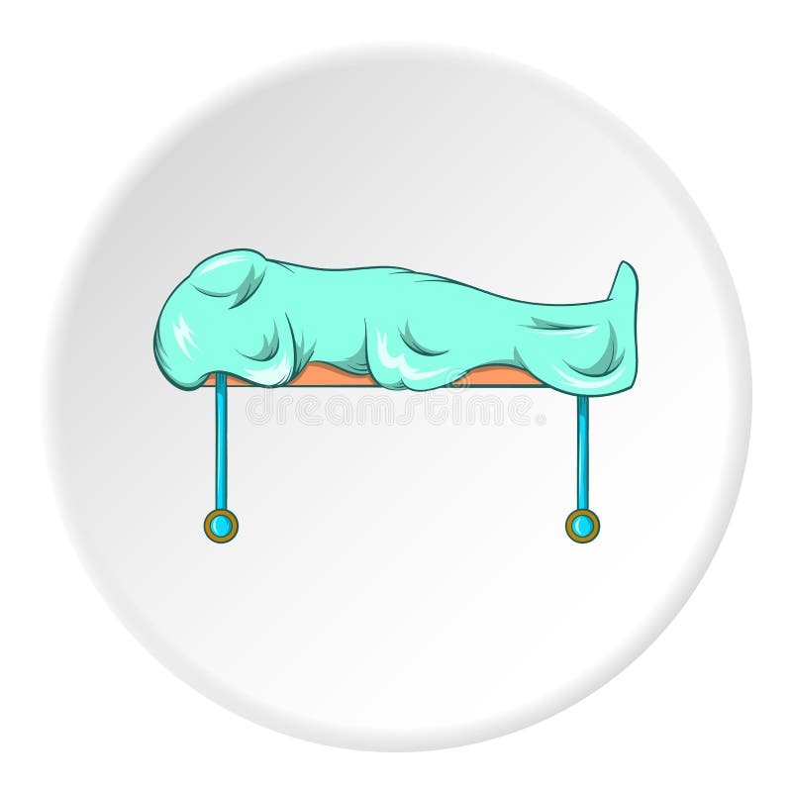
How has Erik's life been affected by his bad decisions?
waving Mum goodbye & ...thinking the next time she sees [me], [I] might be on a slab.
Do you think Erik regrets his choice to get involved in county lines? How do you know?
How do we know he is feeling scared?
Fisher presents Erik as full of fear. The word ‘slab’ suggests that he is worried he ….
Fisher shows readers the reality of becoming involved in gangs because…

