Slide 1
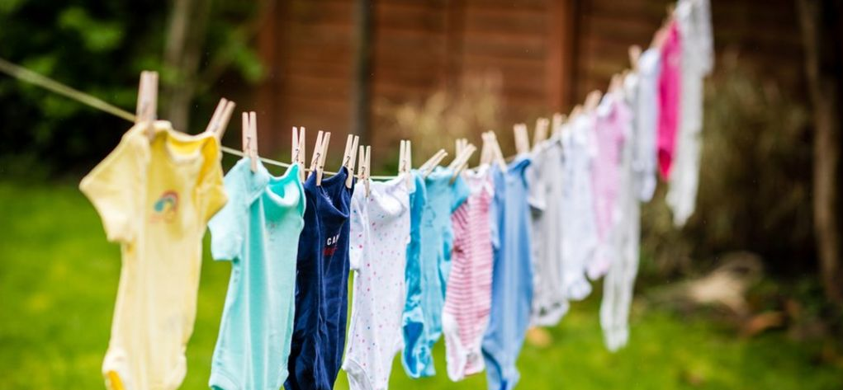
Do Now
How has Erik had to step up at home?
How has this impacted Erik? How does it impact his school life?
What are your first impression of Ravi? Is he a good influence for Erik?

Slide 2
DQ: Can I write a letter of encouragement to a young carer?
Know what a young carer is
Discuss the impact of being a young carer
Craft a letter of encouragement for Erik in his role as a young carer.

Slide 3

What is a Young Carer?
A young carer or young adult carer are young people who look after someone in their family or a friend who is ill, disabled, or has a mental health problem or an addiction.
They may help by:
Shopping, cooking, cleaning
Managing medicines or money
Providing personal care
Helping the person they care for to leave the house
Keeping an eye on someone
Providing emotional support
Helping with access to benefits or healthcare

Slide 4
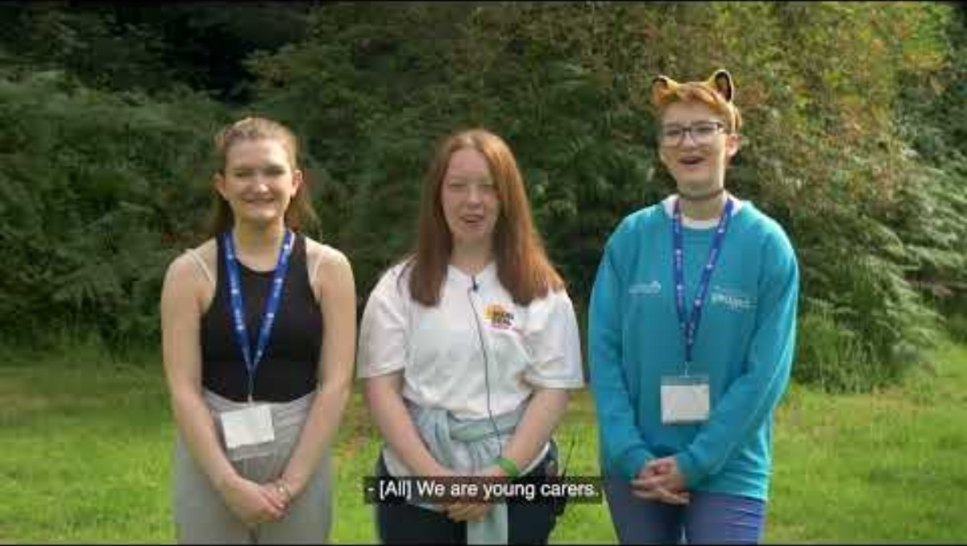
What is life like for young carers?

Slide 5

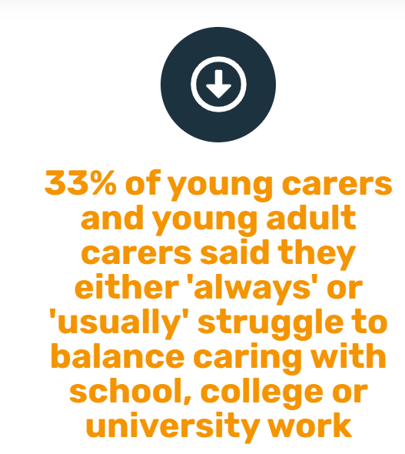
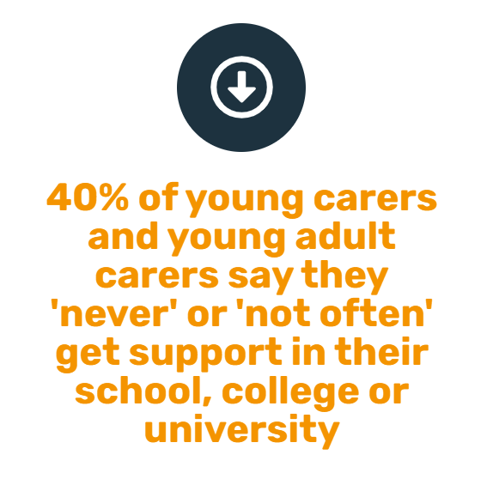
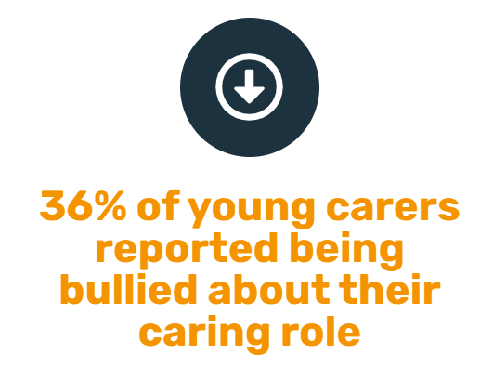
Do any of these statistics apply to Erik?

Slide 6
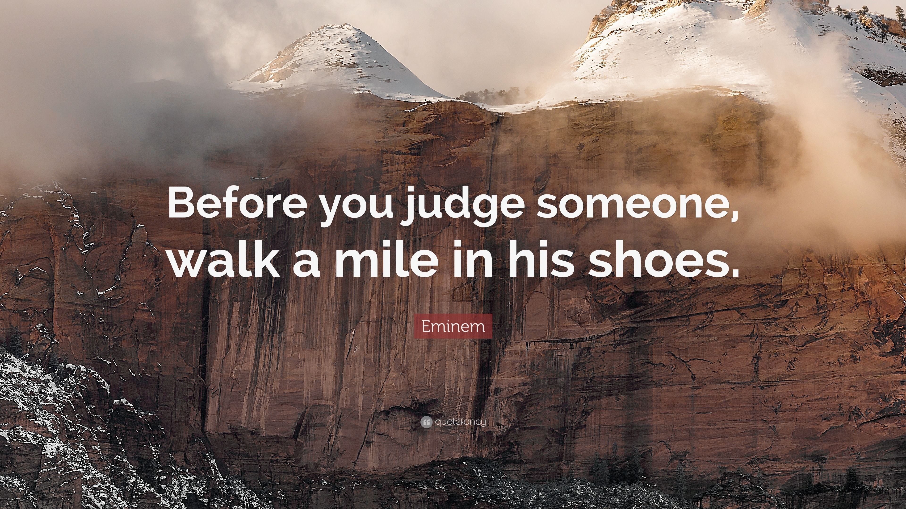

Let's step into Erik's shoes
Falling asleep at school, grades dropping
Being bullied
Have
Empathy!
Not getting enough sleep because sisters are awake at night.
Anything else?

Slide 7
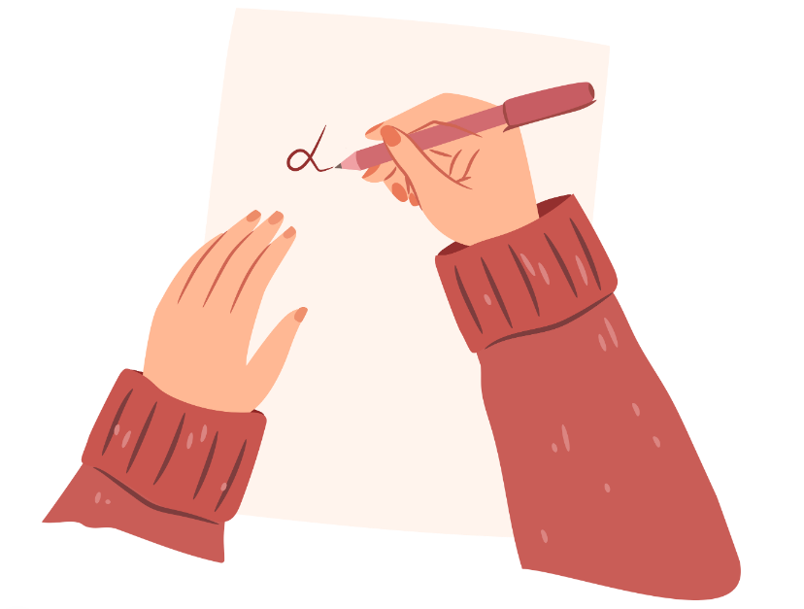
Independent Practice
Imagine you work for the Young Carers charity. Write a short letter of encouragement to Erik about his role as a young carer.
Your letter should be around three paragraphs in length.
In your letter, you should acknowledge the difficulties of his situation and offer encouragement.
Include: alliteration, simile, metaphor, rhetorical question, a colon and a pattern of 3.

Slide 8
Structure the letter
Paragraph 1 - try to establish why he doesn't want to share the news with school.
Paragraph 2 – empathise with his situation
Paragraph 3 – encourage him to share and get help

Slide 9
Model response paragraph 1
Dear Erik,
I know you don’t feel brave enough to share with your Welfare Officer what life is truly like for you at home at the moment. Maybe you are frightened of the consequences: would Social Services get involved and take your sisters away? I know you say they are a pain, but deep in your heart, it's clear you truly love them. Are you worried your mum will get into trouble? These are heavy thoughts for anyone, let alone someone your age—and I want you to know it’s completely okay to feel confused, protective, and even scared.

Slide 10
Model response paragraph 2
Looking after your twin sisters while trying to stay on top of your schoolwork must feel like a constant balancing act. I imagine you're tired, struggling to concentrate in lessons, maybe even falling behind on homework—not because you’re not capable, but because you’re carrying more than most people realise. That pressure can be overwhelming, and it’s no wonder if some days you feel like giving up. You shouldn’t have to go through this alone.

Slide 11
Model response paragraph 3
That’s why it’s so important to talk to someone at school. Sharing what you’re going through isn’t weakness—it’s strength. There’s nothing to be ashamed of in being a young carer. In fact, it shows maturity, resilience and a huge heart. If your teachers or Welfare Officer knew what was really going on, they could help—extra support with work, quiet space to focus, someone to talk to when it gets too much. You deserve that support, Erik. You deserve a childhood. You deserve happiness.
With love,
Young Carers Charity Worker

Slide 12
Exit Thoughts
We'd love to know if you are a young carer.
You can talk to your form tutor, the Head of Year or me.
There is loads of help available: https://www.birmingham.gov.uk/info/20065/information_for_carers/1288/young_carers
Notes:
Teachers may have a local link they would like to insert here?

