Slide 1
TEACHING RESOURCES - KS3
CROSSING THE LINE: Before Reading
TIA FISHER

Slide 2
OVERVIEW
These ideas of how to work with Crossing the Line in the classroom span a range of Key Stage 3 learning outcomes across the curriculum.
Most are for group work and involve PSHE discussions and English and Drama activities. They are suggested activities, not lesson plans. Teachers can choose any activity, based on what will work best for their students.
Please be aware that Crossing the Line and these resources deal with sensitive topics, which may be triggering for some students.
You could read the poems aloud to your class or ask students to share the reading and dramatise the dialogue. You could project key poems on to the board so they can be discussed in plenary.
For the concrete poems, try asking students to narrow their eyes before they look at the poem, so they are blurring the words and assessing the shape first and the words second.

Slide 3
MEET THE AUTHOR OF CROSSING THE LINE

Slide 4
SYNOPSIS PART ONE
Erik is twelve years old when his father dies from COVID-19. His mother’s earnings are barely enough to keep them, he’s bullied at school because of his ginger hair and as if things couldn’t get any worse, the loathsome Jonny takes up with his Mum; getting her pregnant then abandoning her when twins come on the scene. Erik feels he is the man of the house and bravely – if rashly – tries to work out how he can make things right.
The answer to his prayers seems to come in the shape of Travis and Ben, who appear to have an endless supply of money, some of which they lavish on him. The reader sees clearly that Erik is being groomed to enter their lucrative and dangerous world of drug dealing, a highly dubious ‘family’ which he is drawn to, naively feeling the meetings in the apartment which they have cuckooed are a substitute for the love and closeness which he no longer experiences at home.
The novel is written in verse, which immediately conveys Erik’s inner voice and the varying speed of events by means of shapes and patterns echoing what he is feeling and what others are doing. It also makes for a fast read, indicating the way in which things rapidly spiral out of his control. Erik crosses many lines in the course of the book – away from true friends, from his mother’s love, from school and his ambitions, particularly in running – but most crucially, across the county lines and into the most dangerous territory of his life.

Slide 5
SYNOPSIS PART TWO
Events accelerate and Erik again finds himself isolated, beaten and his life threatened. It’s not until his best friend Ravi steps in to help that he hopes at last there is a way forward, away from the underworld. Then he receives threatening notes from the county lines world, indicating that his sisters and mother are not safe. The family are forced to move at dead of night but it’s not long until he’s found and his beloved dog is poisoned almost to death. It’s then he knows he must seek help and the book ends on a hopeful and poignant note with his call to a support group created to help children in his situation.
The author researched the issue of county lines thoroughly and her book pulls no punches in both educating and warning, helping to raise the profile of this callous exploitation of children. At the end of the book there are five pages of information about where children and young adults can get help, a statement from the author about friends’ experiences of county lines and discussion questions to be used to discuss the urgent issues contained in the narrative.
Perhaps most powerfully of all, there is a reminder that this is a true story and one which we should, as a society, do all we can to prevent happening.

Slide 6
ACTIVITIES BEFORE READING
CROSSING THE LINE
TIA FISHER

Slide 7
ACTIVITY: FRONT COVER ANALYSIS
What does the phrase ‘crossing the line’ mean to you?
Can you think of some examples when someone ‘crossed a line’?
Can you predict anything about the book from the design the publisher has used? Think about shapes and colours.
Read the front blurb and look at the illustration of Erik. If you wrote a ‘thought bubble’ for him, what would he be thinking?

Slide 8
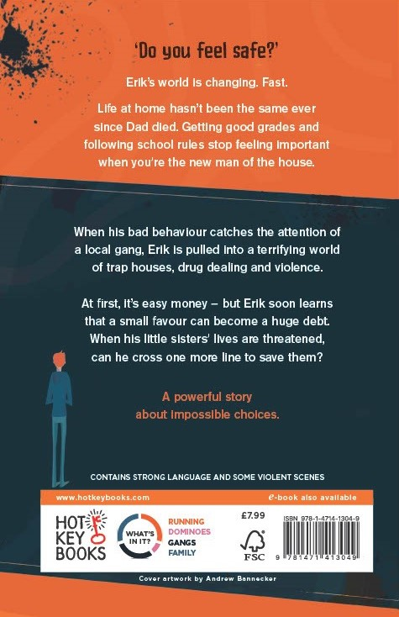
ACTIVITY: BACK COVER ANALYSIS
Read the back blurb. What catches your attention and makes you want to write read the book?
What genre would you say this book is?
Have you heard of young people caught up in Erik’s situation in real life?

