Slide 1

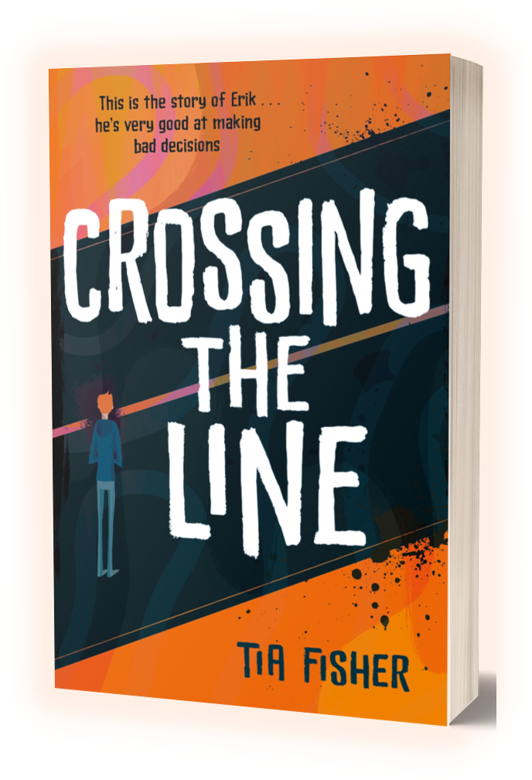

TEACHING RESOURCES - KS3
CROSSING THE LINE: After Reading
TIA FISHER

Slide 2
DISCUSSION QUESTIONS FOR AFTER READING
CROSSING THE LINE
TIA FISHER

Slide 3
DISCUSSION AFTER READING: PART ONE
The book starts with Erik asking, ‘Do you feel safe?’ How did this affect you? Who did you think Erik was telling his story to at the start, and did that change at the end?
Erik says, ‘Seems like bad decisions / stack like dominoes. / When one topples, they all go.’ Have you ever made one wrong decision that seemed to set off a whole load of others? How could you have stopped your dominoes from tumbling?
When Erik meets K1 and is on the edge of making the choice that will affect everything that follows, he explains it was ‘all those other dominoes leaning on my back’. How far do you agree that the weight of other pressures pushed him into agreeing?
‘It wasn’t a choice, not really.’ Do you agree that Erik had no choice about whether to ‘go country’? What would you have done if you were Erik? What risks was Erik taking by carrying the gun?

Slide 4
DISCUSSION AFTER READING: PART TWO
What’s your reaction to Erik’s mum? What choices did she make which affected everything that followed? Do you feel that she could have helped her son more, or did you sympathise with her? Or both?
What do you think of Ravi’s attempts to try to stop Erik? If you had a friend you thought was caught up with county lines, how could you try to help them?
What was your response to K1 and the members of the county lines gangs? Do you think they seem realistic? What factors do you think make Erik vulnerable to gang leaders like K1?
How realistic is the depiction of school? What makes it seem authentic or inauthentic to you? What do you think the school should have done to help Erik? Could it have prevented him becoming caught up in county lines?
Do you think the ending is realistic? What do you think happens to Erik and his family after the book finishes? Can you think of any alternative endings, and what would they add to the story?

Slide 5
DISCUSSION AFTER READING: PART THREE
The novel is written in verse. How does that change your expectations? Does it make it more accessible to you, or more challenging? Has this book altered your view of what is – and what is not – poetry?
What do you think of the way the words are set out on the page – the use of different fonts and concrete poetry? How does it affect the way you take in the information?
What different formats or media can you find in the book (for example text messages)? What do you think about mixing up different formats? What is the effect of the author not using conventional poem titles?
And finally . . . what did you learn from reading Crossing the Line ? Who will you recommend it to? Do you think this is an important book for young people to read?

